Slide 1
Building RAG Agents with LLMs
Introduction
Notes:
Welcome to our course on Building RAG Agents with LLMs!
REMIND STUDENTS TO START UP THEIR COURSE ENVIRONMENT!
LLMs: Large Language Models which take in, produce, or otherwise reason with text. We’ll learn to make more complex systems
Course Topics:
Creating chatbot applications capable of dialogue management and retrieval augmented generation.
Built from the ground up using foundation models which can be deployed on your own compute.
Leveraging current best practices from open-source frameworks like LangChain.

Slide 2
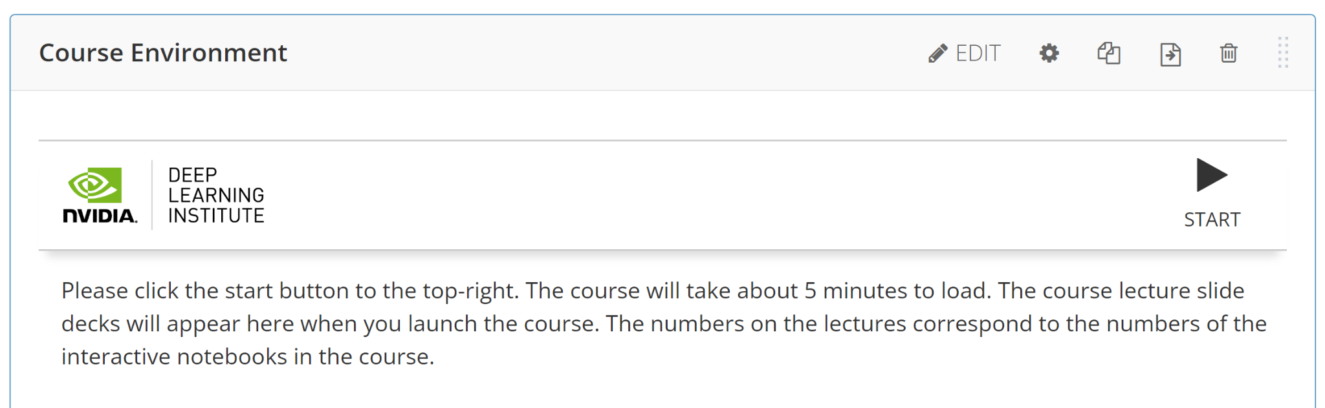
Building RAG Agents with LLMs
Introduction
Notes:
Welcome to our course on Building RAG Agents with LLMs!
REMIND STUDENTS TO START UP THEIR COURSE ENVIRONMENT!
LLMs: Large Language Models which take in, produce, or otherwise reason with text. We’ll learn to make more complex systems
Course Topics:
Creating chatbot applications capable of dialogue management and retrieval augmented generation.
Built from the ground up using foundation models which can be deployed on your own compute.
Leveraging current best practices from open-source frameworks like LangChain.

Slide 3

Large Language Models
Backbones for Language Understanding
Backbones for language tasks, including classification and generation.
https://www.nvidia.com/content/dam/en-zz/Solutions/lp/large-language-models-ebook/nvidia-llm-ebook-og.jpg
Notes:
Welcome to our course on Building RAG Agents with LLMs!
LLMs: Large Language Models which take in, produce, or otherwise reason with text. We’ll learn to make more complex systems

Slide 4
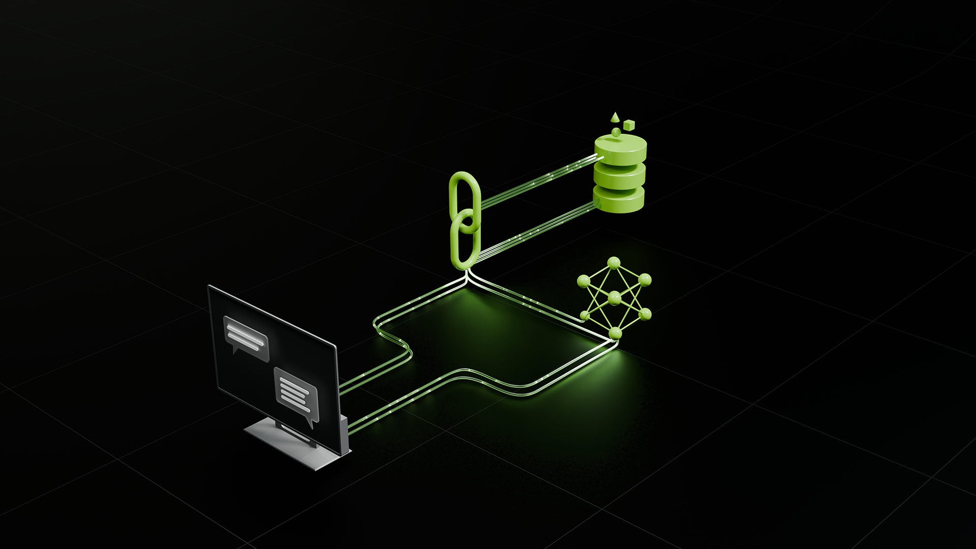
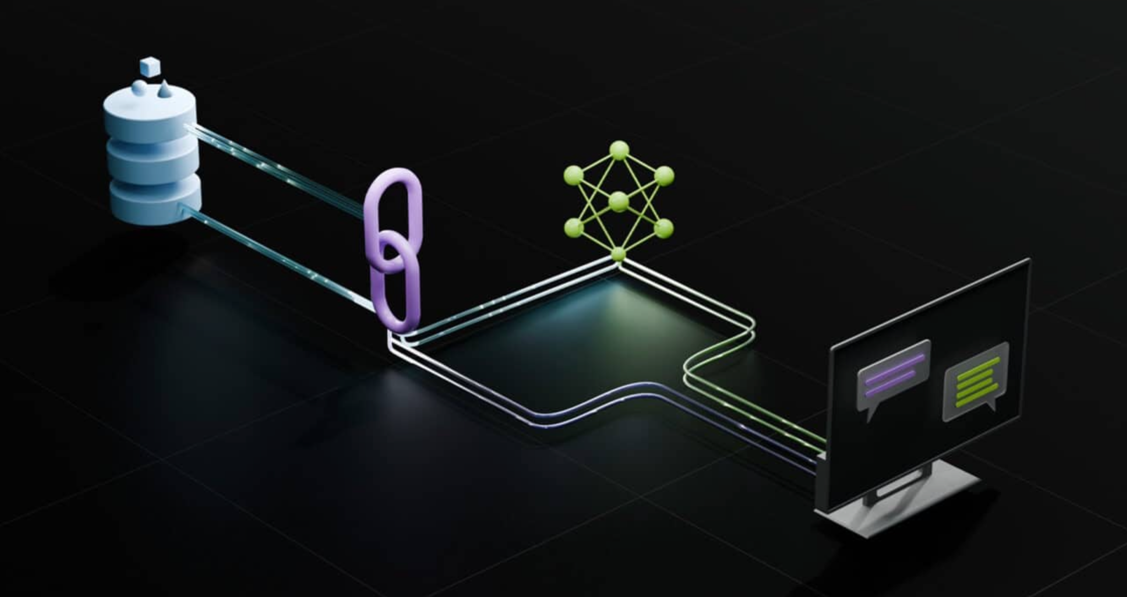
Dialog/Retrieval Agents
LLMs with Context and Control
User Asks Something
Agent Responds
https://www.nvidia.com/content/dam/en-zz/Solutions/lp/large-language-models-ebook/nvidia-llm-ebook-og.jpg
Notes:
Welcome to our course on Building RAG Agents with LLMs!
Course Topics:
Creating chatbot applications capable of dialogue management and retrieval augmented generation.
Superficial: User sends message, and agent responds. But we want to bring our own data.
To achieve this, we need LLM Orchestration, so combining software practices and LLMs together.
Using this, we can Retrieve and synthesize data from a database or environment…
…create a new input that contains the grounding information (AKA augmenting our LLM’s behavior)…
…and then generating our response, having supplied our LLM with all the necessary info to make the decision.

Slide 5
Dialog/Retrieval Agents
LLMs with Context and Control
LLM Orchestration: Software + LLM helps to route to software and LLMs.
User Asks Something
Agent Responds
https://www.nvidia.com/content/dam/en-zz/Solutions/lp/large-language-models-ebook/nvidia-llm-ebook-og.jpg
Notes:
Welcome to our course on Building RAG Agents with LLMs!
Course Topics:
Creating chatbot applications capable of dialogue management and retrieval augmented generation.
Superficial: User sends message, and agent responds. But we want to bring our own data.
To achieve this, we need LLM Orchestration, so combining software practices and LLMs together.
Using this, we can Retrieve and synthesize data from a database or environment…
…create a new input that contains the grounding information (AKA augmenting our LLM’s behavior)…
…and then generating our response, having supplied our LLM with all the necessary info to make the decision.

Slide 6
Dialog/Retrieval Agents
LLMs with Context and Control
Retrieval: Tool runs algorithms (database, code execution, semantic search, return a constant value, etc) to provide context
LLM Orchestration: Software + LLM helps to route to software and LLMs.
User Asks Something
Agent Responds
https://www.nvidia.com/content/dam/en-zz/Solutions/lp/large-language-models-ebook/nvidia-llm-ebook-og.jpg
Notes:
Welcome to our course on Building RAG Agents with LLMs!
Course Topics:
Creating chatbot applications capable of dialogue management and retrieval augmented generation.
Superficial: User sends message, and agent responds. But we want to bring our own data.
To achieve this, we need LLM Orchestration, so combining software practices and LLMs together.
Using this, we can Retrieve and synthesize data from a database or environment…
…create a new input that contains the grounding information (AKA augmenting our LLM’s behavior)…
…and then generating our response, having supplied our LLM with all the necessary info to make the decision.

Slide 7
Dialog/Retrieval Agents
LLMs with Context and Control
Retrieval: Tool runs algorithms (database, code execution, semantic search, return a constant value, etc) to provide context
LLM Orchestration: Software + LLM helps to route to software and LLMs.
Augmented: Based on tool responses, the software pipeline synthesizes some “context”
to feed to LLM w/ question.
User Asks Something
Agent Responds
https://www.nvidia.com/content/dam/en-zz/Solutions/lp/large-language-models-ebook/nvidia-llm-ebook-og.jpg
Notes:
Welcome to our course on Building RAG Agents with LLMs!
Course Topics:
Creating chatbot applications capable of dialogue management and retrieval augmented generation.
Superficial: User sends message, and agent responds. But we want to bring our own data.
To achieve this, we need LLM Orchestration, so combining software practices and LLMs together.
Using this, we can Retrieve and synthesize data from a database or environment…
…create a new input that contains the grounding information (AKA augmenting our LLM’s behavior)…
…and then generating our response, having supplied our LLM with all the necessary info to make the decision.

Slide 8
Dialog/Retrieval Agents
LLMs with Context and Control
Retrieval: Tool runs algorithms (database, code execution, semantic search, return a constant value, etc) to provide context
LLM Orchestration: Software + LLM helps to route to software and LLMs.
Augmented: Based on tool responses, the software pipeline synthesizes some “context”
to feed to LLM w/ question.
User Asks Something
Generation: Based on question, instructions, and enhanced context, the LLM returns a response.
Agent Responds
https://www.nvidia.com/content/dam/en-zz/Solutions/lp/large-language-models-ebook/nvidia-llm-ebook-og.jpg
Notes:
Welcome to our course on Building RAG Agents with LLMs!
Course Topics:
Creating chatbot applications capable of dialogue management and retrieval augmented generation.
Superficial: User sends message, and agent responds. But we want to bring our own data.
To achieve this, we need LLM Orchestration, so combining software practices and LLMs together.
Using this, we can Retrieve and synthesize data from a database or environment…
…create a new input that contains the grounding information (AKA augmenting our LLM’s behavior)…
…and then generating our response, having supplied our LLM with all the necessary info to make the decision.
We’ll learn to build these pipelines from the ground up using foundation models which can be deployed on your own compute and at scale.

Slide 9

Chat Applications
Full Applications Build with LLMs
https://www.nvidia.com/content/dam/en-zz/Solutions/lp/large-language-models-ebook/nvidia-llm-ebook-og.jpg
Notes:
Welcome to our course on Building RAG Agents with LLMs!
Course Topics:
Creating chatbot applications capable of dialogue management and retrieval augmented generation.
We’ll learn to build these pipelines from the ground up using foundation models which can be deployed on your own compute and at scale.
Leveraging current best practices from open-source frameworks like LangChain, as well as enterprise-grade microservice options like NVIDIA NIMs.

Slide 10
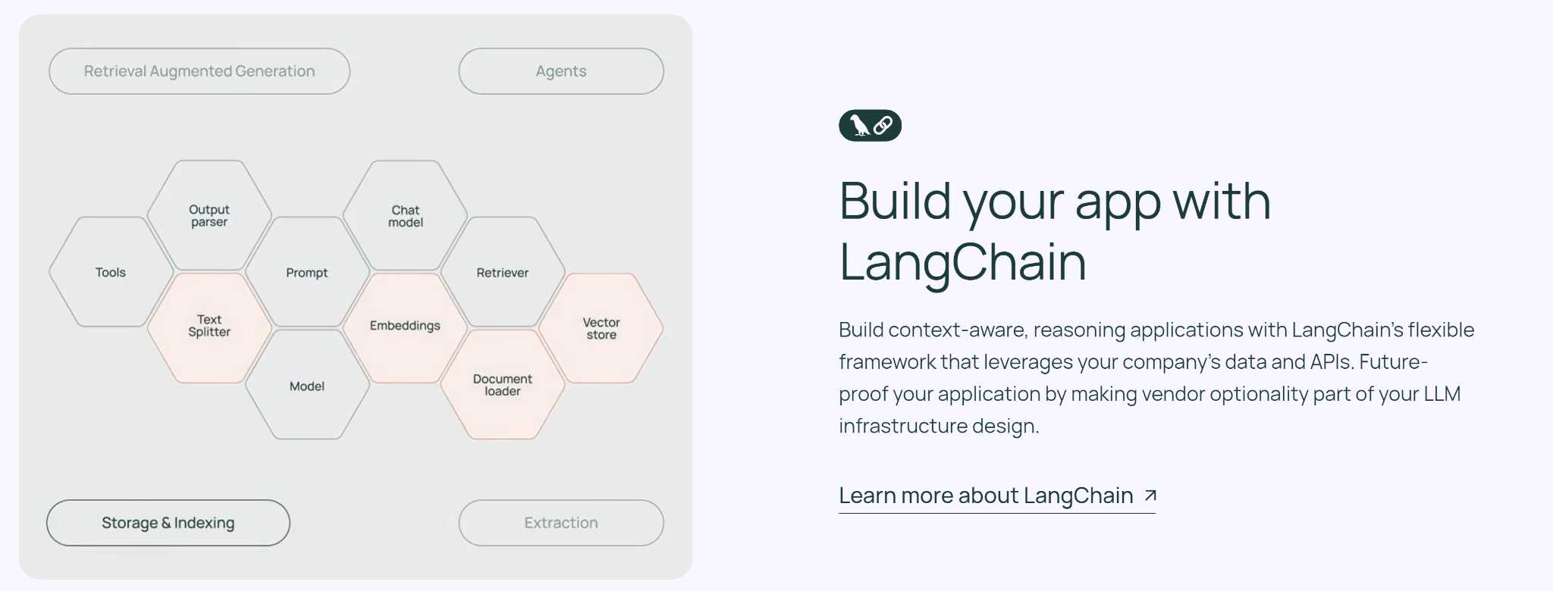
Chat Applications
Full Applications Build with LLMs
Production-Ready APIs That Run Anywhere | NVIDIA
Notes:
Welcome to our course on Building RAG Agents with LLMs!
Course Topics:
Creating chatbot applications capable of dialogue management and retrieval augmented generation.
We’ll learn to build these pipelines from the ground up using foundation models which can be deployed on your own compute and at scale.
Leveraging current best practices from open-source frameworks like LangChain, as well as enterprise-grade microservice options like NVIDIA NIMs.

Slide 11
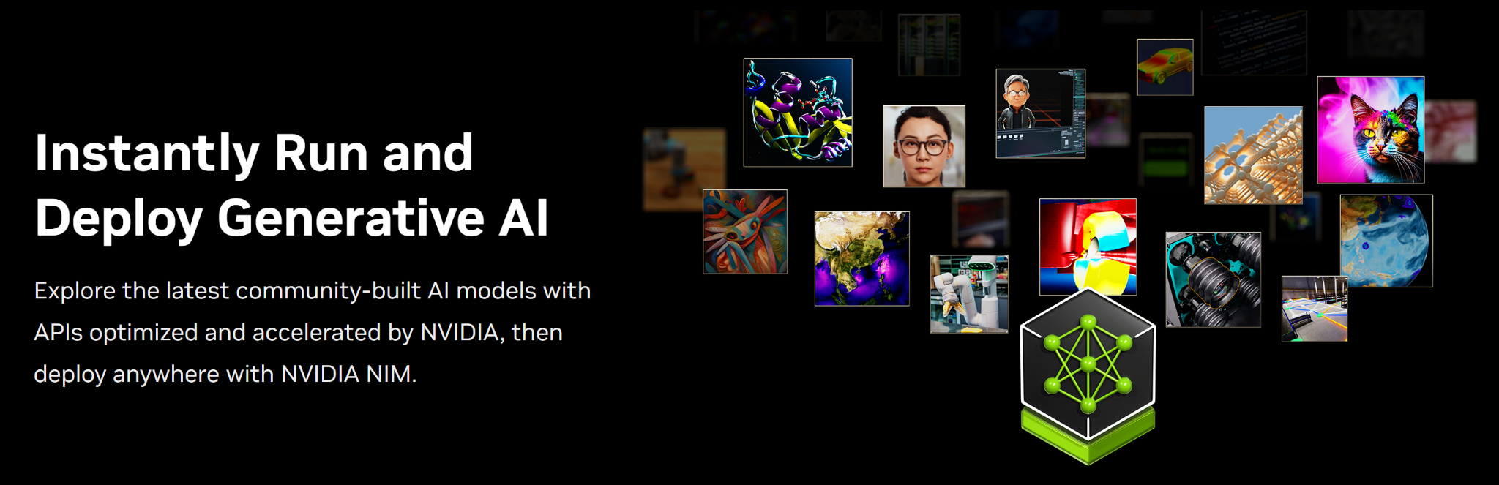
Chat Applications
Full Applications Build with LLMs
Production-Ready APIs That Run Anywhere | NVIDIA
Notes:
Welcome to our course on Building RAG Agents with LLMs!
Course Topics:
Creating chatbot applications capable of dialogue management and retrieval augmented generation.
We’ll learn to build these pipelines from the ground up using foundation models which can be deployed on your own compute and at scale.
Leveraging current best practices from open-source frameworks like LangChain, as well as enterprise-grade microservice options like NVIDIA NIMs.
(Up Next: Prerequisites)
(After That: Course Objectives/Outline)
(Up Next: Section 1 Title)

Slide 12
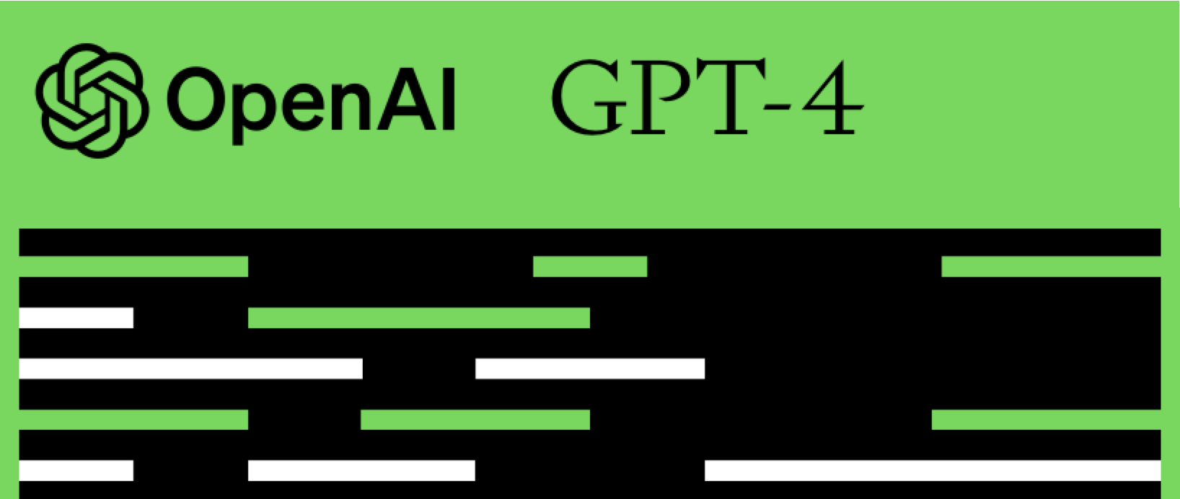
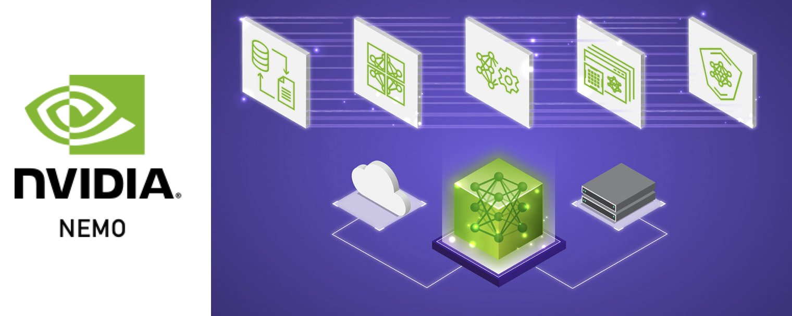


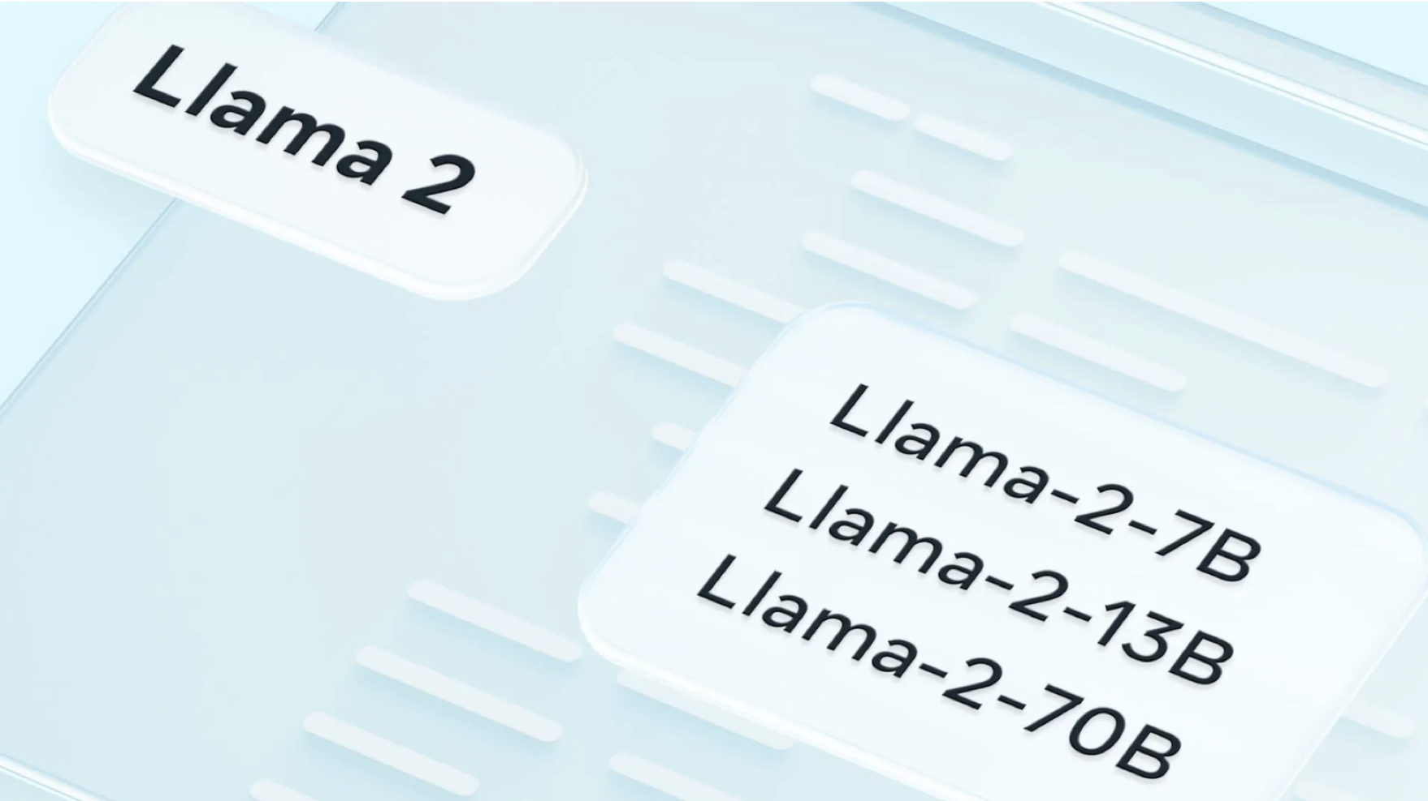
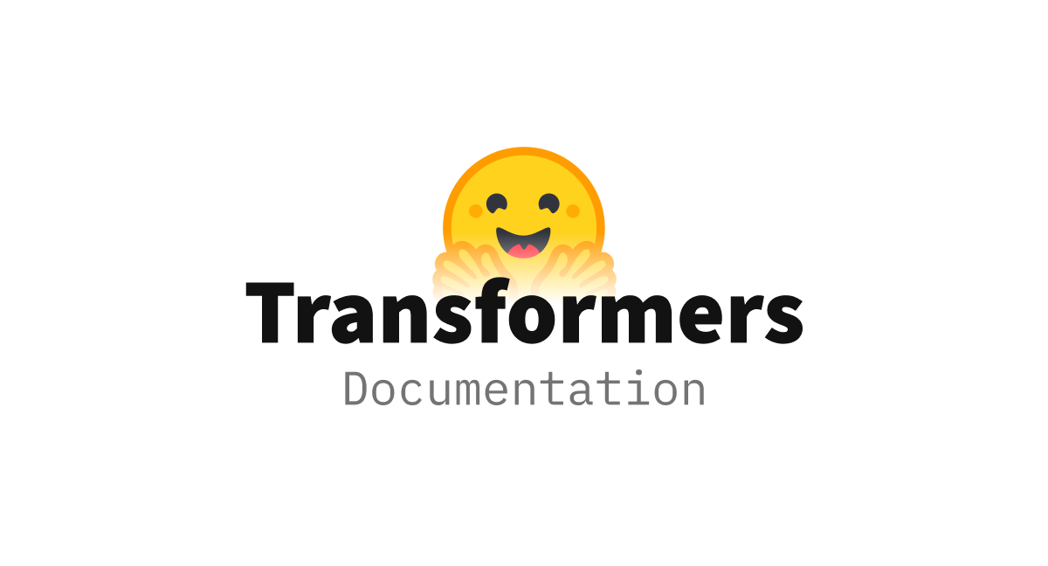
Prerequisites
RAG Agents in Production
Prior LLM/LangChain Exposure
Intermediate Python Experience
Exposure to Web Engineering
Notes:
(Current: Prerequisites)
(Up Next: Course Objectives/Outline)
(After That: Section 1 Title)

Slide 13
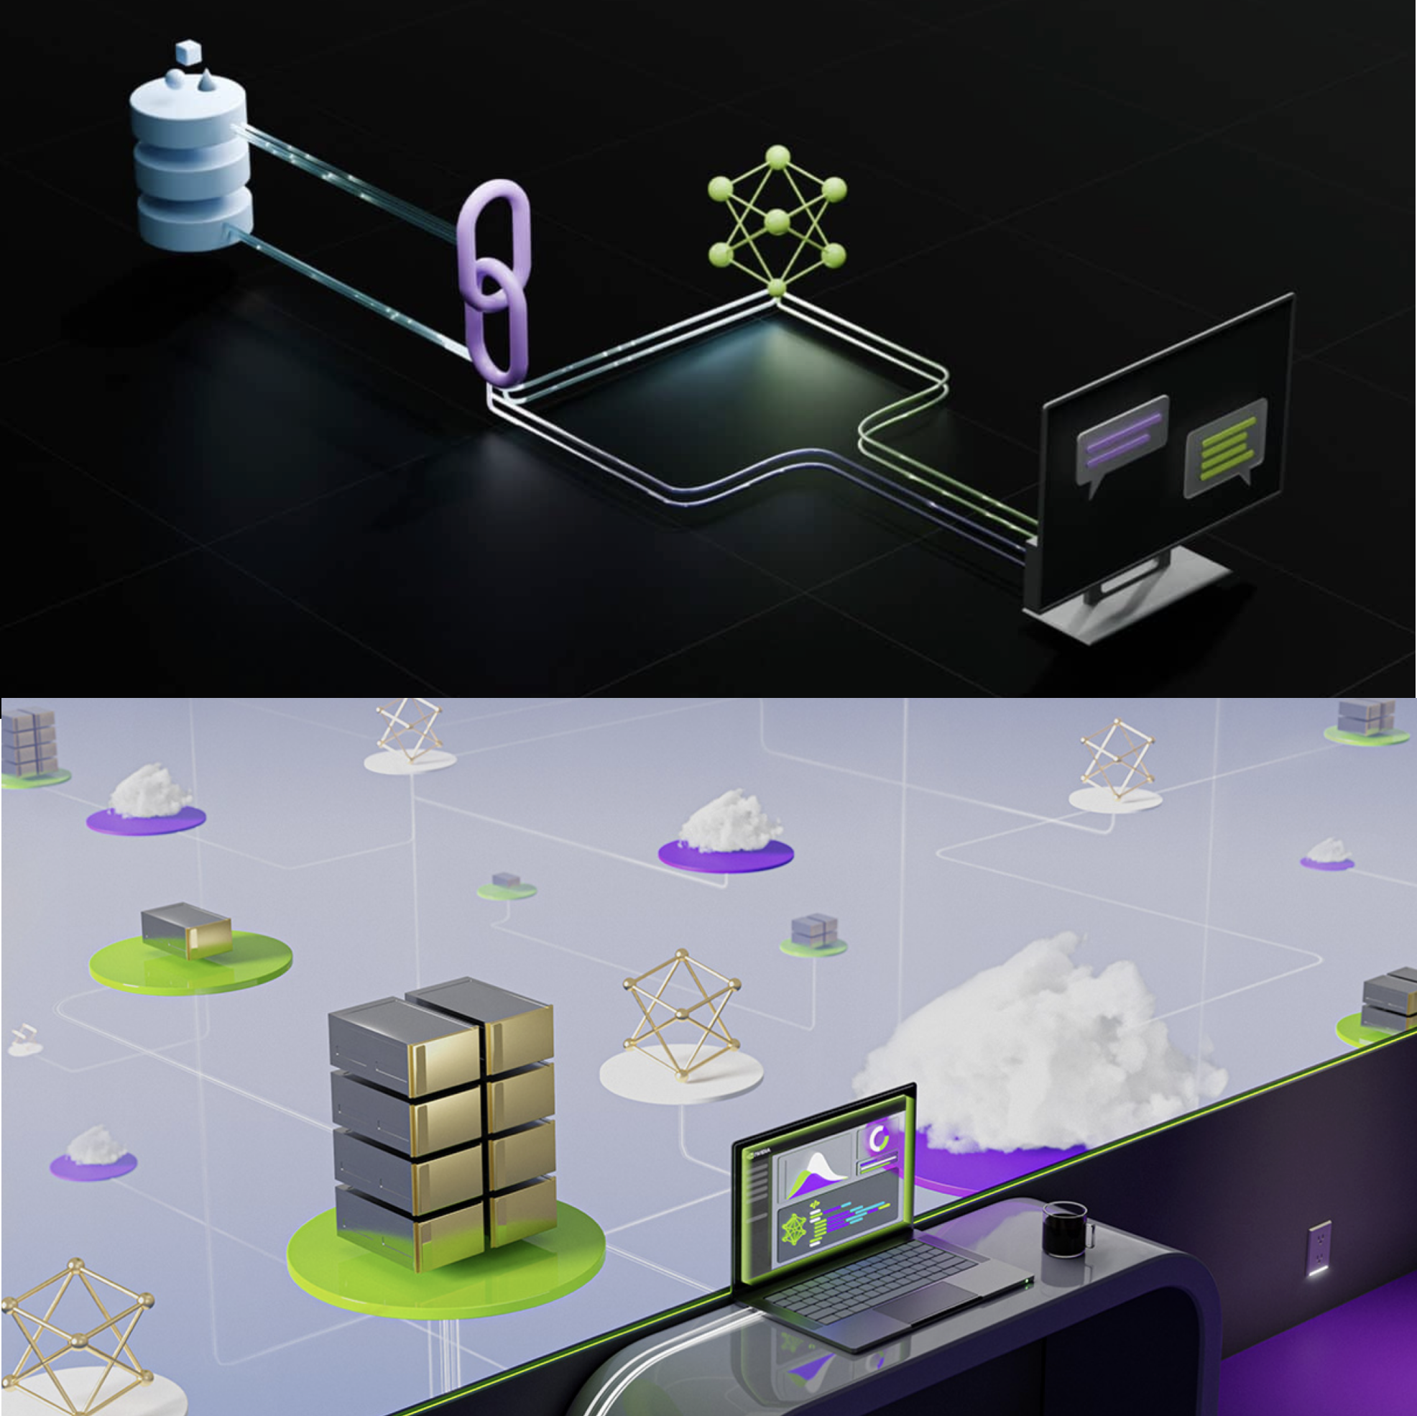
Course Objectives
RAG Agents in Production
Environment
LLM Services
Intro to LangChain (LCEL)
Running State Chains
Document Loading
Embeddings
Document Retrieval
RAG Evaluation
Notes:
(Previous: Prerequisites)
(Current: Course Objectives/Outline)
(Up Next: Section 1: Your Course Environment)

Slide 14
Course Objectives
RAG Agents in Production
(Starts at 9)
Environment
LLM Services
Intro to LangChain (LCEL)
Running State Chains
(Lunch)
Document Loading
Embeddings
Document Retrieval
RAG Evaluation
(Ends at 5, take-home/ask instructor)
Notes:
(Previous: Prerequisites)
(Current: Course Objectives/Outline)
(Up Next: Section 1: Your Course Environment)

Slide 15
Building RAG Agents with LLMs
Part 1: Your Course Environment

Slide 16
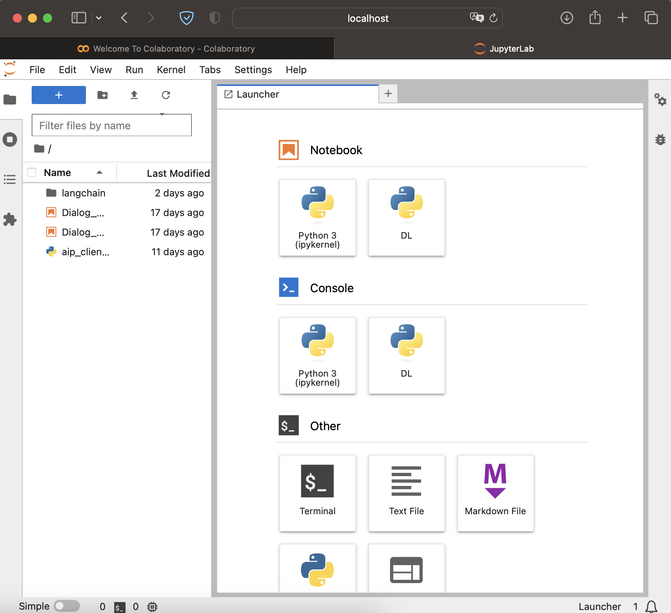
Typical Jupyter Labs Interface
jupyter lab . &; open -a Safari http://localhost:8888/lab
Notes:
"Once you've launched the course environment, you'll be greeted with the JupyterLab interface.
Can be deployed locally from a system and using your resources. Rely on your hardware and access via your browser.
Can also be launched through a service like Google Colab! Allocates resources for you, and doesn’t rely on your compute!

Slide 17
Typical Jupyter Labs Interface
Your Device
Your Device
Web Browser
Files
Python
OS
C++
Hardware
jupyter lab . &; open -a Safari http://localhost:8888/lab
Notes:
"Once you've launched the course environment, you'll be greeted with the JupyterLab interface.
Can be deployed locally from your system and using your resources. Rely on your hardware and access via your browser.
(Next slide adds in Jupyter Labs server, which probably stays within your local host scope.)
Can also be launched through a service like Google Colab! Allocates resources for you, and doesn’t rely on your compute!

Slide 18
Typical Jupyter Labs Interface
Your Device
Your Device
Web Browser
:8888
Files
Python
OS
Jupyter Labs
C++
Hardware
jupyter lab . &; open -a Safari http://localhost:8888/lab
Notes:
"Once you've launched the course environment, you'll be greeted with the JupyterLab interface.
Can be deployed locally from your system and using your resources. Rely on your hardware and access via your browser.
Can also be launched through a service like Google Colab! Allocates resources for you, and doesn’t rely on your compute!

Slide 19
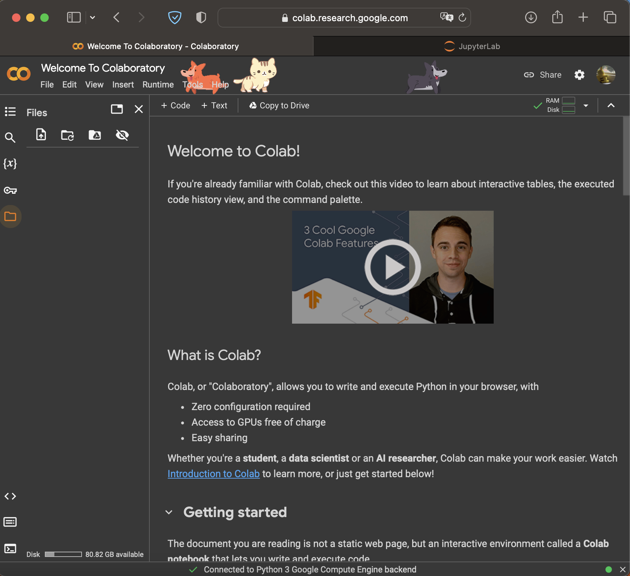
Typical Jupyter Labs Interface
Your Device
Your Device
Web Browser
:8888
Files
Python
OS
Jupyter Labs
C++
Hardware
jupyter lab . &; open -a Safari http://localhost:8888/lab
https://colab.research.google.com
Notes:
"Once you've launched the course environment, you'll be greeted with the JupyterLab interface.
Can be deployed locally from your system and using your resources. Rely on your hardware and access via your browser.
Can also be launched through a service like Google Colab! Allocates resources for you, and doesn’t rely on your compute!
(Use your computer to coordinate with some allocation system)
(Get yourself access to a GPU-enabled resource from the cloud)

Slide 20

Typical Jupyter Labs Interface
Your Device
Your Device
Web Browser
Your Device
:8888
Web Browser
Files
Python
OS
Jupyter Labs
C++
Hardware
Files
Python
OS
C++
Hardware
jupyter lab . &; open -a Safari http://localhost:8888/lab
https://colab.research.google.com
Notes:
"Once you've launched the course environment, you'll be greeted with the JupyterLab interface.
Can be deployed locally from your system and using your resources. Rely on your hardware and access via your browser.
Can also be launched through a service like Google Colab! Allocates resources for you, and doesn’t rely on your compute!
(Use your computer to coordinate with some allocation system)
(Get yourself access to a GPU-enabled resource from the cloud)

Slide 21
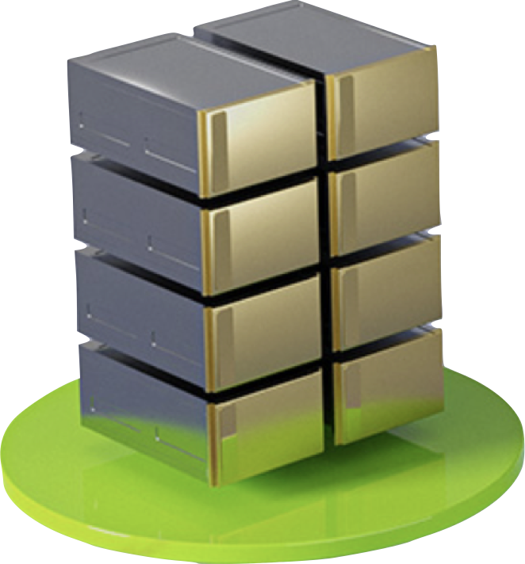
Typical Jupyter Labs Interface
Your Device
Your Device
Web Browser
Your Device
:8888
Web Browser
Files
Python
OS
Jupyter Labs
C++
Hardware
Files
Python
OS
C++
Hardware
jupyter lab . &; open -a Safari http://localhost:8888/lab
https://colab.research.google.com
Notes:
"Once you've launched the course environment, you'll be greeted with the JupyterLab interface.
Can be deployed locally from your system and using your resources. Rely on your hardware and access via your browser.
Can also be launched through a service like Google Colab! Allocates resources for you, and doesn’t rely on your compute!
(Use your computer to coordinate with some allocation system)
(Get yourself access to a GPU-enabled resource from the cloud)

Slide 22
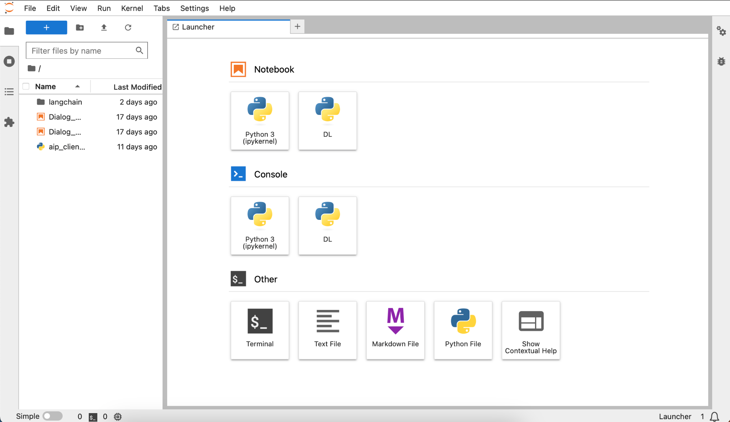
DLI Jupyter Labs Interface
Notes:
How is this interface actually provided for you?
Compute allocated for you by cloud provider like AWS or Azure. Has some hardware, os, software, etc.
Good to go!!! Except there are other things happening in the background…
Maybe data loader? Maybe proxy server? Metadata tracker? Database connection? Need different software…
Maybe some of the other resources have different requirements? Volume space? Hardware allocation?...
TO HELP SOLVE THIS, WE CAN CONTAINERIZE INTO MICROSERVICES!

Slide 23


DLI Jupyter Labs Interface
Your Device
Remote Host
Files
Jupyter Labs
Python
OS
C++
Hardware
Your Device
Your Device
Web Browser
Notes:
How is this interface actually provided for you?
Compute allocated for you by cloud provider like AWS or Azure. Has some hardware, os, software, etc.
Good to go!!! Except there are other things happening in the background…
Maybe data loader? Maybe proxy server? Metadata tracker? Database connection? Need different software…
Maybe some of the other resources have different requirements? Volume space? Hardware allocation?...
TO HELP SOLVE THIS, WE CAN CONTAINERIZE INTO MICROSERVICES!

Slide 24
DLI Jupyter Labs Interface
Your Device
Remote Host
Good to go!
… sort of …
Files
Jupyter Labs
Python
OS
C++
Hardware
Your Device
Your Device
Web Browser
Notes:
How is this interface actually provided for you?
Compute allocated for you by cloud provider like AWS or Azure. Has some hardware, os, software, etc.
Good to go!!! Except there are other things happening in the background…
Maybe data loader? Maybe proxy server? Metadata tracker? Database connection? Need different software…
Maybe some of the other resources have different requirements? Volume space? Hardware allocation?...
TO HELP SOLVE THIS, WE CAN CONTAINERIZE INTO MICROSERVICES!

Slide 25
DLI Jupyter Labs Interface
Your Device
Remote Host
More Processes?
Python
Data Loader
Scheduler
Proxy Service
Node
Env
Shell
Python
Files
Jupyter Labs
OS
C++
Hardware
Your Device
Your Device
Web Browser
Notes:
How is this interface actually provided for you?
Compute allocated for you by cloud provider like AWS or Azure. Has some hardware, os, software, etc.
Good to go!!! Except there are other things happening in the background…
Maybe data loader? Maybe proxy server? Metadata tracker? Database connection? Need different software…
Maybe some of the other resources have different requirements? Volume space? Hardware allocation?...
TO HELP SOLVE THIS, WE CAN CONTAINERIZE INTO MICROSERVICES!

Slide 26
DLI Jupyter Labs Interface
Your Device
Remote Host
More Processes?
Python
Data Loader
Scheduler
Proxy Service
Node
Env
Shell
Python
Files
Jupyter Labs
OS
C++
Hardware
Your Device
Your Device
Dividing Resources?
Web Browser
Notes:
How is this interface actually provided for you?
Compute allocated for you by cloud provider like AWS or Azure. Has some hardware, os, software, etc.
Good to go!!! Except there are other things happening in the background…
Maybe data loader? Maybe proxy server? Metadata tracker? Database connection? Need different software…
Maybe some of the other resources have different requirements? Volume space? Hardware allocation?...
TO HELP SOLVE THIS, WE CAN CONTAINERIZE INTO MICROSERVICES!

Slide 27

Containerization with Docker
Compartmentalizing Functionality Into Microservices
Your Device
Host
Python
Data Loader
Scheduler
Proxy Service
Node
Env
Shell
Your Device
Python
Files
Host
Jupyter Labs
OS
C++
Hardware
Python
Sh
Volume
:8070
:8888
Volume
Files
:88
Python
OS
Jupyter
GPU/2
C++
Hardware
Notes:
How is this interface actually provided for you?
Compute allocated for you by cloud provider like AWS or Azure. Has some hardware, os, software, etc.
Good to go!!! Except there are other things happening in the background…
Maybe data loader? Maybe proxy server? Metadata tracker? Database connection? Need different software…
Maybe some of the other resources have different requirements? Volume space? Hardware allocation?...
TO HELP SOLVE THIS, WE CAN CONTAINERIZE INTO MICROSERVICES!
Avoid dependency conflict, allocate resources as necessary, provide connections through server ports!

Slide 28
Microservices Workflow
Your Device
Your Device
Web Browser
Notes:
What does microservice orchestration look like in practice?
Let’s start with your device, which is telling a service (like DLI?) that you need compute.
DLI will ask AWS/Azure to ALLOCATE RESOURCES for the environment.
Then, DLI will DEFINE the microservices. What they are, how they’re made, what ports they can use. (i.e. docker-compose)
These microservices can then be CONSTRUCTED from a base image. Install packages, move files, download stuff, etc. (i.e. Dockerfile)
Then, perpetual services can be kickstarted in these containers, like servers or endpoints. We now have live microservices!

Slide 29
Microservices Workflow
Your Device
Remote Host
Allocate Resources
Define Services
Construct Containers
Start Processes
Files
Python
OS
C++
Hardware
Your Device
Your Device
Web Browser
Notes:
What does microservice orchestration look like in practice?
Let’s start with your device, which is telling a service (like DLI?) that you need compute.
DLI will ask AWS/Azure to ALLOCATE RESOURCES for the environment.
Then, DLI will DEFINE the microservices. What they are, how they’re made, what ports they can use. (i.e. docker-compose)
These microservices can then be CONSTRUCTED from a base image. Install packages, move files, download stuff, etc. (i.e. Dockerfile)
Then, perpetual services can be kickstarted in these containers, like servers or endpoints. We now have live microservices!

Slide 30
Microservices Workflow
Your Device
Remote Host
Allocate Resources
Define Services
Construct Containers
Start Processes
Python
Sh
Volume
:8070
:8888
Volume
Files
:88
Python
OS
Jupyter
GPU/2
C++
Hardware
Your Device
Your Device
Web Browser
Notes:
What does microservice orchestration look like in practice?
Let’s start with your device, which is telling a service (like DLI?) that you need compute.
DLI will ask AWS/Azure to ALLOCATE RESOURCES for the environment.
Then, DLI will DEFINE the microservices. What they are, how they’re made, what ports they can use. (i.e. docker-compose)
These microservices can then be CONSTRUCTED from a base image. Install packages, move files, download stuff, etc. (i.e. Dockerfile)
Then, perpetual services can be kickstarted in these containers, like servers or endpoints. We now have live microservices!

Slide 31
Microservices Workflow
Your Device
Remote Host
Allocate Resources
Define Services
Construct Containers
Start Processes
Database Environment
Data Loader
:8070
:8888
Jupyter Notebook Environment
Files
:88
Python
OS
C++
Hardware
Your Device
Your Device
Web Browser
Notes:
What does microservice orchestration look like in practice?
Let’s start with your device, which is telling a service (like DLI?) that you need compute.
DLI will ask AWS/Azure to ALLOCATE RESOURCES for the environment.
Then, DLI will DEFINE the microservices. What they are, how they’re made, what ports they can use. (i.e. docker-compose)
These microservices can then be CONSTRUCTED from a base image. Install packages, move files, download stuff, etc. (i.e. Dockerfile)
Then, perpetual services can be kickstarted in these containers, like servers or endpoints. We now have live microservices!

Slide 32
Microservices Workflow
Your Device
Remote Host
Allocate Resources
Define Services
Construct Containers
Start Processes
Database Environment
Data Loader
:8070
:8888
Jupyter Notebook Environment
Files
:88
Python
OS
C++
Hardware
Your Device
Your Device
Web Browser
Notes:
What does microservice orchestration look like in practice?
Let’s start with your device, which is telling a service (like DLI?) that you need compute.
DLI will ask AWS/Azure to ALLOCATE RESOURCES for the environment.
Then, DLI will DEFINE the microservices. What they are, how they’re made, what ports they can use. (i.e. docker-compose)
These microservices can then be CONSTRUCTED from a base image. Install packages, move files, download stuff, etc. (i.e. Dockerfile)
Then, perpetual services can be kickstarted in these containers, like servers or endpoints. We now have live microservices!
Why bother setting things up this way though?
…

Slide 33

Scaling Containerized Applications
Company
Database
Your Device
GenAI
Service
Arbitrary Host
Database Environment
Data Loader
:8070
:8888
Jupyter Notebook Environment
Files
Python
OS
C++
Hardware
Your Device
Your Device
Web Browser
Your Device
Your Device
Other Devices
Your Device
Other Devices
Your Device
Web Browser
Other Devices
Web Browser
Other Devices
Web Browser
Web Browser
Notes:
What does microservice orchestration look like in practice?
…
Why bother setting things up this way though?
Turns out, creating services that communicate over ports makes it simple to move stuff around! (next slide shows connections)
You can move services off your device and into the cloud, or can move processes towards edge devices without too much trouble!

Slide 34
Scaling Containerized Applications
Company
Database
Your Device
GenAI
Service
Arbitrary Host
Database Environment
Data Loader
:8070
:8888
Jupyter Notebook Environment
Files
Python
OS
C++
Hardware
Your Device
Your Device
Your Device
Your Device
Your Device
Web Browser
Your Device
Your Device
Other Devices
Your Device
Other Devices
Your Device
Web Browser
Other Devices
Web Browser
Other Devices
Web Browser
Web Browser
Notes:
What does microservice orchestration look like in practice?
…
Why bother setting things up this way though?
Turns out, creating services that communicate over ports makes it simple to move stuff around! (next slide shows connections)
You can move services off your device and into the cloud, or move processes towards edge devices without too much trouble!
So, let’s get back to our own environment! So far, we know we have our Jupyter Labs interface, but what else?

Slide 35
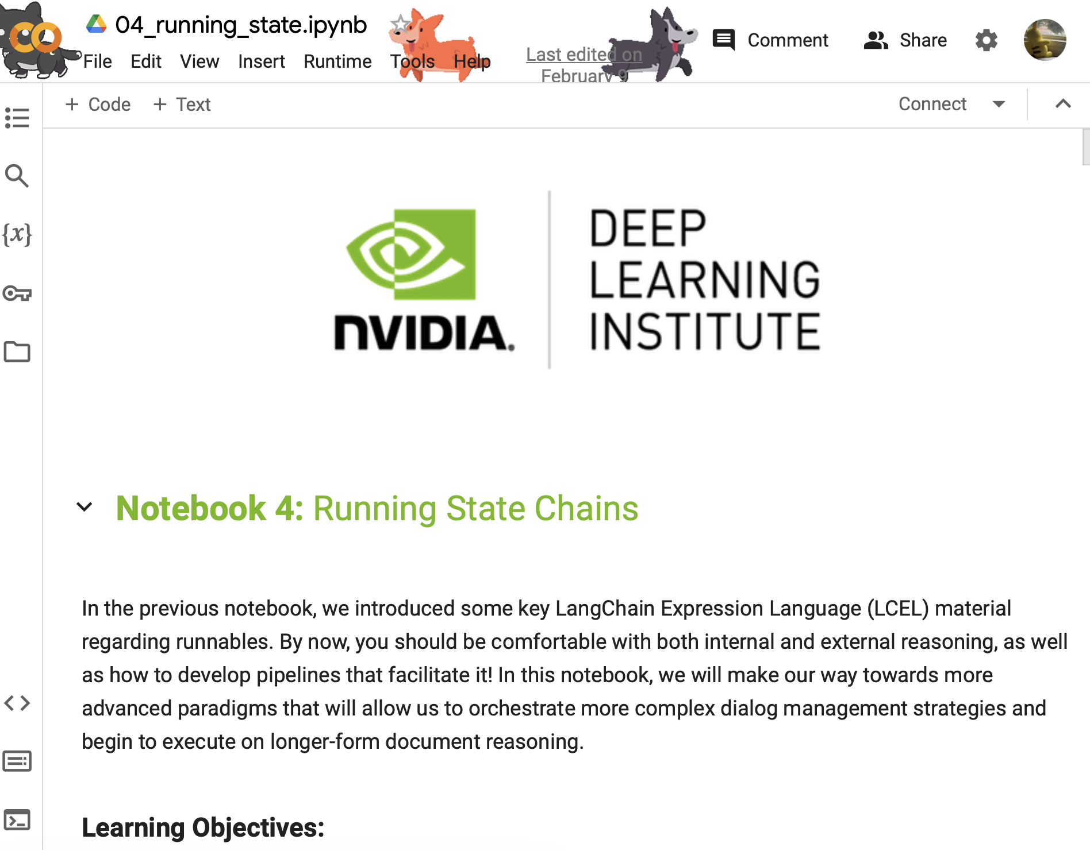
Our Environment
Jupyter Notebooks
Your Device
Remote Host
Docker
Router
Jupyter Notebook Server
:88
Notes:
What does microservice orchestration look like in practice?
So, let’s get back to our own environment! So far, we know we have our Jupyter Labs interface, but what else?
In the lab, you’ll find out about the frontend microservice, which is already hosted on port 8090.

Slide 36
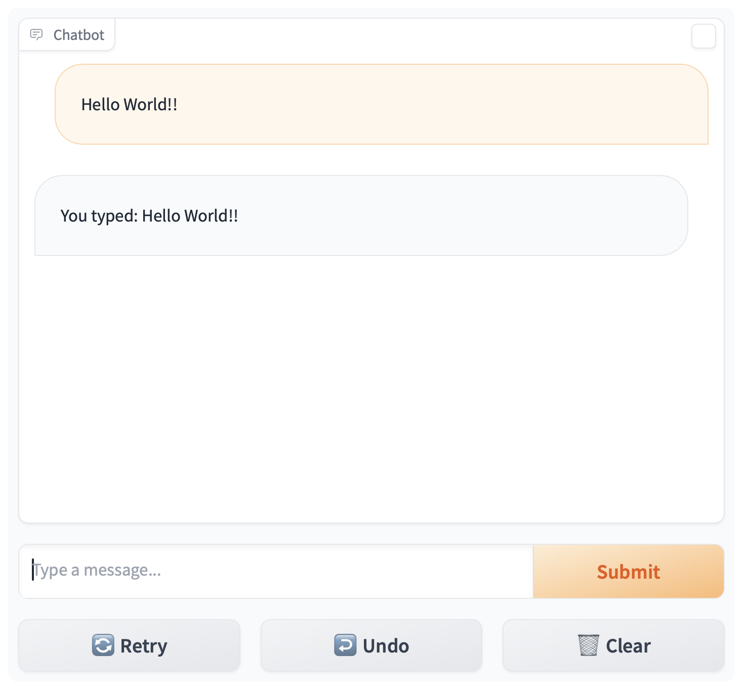
Our Environment
Jupyter Notebooks + Frontend
Your Device
Remote Host
:8090
Frontend
Docker
Router
Jupyter Notebook Server
:88
Notes:
What does microservice orchestration look like in practice?
So, let’s get back to our own environment! So far, we know we have our Jupyter Labs interface, but what else?
In the lab, you’ll find out about the frontend microservice, which is already hosted on port 8090.
This frontend is hosted in Gradio, an open-source web interface design library well-suited for presenting AI models.

Slide 37
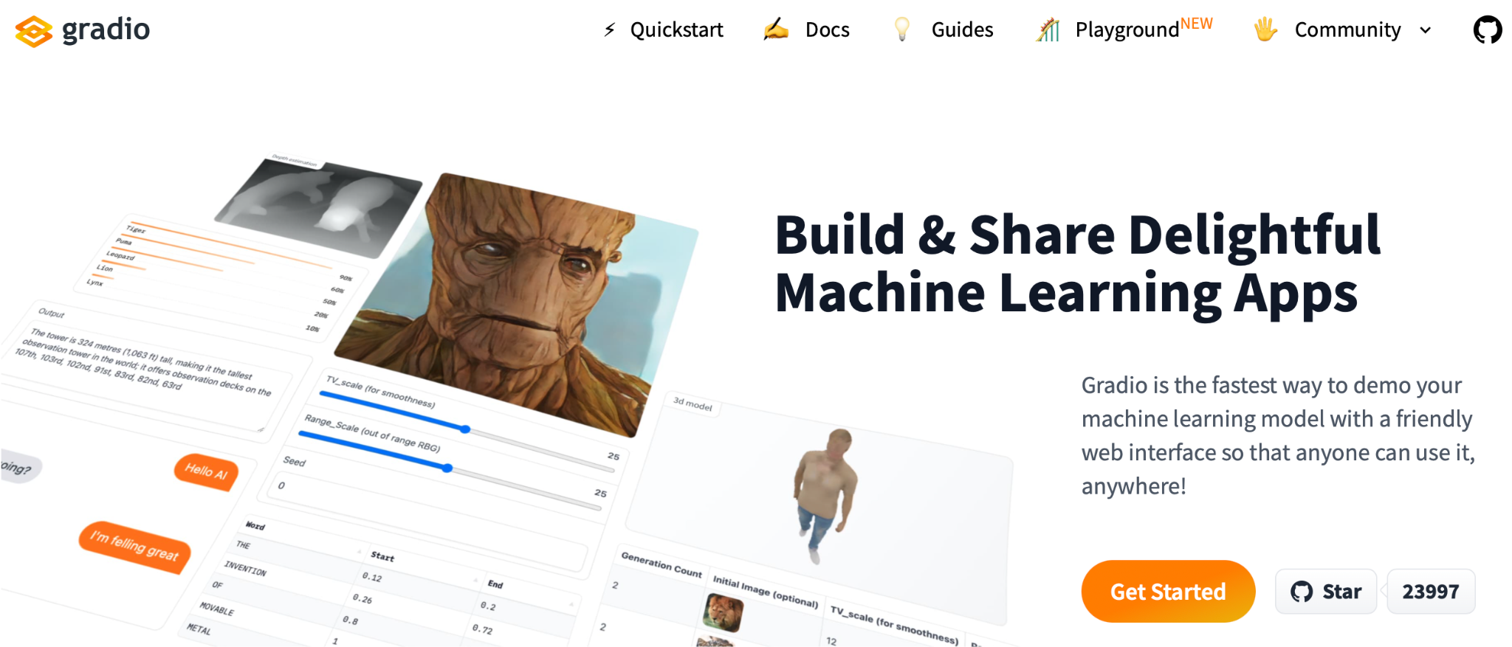
Gradio
Notes:
What does microservice orchestration look like in practice?
So, let’s get back to our own environment! So far, we know we have our Jupyter Labs interface, but what else?
In the lab, you’ll find out about the frontend microservice, which is already hosted on port 8090.
This frontend is hosted in Gradio, an open-source web interface design library well-suited for presenting AI models.
1. Simple interface: slow_echo is being ran in a loop
2. More involved interface example from huggingface spaces, which anybody can contribute to
3. A more involved interface, which is closer to what is available/running in environment. See ./frontent/server_app.py

Slide 38
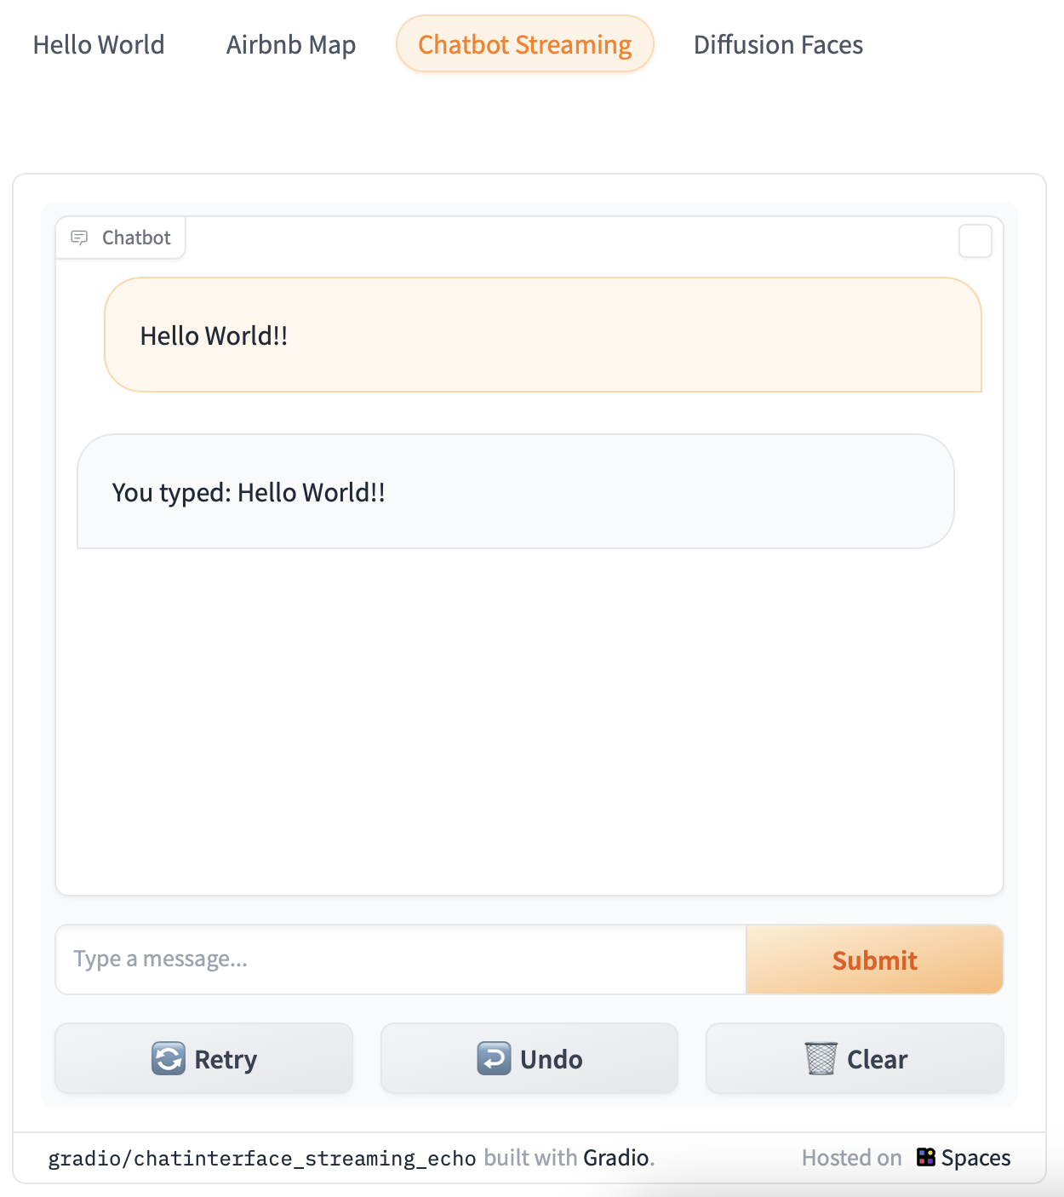
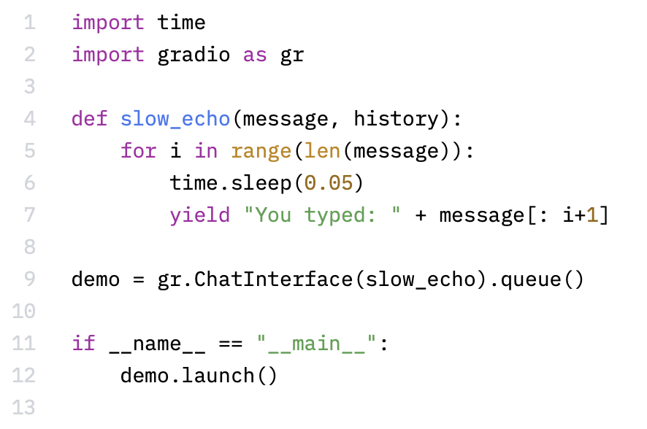
Simple Gradio ChatInterface
https://www.gradio.app/
https://huggingface.co/spaces/gradio/chatinterface_streaming_echo/blob/main/run.py
Notes:
What does microservice orchestration look like in practice?
So, let’s get back to our own environment! So far, we know we have our Jupyter Labs interface, but what else?
In the lab, you’ll find out about the frontend microservice, which is already hosted on port 8090.
This frontend is hosted in Gradio, an open-source web interface design library well-suited for presenting AI models.
1. Simple interface: slow_echo is being ran in a loop
2. More involved interface example from huggingface spaces, which anybody can contribute to
3. A more involved interface, which is closer to what is available/running in environment. See ./frontent/server_app.py

Slide 39
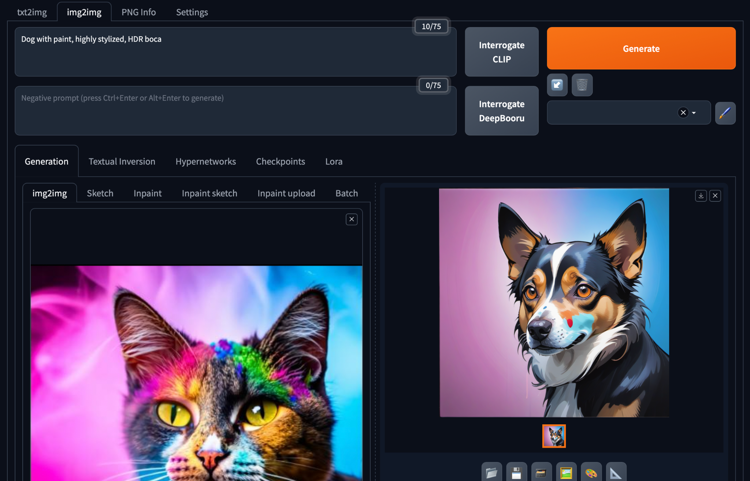
Gradio in HuggingFace Spaces
https://huggingface.co/spaces/camenduru-com/webui
Notes:
What does microservice orchestration look like in practice?
So, let’s get back to our own environment! So far, we know we have our Jupyter Labs interface, but what else?
In the lab, you’ll find out about the frontend microservice, which is already hosted on port 8090.
This frontend is hosted in Gradio, an open-source web interface design library well-suited for presenting AI models.
1. Simple interface: slow_echo is being ran in a loop
2. More involved interface example from huggingface spaces, which anybody can contribute to
3. A more involved interface, which is closer to what is available/running in environment. See ./frontent/server_app.py

Slide 40
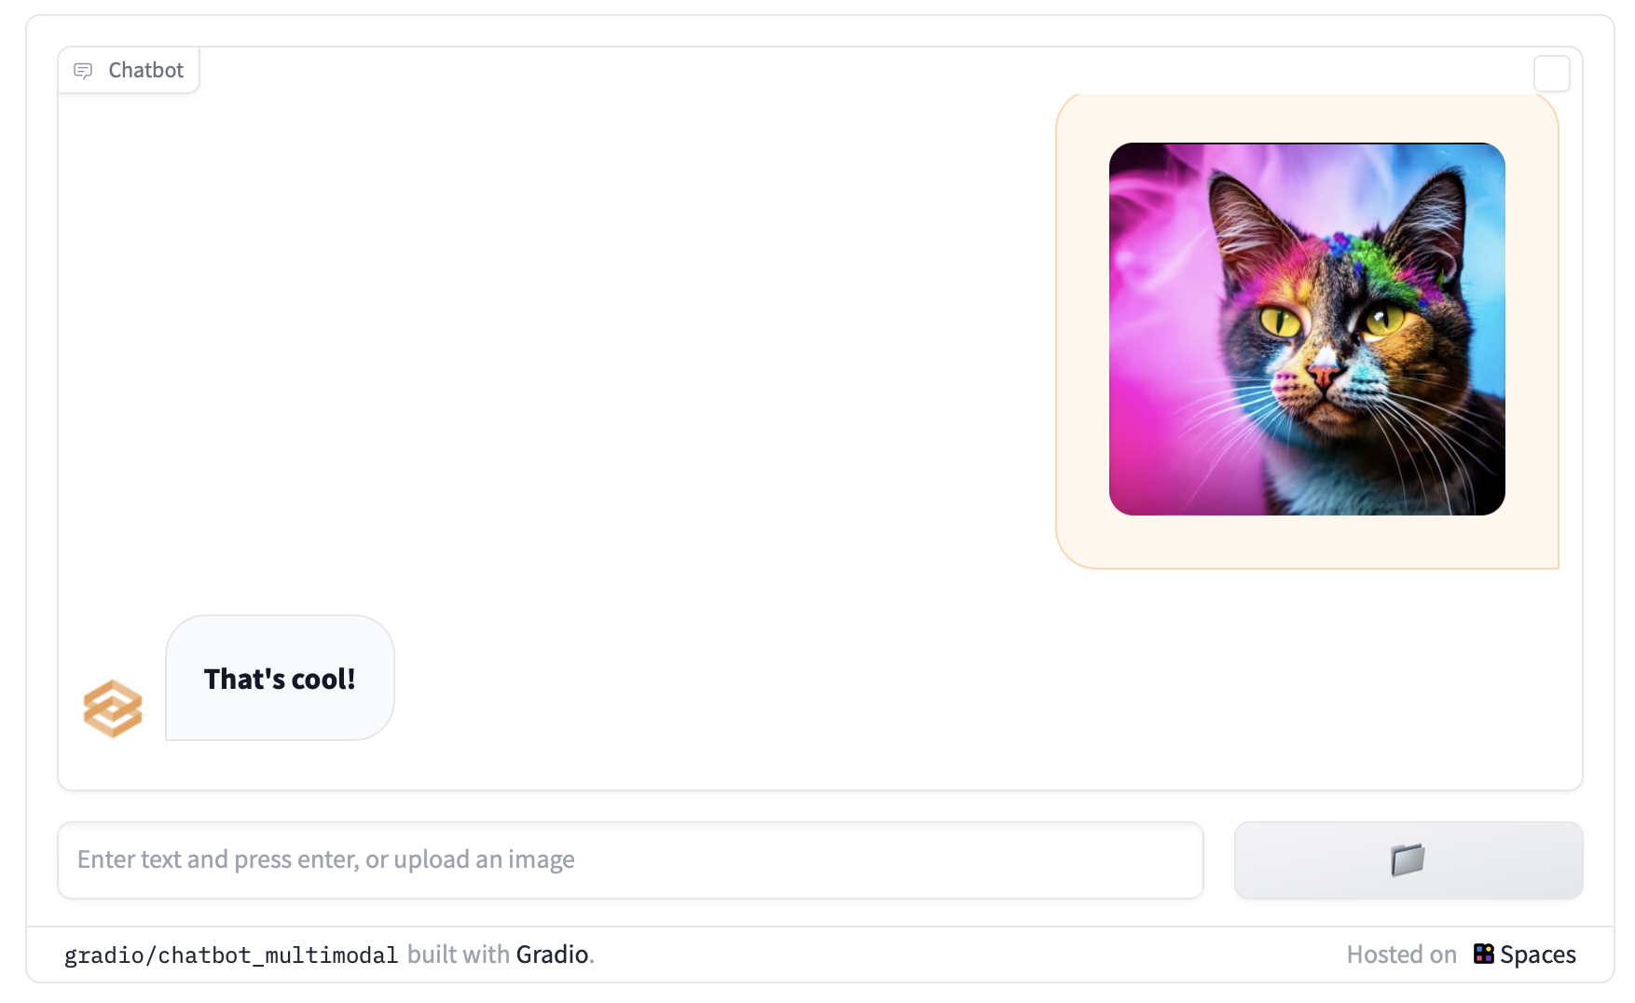
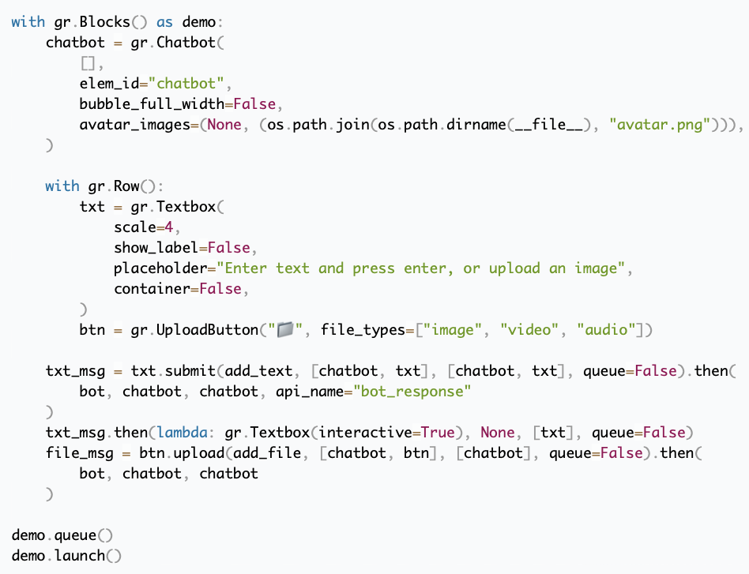
Custom Gradio Block Interface
https://www.gradio.app/guides/creating-a-custom-chatbot-with-blocks
Notes:
What does microservice orchestration look like in practice?
So, let’s get back to our own environment! So far, we know we have our Jupyter Labs interface, but what else?
In the lab, you’ll find out about the frontend microservice, which is already hosted on port 8090.
This frontend is hosted in Gradio, an open-source web interface design library well-suited for presenting AI models.
1. Simple interface: slow_echo is being ran in a loop
2. More involved interface example from huggingface spaces, which anybody can contribute to
3. A more involved interface, which is closer to what is available/running in environment. See ./frontent/server_app.py

Slide 41
Our Environment
Jupyter Notebooks + Frontend
Your Device
Remote Host
:8090
Frontend
Docker
Router
Jupyter Notebook Server
:88
Notes:
So that’s it!
Frontend interface already running on port :8090. To see details, check out ./frontend
Jupyter notebook running on port :88. To see details, check out ./composer
(Next Section: We’ll talk about the LLM-serving microservice)
Enjoy the lab!

Slide 42
Building RAG Agents with LLMs
Part 2: LLM Services

Slide 43
Our Environment
Jupyter Notebooks + Frontend
Your Device
Remote Host
:8090
Frontend
Docker
Router
Jupyter Notebook Server
:88
Notes:
So we have our environment, and we can use it to run some Python…
but wasn’t the point of this course to learn about chatbots and agents and RAG?
So where’s the LLM?
Well, if we don’t have a microservice for it…
…perhaps we can just pull in an LLM directly into our Jupyter notebook session and go from there!

Slide 44
Dialog/Retrieval Agents
LLMs with Context and Control
Execute with dialog management and information retrieval in production
https://www.nvidia.com/content/dam/en-zz/Solutions/lp/large-language-models-ebook/nvidia-llm-ebook-og.jpg
Notes:
So we have our environment, and we can use it to run some Python…
but wasn’t the point of this course to learn about chatbots and agents and RAG?
So where’s the LLM?
Well, if we don’t have a microservice for it…
…perhaps we can just pull in an LLM directly into our Jupyter notebook session and go from there!

Slide 45
Dialog/Retrieval Agents
LLMs with Context and Control
Execute with dialog management and information retrieval in production
https://www.nvidia.com/content/dam/en-zz/Solutions/lp/large-language-models-ebook/nvidia-llm-ebook-og.jpg
Notes:
So we have our environment, and we can use it to run some Python…
but wasn’t the point of this course to learn about chatbots and agents and RAG?
So where’s the LLM?
Well, if we don’t have a microservice for it…
…perhaps we can just pull in an LLM directly into our Jupyter notebook session and go from there!

Slide 46
Standalone Environment LLM
Your Device
Remote Host
Frontend
Docker
Router
Jupyter Notebook Server
Notes:
So we have our environment, and we can use it to run some Python…
but wasn’t the point of this course to learn about chatbots and agents and RAG?
So where’s the LLM?
Well, if we don’t have a microservice for it…
…perhaps we can just pull in an LLM directly into our Jupyter notebook session and go from there!

Slide 47
Standalone Environment LLM
Your Device
Remote Host
Frontend
Docker
Router
Jupyter Notebook Server
LLM
Notes:
So we have our environment, and we can use it to run some Python…
but wasn’t the point of this course to learn about chatbots and agents and RAG?
So where’s the LLM?
Well, if we don’t have a microservice for it…
…perhaps we can just pull in an LLM directly into our Jupyter notebook session and go from there!

Slide 48
Standalone Environment LLM
Jupyter Notebook
H200
A100
Jupyter Notebook
A10
4070
<s>[INST]<<SYS>>
{{system_message}}
<</SYS>>
{{instruction}} [/INST] {{primer}}
Jupyter Notebook
<s>[INST]<<SYS>>
You are a code generator.
Please provide Python code
per the instruction.
<</SYS>>
Write a Fibonacci method [/INST] ```python
## Implementation of Fibonacci w/
VRAM-bound
CPU-only
Notes:
Datacenter Compute Environment: We’d be able to pull in one or more large models and run them without too much compromises.
This kind of environment is great for exclusive access to models for experimentation and fine-tuning, and is also great for running instances perpetually for delivery to many users. Pretty costly on a per-user basis.
Lighter Datacenter/High-End Consumer Environment: We’d probably still be able to pull in some smaller models or maybe one large model to use with some compromises.
Would need to quantize and conserve resources, but can still scale to some users and have some access to the raw models.
Typical Consumer Device: Problematic to run large models without some severe compromises. Can still be done, but limited interfaces.
Good to follow minimum device spec assumption of “I can run stuff in a browser”

Slide 49
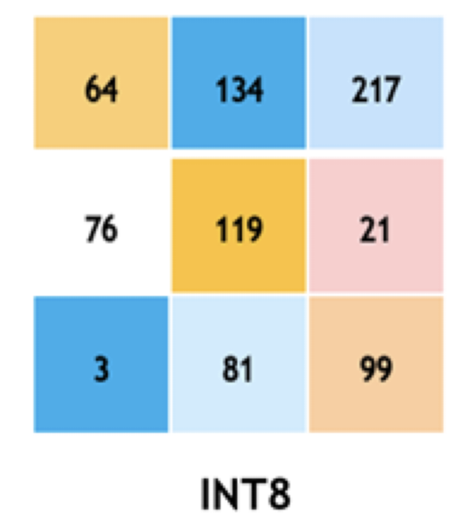
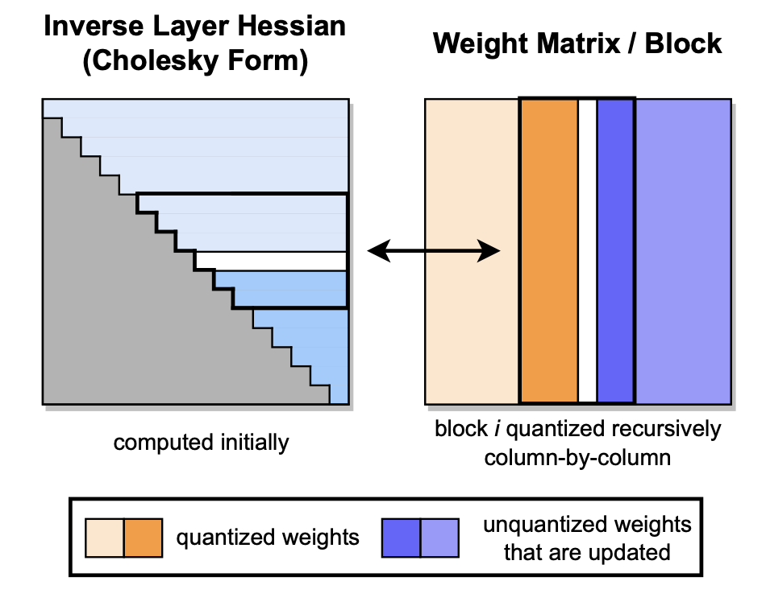
Standalone Environment LLM
Jupyter Notebook
H200
A100
Jupyter Notebook
A10
4070
Jupyter Notebook
VRAM-bound
CPU-only
Notes:
Datacenter Compute Environment: We’d be able to pull in one or more large models and run them without too much compromises.
This kind of environment is great for exclusive access to models for experimentation and fine-tuning, and is also great for running instances perpetually for delivery to many users. Pretty costly on a per-user basis.
Lighter Datacenter/High-End Consumer Environment: We’d probably still be able to pull in some smaller models or maybe one large model to use with some compromises.
Would need to quantize and conserve resources, but can still scale to some users and have some access to the raw models.
Typical Consumer Device: Problematic to run large models without some severe compromises. Can still be done, but limited interfaces.
Good to follow minimum device spec assumption of “I can run stuff in a browser”

Slide 50
Standalone Environment LLM
Jupyter Notebook
H200
A100
Jupyter Notebook
A10
4070
Jupyter Notebook
VRAM-bound
CPU-only
Notes:
Datacenter Compute Environment: We’d be able to pull in one or more large models and run them without too much compromises.
This kind of environment is great for exclusive access to models for experimentation and fine-tuning, and is also great for running instances perpetually for delivery to many users. Pretty costly on a per-user basis.
Lighter Datacenter/High-End Consumer Environment: We’d probably still be able to pull in some smaller models or maybe one large model to use with some compromises.
Would need to quantize and conserve resources, but can still scale to some users and have some access to the raw models.
Typical Consumer Device: Problematic to run large models without some severe compromises. Can still be done, but limited interfaces.
Good to follow minimum device spec assumption of “I can run stuff in a browser”
(Next Slide: Typical consumer device is our assumption, so what now?)

Slide 51

Remote LLM Access
<s>[INST]<<SYS>>
{{system_message}}
<</SYS>>
{{instruction}} [/INST] {{primer}}
Your Device
Remote Host
Llama
Frontend
<s>[INST]<<SYS>>
You are a code generator.
Please provide Python code
per the instruction.
<</SYS>>
Write a Fibonacci method [/INST] ```python
## Implementation of Fibonacci w/
Jupyter Notebook
VRAM-bound
CPU-only
Notes:
Typical Consumer Device: Problematic to run large models without some severe compromises. Can still be done, but limited interfaces.
Good to follow minimum device spec assumption of “I can run stuff in a browser”
That’ll be our assumption, so what can we do?
Luckily, we can interface with large model hosting platforms that can provide the scalable inference services for us!
For now, we can use network requests like GET and POST to communicate to an external platform. Maybe someday these will be hosted by us as well, but for now let’s see what we can bank on from others!

Slide 52
Large Model Hosting Platforms
Your Device
NVIDIA
GPU CLOUD
Remote Host
Frontend
Jupyter Notebook
VRAM-bound
CPU-only
Notes:
Typical Consumer Device: Problematic to run large models without some severe compromises. Can still be done, but limited interfaces.
Good to follow minimum device spec assumption of “I can run stuff in a browser”
That’ll be our assumption, so what can we do?
Luckily, we can interface with large model hosting platforms that can provide the scalable inference services for us!
We can use network requests like GET and POST to communicate to an external platform.
Maybe someday these will be hosted by you, but for now let’s see what we can work with from others!

Slide 53
Large Model Hosting Platforms
NVIDIA
GPU CLOUD
GPT4/3.5
Integrated Tools/Multimodal Support
Models/Query Router Internal
Path to Local Deployment Less Clear
Publicly Available Models
Models/Query Router Accessible
Path to Local Deployment/Self-Hosting
Pieces to Compose Complex Systems
Notes:
OpenAI
Has GPT4/ChatGPT/Dalle/etc. Lots of under-the-hood bells and whistles (models/functions that get called automatically).
(NEXT SECTION: multi-slide tangent on how the models are hosted and provided from OpenAI)
(Later) No straightforward path to local deployment, but it is very easy to use! Great for easily making solutions that work.

Slide 54

Query Router Access
GPT4
Dalle-3
Embed
<s>[INST]<<SYS>>
{{system_message}}
<</SYS>>
{{instruction}} [/INST] {{primer}}????
Notes:
How are these models provided:
Large model providers host models on allocated compute instances where they download the model and let it run perpetually.
From the end user perspective, these large models host endpoints which can be connected to by a variety of users and applications at any given time through a gateway service (more details to come).
Under the hood, these services generally use scaled deployment orchestrators like Kubernetes.

Slide 55
Query Router Access
{
"messages": [{
"content": "...",
"role": "system"
},{
"content": "...",
"role": "user"
}],
"model": ”gpt-4”,
"temperature": 0.2,
"top_p": 0.7,
"max_tokens": 1024,
"stream": True
}
GPT4
/chat/completions
Dalle-3
Facilitate
Monitor
Optimize
Load Balance
Embed
<s>[INST]<<SYS>>
{{system_message}}
<</SYS>>
{{instruction}} [/INST] {{primer}}????
https://kubernetes.io/
Notes:
How are these models provided:
Large model providers host models on allocated compute instances where they download the model and let it run perpetually.
From the end user perspective, these large models host endpoints which can be connected to by a variety of users and applications at any given time through a gateway service (more details to come).
Under the hood, these services generally use scaled deployment orchestrators like Kubernetes.

Slide 56
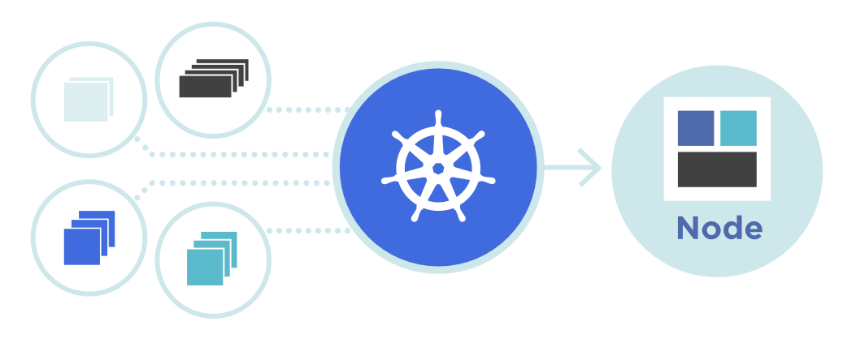
Query Router Access
{
"messages": [{
"content": "...",
"role": "system"
},{
"content": "...",
"role": "user"
}],
"model": ”gpt-4”,
"temperature": 0.2,
"top_p": 0.7,
"max_tokens": 1024,
"stream": True
}
GPT4
/chat/completions
Dalle-3
Facilitate
Monitor
Optimize
Load Balance
Embed
<s>[INST]<<SYS>>
{{system_message}}
<</SYS>>
{{instruction}} [/INST] {{primer}}????
https://kubernetes.io/
Notes:
How are these models provided:
Large model providers host models on allocated compute instances where they download the model and let it run perpetually.
From the end user perspective, these large models host endpoints which can be connected to by a variety of users and applications at any given time through a gateway service (more details to come).
Under the hood, these services generally use scaled deployment orchestrators like Kubernetes.
(UP NEXT: How An OpenAPI-spec gateway server is structured)

Slide 57
Large Model Hosting Platforms - OpenAI
models
completion
chat/completion
embeddings
images/generate
OpenAI Gateway
GPT
(3.5/4)
embed-<>
Dalle-3
Notes:
More details about the OpenAI gateway, which conforms to the OpenAPI standard.
Slide 1: It’s an abstraction layer over call functions that are deployed to run persistently and auto-scale.
Slide 2: Things like model name, messages, API keys, etc are ingested, gateway handles redirect and handling, and finally returns the response.
Slide 3: Using this interface as a building block, you can build applications on top of this, including custom microservices and end-user applications.

Slide 58
Large Model Hosting Platforms - OpenAI
models
completion
chat/completion
embeddings
images/generate
Messages
Model Name
Settings
API Key
OpenAI Gateway
Responses
GPT
(3.5/4)
embed-<>
Dalle-3
Notes:
More details about the OpenAI gateway, which conforms to the OpenAPI standard.
Slide 1: It’s an abstraction layer over call functions that are deployed to run persistently and auto-scale.
Slide 2: Things like model name, messages, API keys, etc are ingested, gateway handles redirect and handling, and finally returns the response.
Slide 3: Using this interface as a building block, you can build applications on top of this, including custom microservices and end-user applications.

Slide 59
Large Model Hosting Platforms - OpenAI
End-User Application
Retriever Microservice
models
completion
chat/completion
embeddings
images/generate
Messages
Model Name
Settings
API Key
OpenAI Gateway
Responses
GPT
(3.5/4)
embed-<>
Dalle-3
Server Management
https://developer.nvidia.com/blog/simplifying-ai-inference-in-production-with-triton/
Notes:
More details about the OpenAI gateway, which conforms to the OpenAPI standard.
Slide 1: It’s an abstraction layer over call functions that are deployed to run persistently and auto-scale.
Slide 2: Things like model name, messages, API keys, etc are ingested, gateway handles redirect and handling, and finally returns the response.
Slide 3: Using this interface as a building block, you can build applications on top of this, including custom microservices and end-user applications.
(Up Next) Limitations of OpenAI service with regard to privacy and cost ownership.

Slide 60
Large Model Hosting Platforms
NVIDIA
GPU CLOUD
GPT4/3.5
Integrated Tools/Multimodal Support
Models/Query Router Internal
Path to Local Deployment Less Clear
Publicly Available Models
Models/Query Router Accessible
Path to Local Deployment/Self-Hosting
Pieces to Compose Complex Systems
Notes:
Now that we know what large model hosting platforms are, let’s look at some of our options!
OpenAI API
Has GPT4/ChatGPT/etc. Lots of under-the-hood bells and whistles (models/functions that get called automatically).
No straightforward path to local deployment (for cost and scale), cannot guarantee data security.
NVIDIA GPU Cloud
Allows you to access publicly-available models and set up systems that work directly on the optimized deployments. Straightforward path to local deployment, but it’s not quite as automatic as some systems. These are your own deployments, after all!

Slide 61
Large Model Hosting Platforms
NVIDIA
GPU CLOUD
GPT4/3.5
Integrated Tools/Multimodal Support
Models/Query Router Internal
Path to Local Deployment Less Clear
Publicly Available Models
Models/Query Router Accessible
Path to Local Deployment/Self-Hosting
Pieces to Compose Complex Systems
Notes:
Now that we know what large model hosting platforms are, let’s look at some of our options!
OpenAI API
Has GPT4/ChatGPT/etc. Lots of under-the-hood bells and whistles (models/functions that get called automatically).
No straightforward path to local deployment (for cost and scale), cannot guarantee data security.
NVIDIA GPU Cloud
Allows you to access publicly-available models and set up systems that work directly on the optimized deployments. Straightforward path to local deployment, but it’s not quite as automatic as some systems. These are your own deployments, after all!

Slide 62
Query Router Access
GPT4
Dalle-3
Embed
{
"messages": [{
"content": "...",
"role": "system"
},{
"content": "...",
"role": "user"
}],
"model": ”mixtral”,
"temperature": 0.2,
"top_p": 0.7,
"max_tokens": 1024,
"stream": True
}
<s>[INST]<<SYS>>
{{system_message}}
<</SYS>>
{{instruction}} [/INST] {{primer}}
/chat/completions
Mixtral
SDXL
Facilitate
Monitor
Optimize
Load Balance
{
“context”:{{context}}
“model”:“query”/”doc”
}
E5
https://kubernetes.io/
Notes:
1. Structured similar to OpenAI, so either service can be used.
2. Full GenAI deployment stack for those interested.
3. State of our environment (jupyter + frontend + service API)

Slide 63
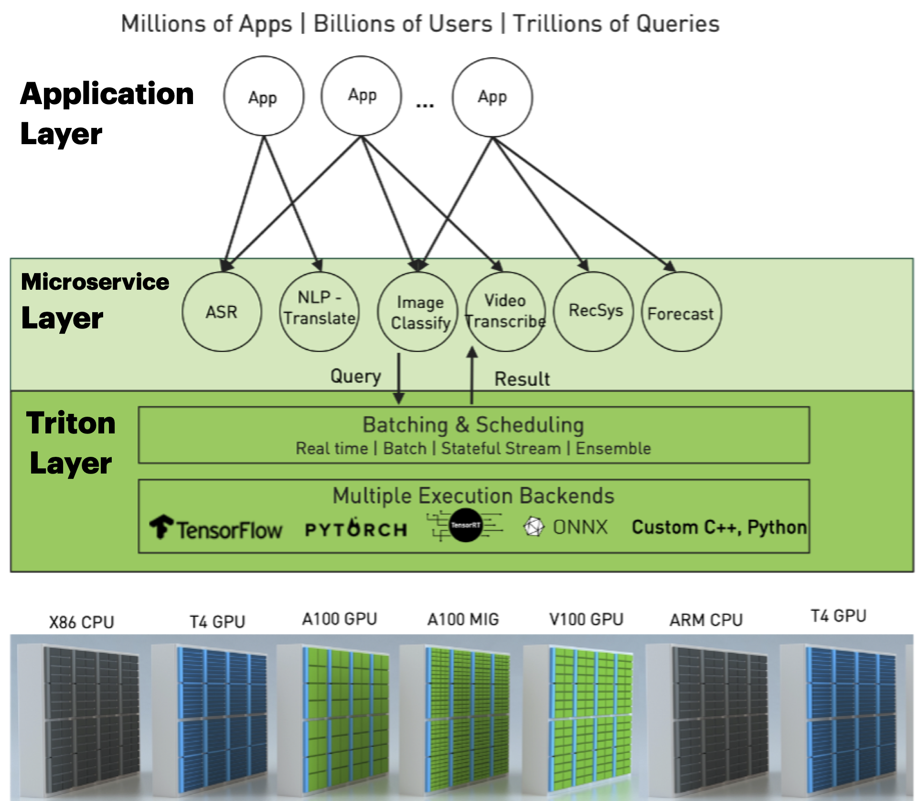
Full Deployment Stack
General Chatbot
Image Generator
Document
Copilot
Custom Server
NIMs
NeMo Retriever
Mixtral
E5
SDXL
VideoGen
RIVA
TensorRT-LLM / vLLM
K8s
Azure
/AWS
Org
Cluster
https://developer.nvidia.com/blog/simplifying-ai-inference-in-production-with-triton/
Notes:
1. Structured similar to OpenAI, so either service can be used.
2. Full GenAI deployment stack for those interested.
3. State of our environment (jupyter + frontend + service API)

Slide 64
Our Environment
Jupyter Notebooks + Frontend
LLM Client
Your Device
Remote Host
:8090
Frontend
LLMs
Docker
Router
:9000
Jupyter Notebook Server
:88
Notes:
1. Structured similar to OpenAI, so either service can be used.
2. Full GenAI deployment stack for those interested.
3. State of our environment (jupyter + frontend + service API)
(Next Slide: Talk about the LLM service)

Slide 65
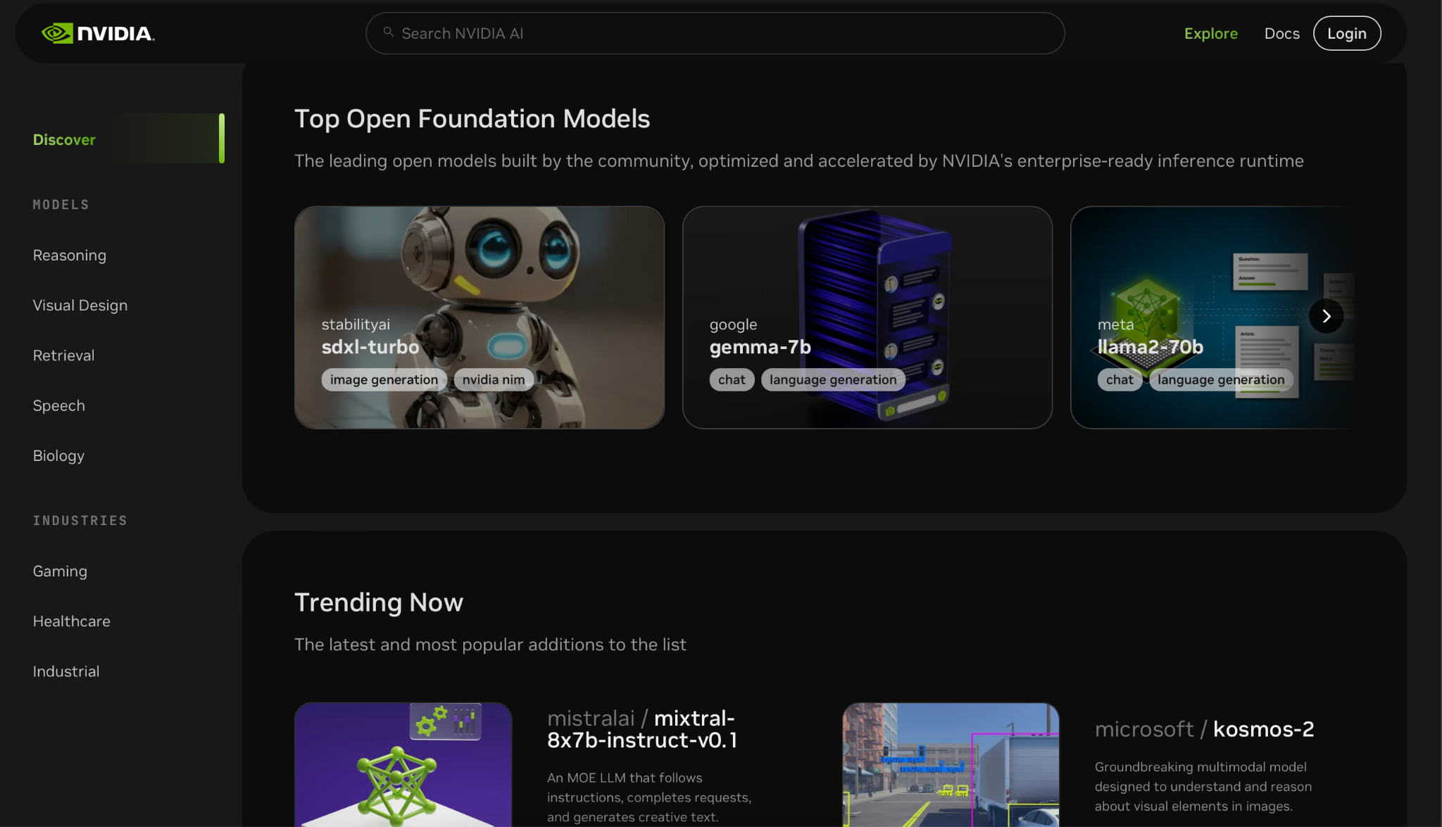
NVIDIA Foundation Model Endpoints
NVIDIA
GPU CLOUD
Notes:
So what are we going to use to get started with some LLMs quickly?... NVIDIA Foundation Model Endpoints!
1. Free access to publicly-available models which can be deployed on your own infrastructure (i.e. with NIMs)!
2. Picture of Mixtral model hosted in API Catalog. Other options available in environment.
3. Picture of user interface and API specification

Slide 66
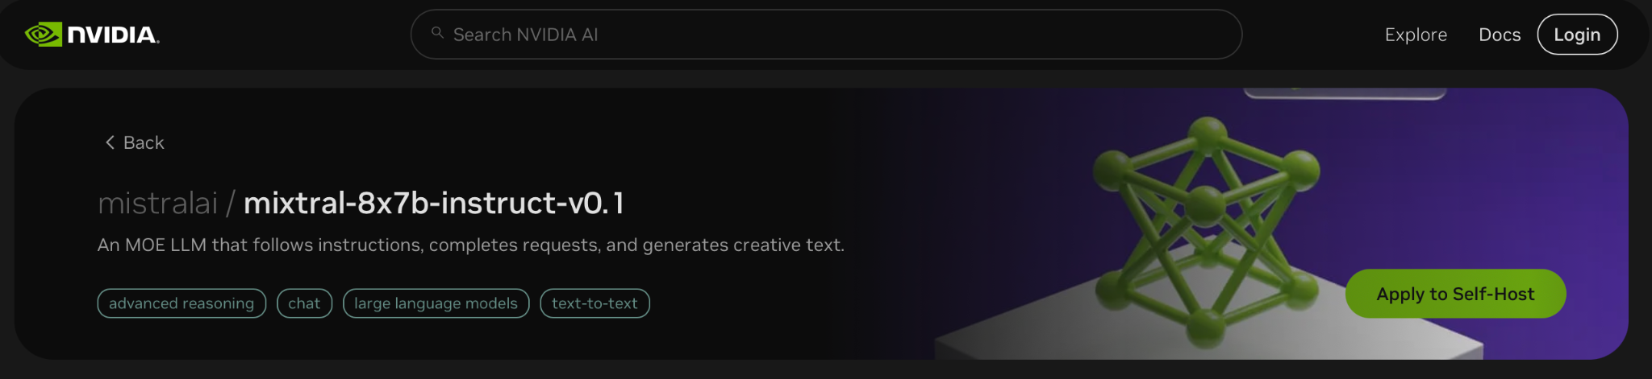
NVIDIA Foundation Model Endpoints
NVIDIA
GPU CLOUD
Notes:
So what are we going to use to get started with some LLMs quickly?... NVIDIA Foundation Model Endpoints!
1. Free access to publicly-available models which can be deployed on your own infrastructure (i.e. with NIMs)!
2. Picture of Mixtral model hosted in API Catalog. Other options available in environment.
3. Picture of user interface and API specification

Slide 67
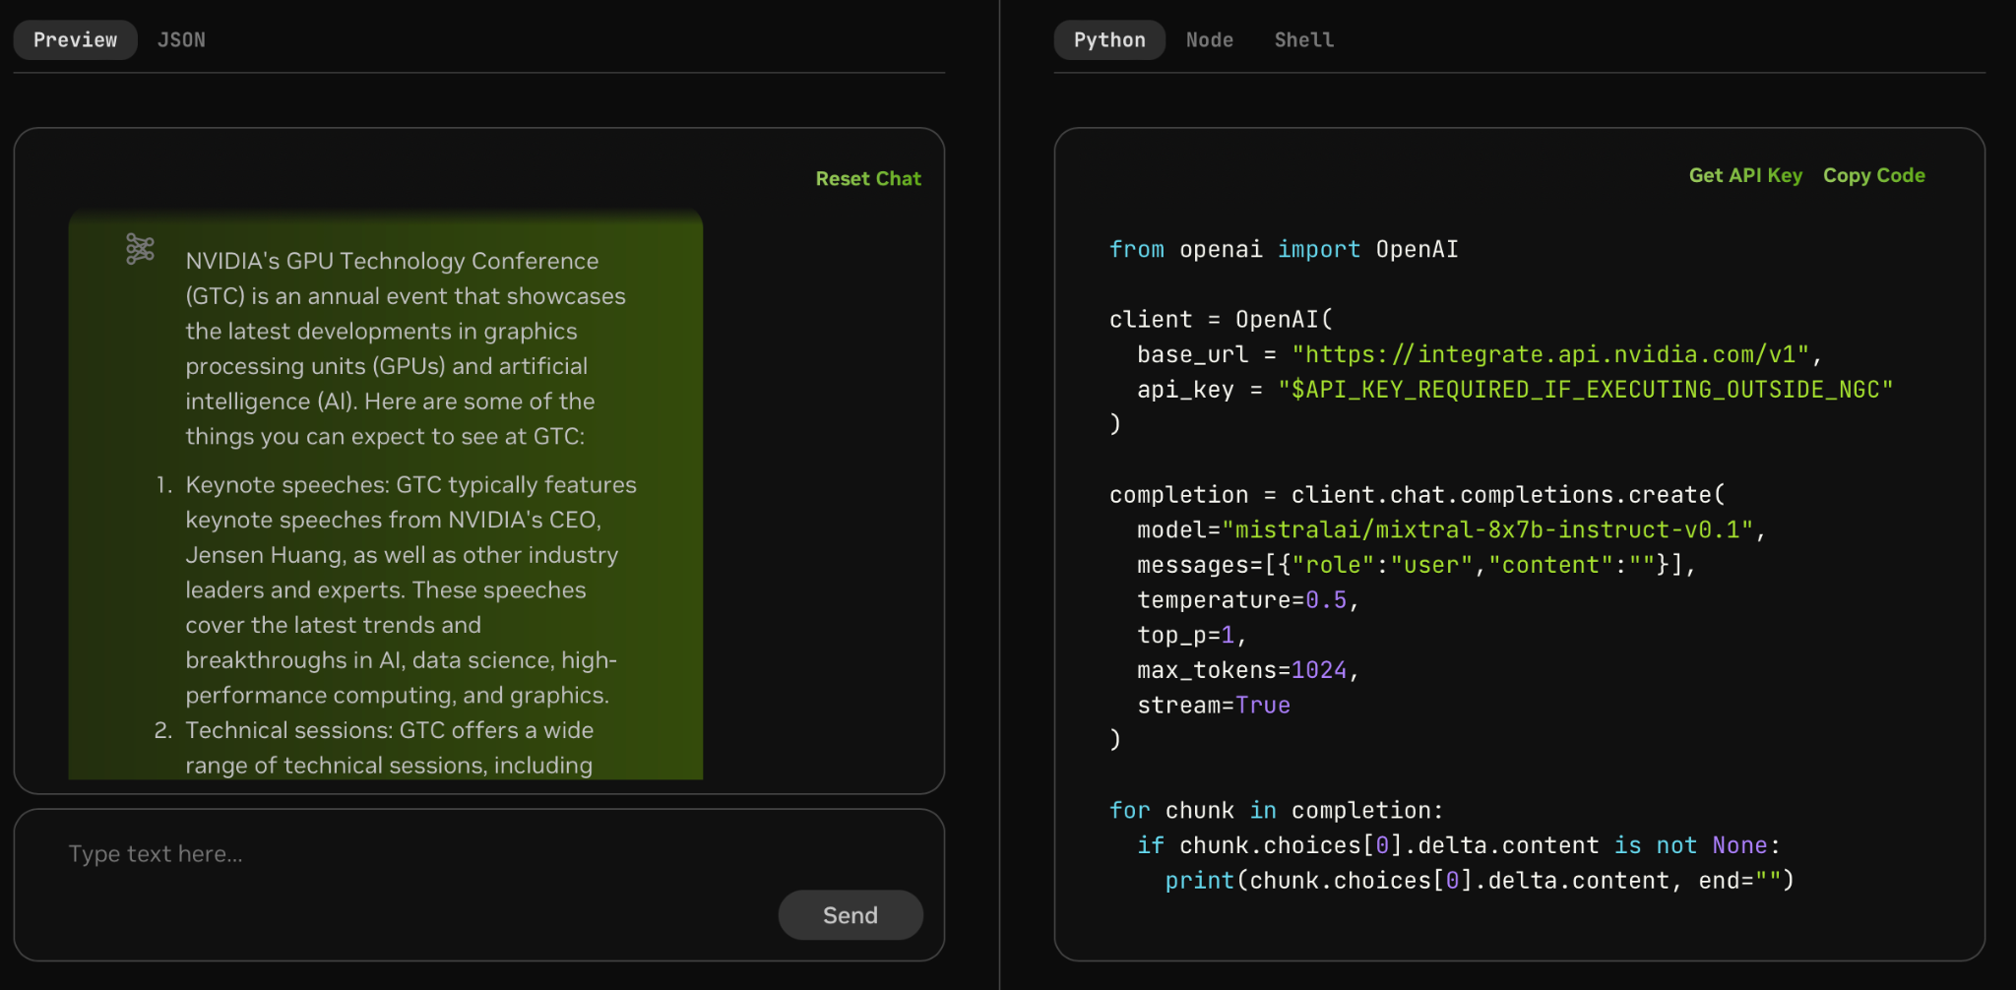
NVIDIA Foundation Model Endpoints
NVIDIA
GPU CLOUD
Notes:
So what are we going to use to get started with some LLMs quickly?... NVIDIA Foundation Model Endpoints!
1. Free access to publicly-available models which can be deployed on your own infrastructure (i.e. with NIMs)!
2. Picture of Mixtral model hosted in API Catalog. Other options available in environment.
3. Picture of user interface and API specification. You can make your own apps with it!
(Next: But we need LangChain…)

Slide 68
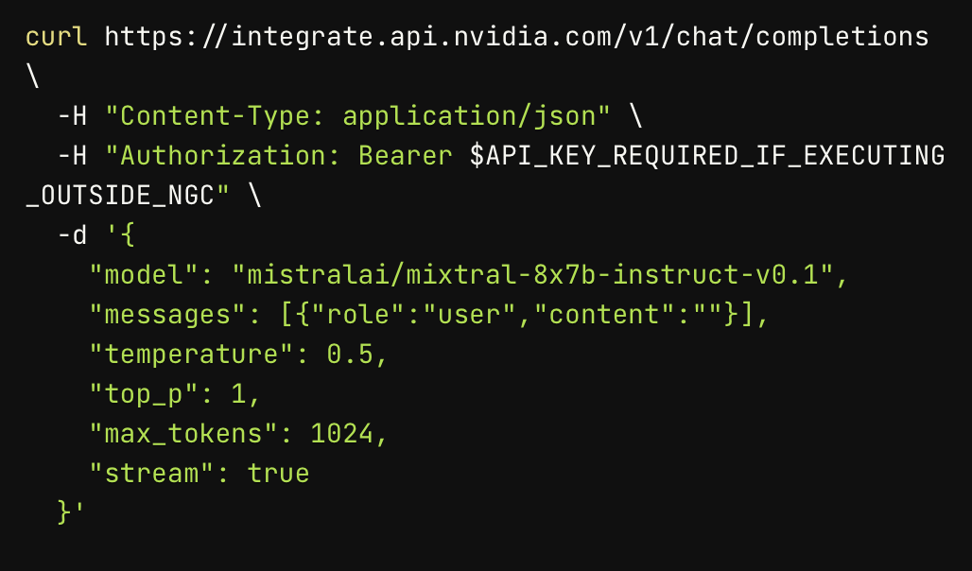
NVIDIA Foundation Model Endpoints
NVIDIA
GPU CLOUD
Notes:
So what are we going to use to get started with some LLMs quickly?... NVIDIA Foundation Model Endpoints!
1. Free access to publicly-available models which can be deployed on your own infrastructure (i.e. with NIMs)!
2. Picture of Mixtral model hosted in API Catalog. Other options available in environment.
3. Picture of user interface and API specification. You can make your own apps with it!

Slide 69
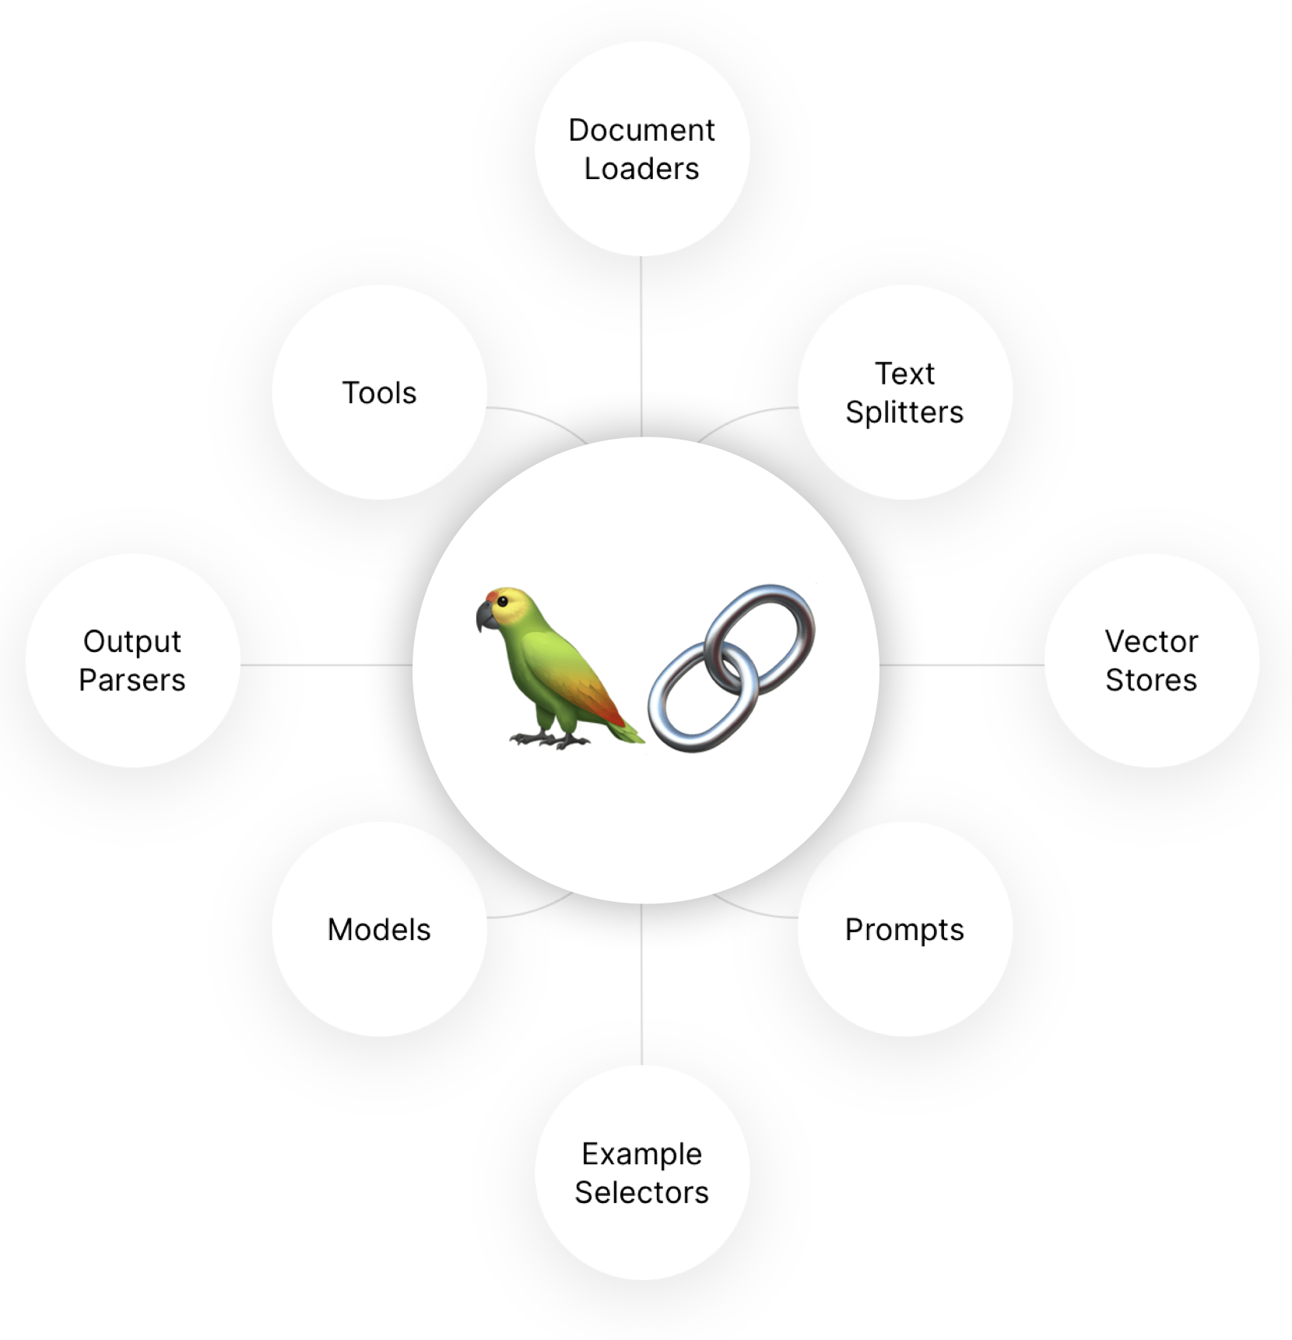
From Raw Requests to LangChain Model
Notes:
For this course, we will use LangChain to orchestrate our large model endpoints into more complex software…
Our new API will need to change just a bit for it to play well. To be discussed in the notebook.
(Sequence) Final walkthrough of abstractions going from scaled deployment API -> to gateway API -> to language wrapper -> to framework wrapper.

Slide 70
From Raw Requests to LangChain Model
> llm(“Hello world”)
ChatMessage(content=”hello”)
> embedder(“Hello”)
[0.4535437, 0.0800435, ...]
<s>[INST]<<SYS>>
{{system_message}}
<</SYS>>
{{instruction}} [/INST] {{primer}}
Query Router
Llama
Mistral
Facilitate
Monitor
Optimize
{
“context”:{{context}}
“model”:“query”/”doc”
}
E5
Notes:
For this course, we will use LangChain to orchestrate our large model endpoints into more complex software…
Our new API will need to change just a bit for it to play well. To be discussed in the notebook.
(Sequence) Final walkthrough of abstractions going from scaled deployment API -> to gateway API -> to language wrapper -> to framework wrapper.

Slide 71
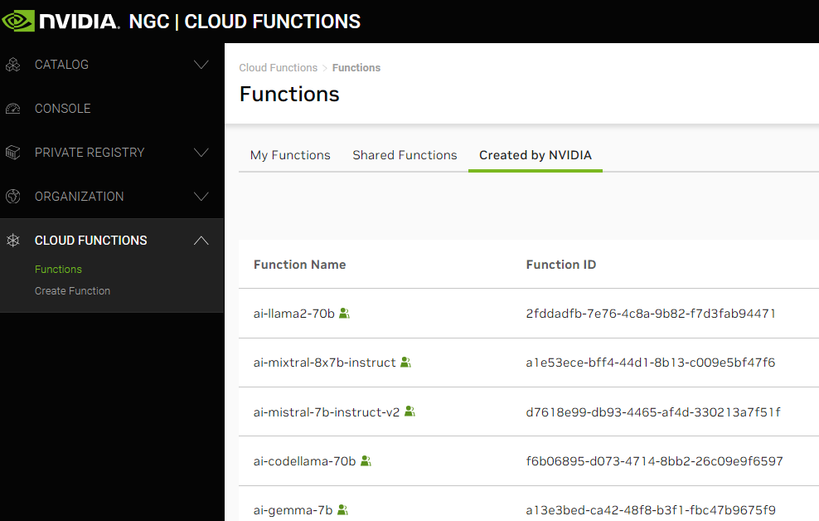
LLM Interfaces
The Whole Stack
api.nvcf.
nvidia.com
/v2/nvcf
Scaled
Function Deployment Solution
Notes:
For this course, we will use LangChain to orchestrate our large model endpoints into more complex software…
Our new API will need to change just a bit for it to play well. To be discussed in the notebook.
(Sequence) Final walkthrough of abstractions going from scaled deployment API -> to gateway API -> to language client->...-> to framework connector.

Slide 72
LLM Interfaces
The Whole Stack
health.api.nvidia.com/
ai.api.nvidia.com/
api.nvcf.
nvidia.com
/v2/nvcf
integrate.api.nvidia.com
v1/models
v1/completions
v1/chat/completions
v1/embeddings
Scaled
Function Deployment Solution
api.openai.com
v1/models
v1/completions
v1/chat/completions
v1/embeddings
Notes:
For this course, we will use LangChain to orchestrate our large model endpoints into more complex software…
Our new API will need to change just a bit for it to play well. To be discussed in the notebook.
(Sequence) Final walkthrough of abstractions going from scaled deployment API -> to gateway API -> to language client->...-> to framework connector.

Slide 73
LLM Interfaces
The Whole Stack
health.api.nvidia.com/
ai.api.nvidia.com/
api.nvcf.
nvidia.com
/v2/nvcf
NVIDIABase
integrate.api.nvidia.com
v1/models
v1/completions
v1/chat/completions
v1/embeddings
Scaled
Function Deployment Solution
api.openai.com
v1/models
v1/completions
v1/chat/completions
v1/embeddings
OpenAI
Notes:
For this course, we will use LangChain to orchestrate our large model endpoints into more complex software…
Our new API will need to change just a bit for it to play well. To be discussed in the notebook.
(Sequence) Final walkthrough of abstractions going from scaled deployment API -> to gateway API -> to language client->...-> to framework connector.

Slide 74
LLM Interfaces
The Whole Stack
health.api.nvidia.com/
ai.api.nvidia.com/
api.nvcf.
nvidia.com
/v2/nvcf
NVIDIABase
integrate.api.nvidia.com
v1/models
v1/completions
v1/chat/completions
v1/embeddings
Scaled
Function Deployment Solution
api.openai.com
v1/models
v1/completions
v1/chat/completions
v1/embeddings
OpenAI
Notes:
For this course, we will use LangChain to orchestrate our large model endpoints into more complex software…
Our new API will need to change just a bit for it to play well. To be discussed in the notebook.
(Sequence) Final walkthrough of abstractions going from scaled deployment API -> to gateway API -> to language client->...-> to framework connector.

Slide 75
LLM Interfaces
The Whole Stack
health.api.nvidia.com/
ai.api.nvidia.com/
api.nvcf.
nvidia.com
/v2/nvcf
ChatNVIDIA
NVIDIABase
integrate.api.nvidia.com
v1/models
v1/completions
v1/chat/completions
v1/embeddings
Scaled
Function Deployment Solution
api.openai.com
ChatOpenAI
v1/models
v1/completions
v1/chat/completions
v1/embeddings
OpenAI
Notes:
For this course, we will use LangChain to orchestrate our large model endpoints into more complex software…
Our new API will need to change just a bit for it to play well. To be discussed in the notebook.
(Sequence) Final walkthrough of abstractions going from scaled deployment API -> to gateway API -> to language client->...-> to framework connector.

Slide 76
Building RAG Agents with LLMs
Part 3: Intro to LangChain

Slide 77
LangChain Structure
Notes:
In the previous section, we saw how we can wrap our endpoints with a LangChain connector interface, and alleged that this will make life a lot easier since LangChain is an LLM orchestration framework. Let’s see what this means in practice!
At minimum, we’d expect our LLM to accept an input and produce an output, so of course our connector can do that.

Slide 78

Chain Building
Just The LLM
Input
LLM
Output

Slide 79
Chain Building
Just The LLM
Input
LLM
Output
Hey There
AIMessage(“Hello”)
LLM
Notes:
In the previous section, we saw how we can wrap our endpoints with a LangChain connector interface, and alleged that this will make life a lot easier since LangChain is an LLM orchestration framework. Let’s see what this means in practice!
At minimum, we’d expect our LLM to accept an input and produce an output, so of course our connector can do that.
In addition, we also would want a way to specifying additional components to our inputs. System messages, other components, etc.
In LangChain, specifying this can be done using a paradigm called Runnables, for which you can chain modules of functionality into pipelines.
These are pretty simple to specify manually. All you have to do is define a function that takes in the previous input and produces the next output, and then you can add it to the chain like this.
And then there you go! You now have a chain…
…which you can either invoke for an all-at-once response or stream for a one-token-at-a-time response.

Slide 80
Chain Building
Simple Prompt+LLM Chain
Input
Prompt
LLM
Output
{‘input’ : “Hey There”}
AIMessage(“Hello”)
Hey There
Prompt
Context: {context}
Input: {input}
LLM
Notes:
In the previous section, we saw how we can wrap our endpoints with a LangChain connector interface, and alleged that this will make life a lot easier since LangChain is an LLM orchestration framework. Let’s see what this means in practice!
At minimum, we’d expect our LLM to accept an input and produce an output, so of course our connector can do that.
In addition, we also would want a way to specifying additional components to our inputs. System messages, other components, etc.
In LangChain, specifying this can be done using a paradigm called Runnables, for which you can chain modules of functionality into pipelines.
These are pretty simple to specify manually. All you have to do is define a function that takes in the previous input and produces the next output, and then you can add it to the chain like this.
And then there you go! You now have a chain…
…which you can either invoke for an all-at-once response or stream for a one-token-at-a-time response.

Slide 81
Chain Building
Simple Prompt+LLM Chain
Input
Prompt
LLM
Output
chain = prompt | chat
chain.invoke(inputs)
{‘input’ : “Hey There”}
AIMessage(“Hello”)
Hey There
Prompt
Context: {context}
Input: {input}
LLM
Notes:
In the previous section, we saw how we can wrap our endpoints with a LangChain connector interface, and alleged that this will make life a lot easier since LangChain is an LLM orchestration framework. Let’s see what this means in practice!
At minimum, we’d expect our LLM to accept an input and produce an output, so of course our connector can do that.
In addition, we also would want a way to specifying additional components to our inputs. System messages, other components, etc.
In LangChain, specifying this can be done using a paradigm called Runnables, for which you can chain modules of functionality into pipelines.
These are pretty simple to specify manually. All you have to do is define a function that takes in the previous input and produces the next output, and then you can add it to the chain like this.
And then there you go! You now have a chain…
…which you can either invoke for an all-at-once response or stream for a one-token-at-a-time response.

Slide 82
Chain Building
Simple Prompt+LLM Chain
Input
Prompt
LLM
Output
## StrOutputParser()
def get_content(value):
return getattr(value, “content”, value)
| get_content
chain = prompt | chat
chain.invoke(inputs)
{‘input’ : “Hey There”}
AIMessage(“Hello”)
Hey There
Prompt
Context: {context}
Input: {input}
LLM
Notes:
In the previous section, we saw how we can wrap our endpoints with a LangChain connector interface, and alleged that this will make life a lot easier since LangChain is an LLM orchestration framework. Let’s see what this means in practice!
At minimum, we’d expect our LLM to accept an input and produce an output, so of course our connector can do that.
In addition, we also would want a way to specifying additional components to our inputs. System messages, other components, etc.
In LangChain, specifying this can be done using a paradigm called Runnables, for which you can chain modules of functionality into pipelines.
These are pretty simple to specify manually. All you have to do is define a function that takes in the previous input and produces the next output, and then you can add it to the chain like this.
And then there you go! You now have a chain…
…which you can either invoke for an all-at-once response or stream for a one-token-at-a-time response.

Slide 83
Chain Building
Invoking Runnables
Input
Prompt
LLM
Output
chain = prompt | chat | StrOutputParser()
Notes:
In the previous section, we saw how we can wrap our endpoints with a LangChain connector interface, and alleged that this will make life a lot easier since LangChain is an LLM orchestration framework. Let’s see what this means in practice!
At minimum, we’d expect our LLM to accept an input and produce an output, so of course our connector can do that.
In addition, we also would want a way to specifying additional components to our inputs. System messages, other components, etc.
In LangChain, specifying this can be done using a paradigm called Runnables, for which you can chain modules of functionality into pipelines.
These are pretty simple to specify manually. All you have to do is define a function that takes in the previous input and produces the next output, and then you can add it to the chain like this.
And then there you go! You now have an end-to-end chain…
…which you can either invoke for an all-at-once response or stream for a one-token-at-a-time response.

Slide 84
Chain Building
Invoking Runnables
Input
Prompt
LLM
Output
chain = prompt | chat | StrOutputParser()
msg = chain.invoke(...)
for token in chain.stream(...)
Notes:
In the previous section, we saw how we can wrap our endpoints with a LangChain connector interface, and alleged that this will make life a lot easier since LangChain is an LLM orchestration framework. Let’s see what this means in practice!
At minimum, we’d expect our LLM to accept an input and produce an output, so of course our connector can do that.
In addition, we also would want a way to specifying additional components to our inputs. System messages, other components, etc.
In LangChain, specifying this can be done using a paradigm called Runnables, for which you can chain modules of functionality into pipelines.
These are pretty simple to specify manually. All you have to do is define a function that takes in the previous input and produces the next output, and then you can add it to the chain like this.
And then there you go! You now have an end-to-end chain…
…which you can either invoke for an all-at-once response or stream for a one-token-at-a-time response.

Slide 85
Chain Building
Building Information Pipelines
Input
Prompt
LLM
Output
External
Notes:
As of right now, we have talked about a single chain, which is already a powerful module for generating an LLM “external” response to a user.
Chaining these together, however, allows you to make pipelines that route from one component to another. You can imagine processes like gating, prompt selection, and even programmatic decision making would happen at this layer, and then the user would only end up seeing the final result that comes out from the chat model after all of the internal prompt construction is finished.
In this notebook, you’ll get to explore chaining and more, including LangServe for chain deployment and the aforementioned Gradio framework for making user interfaces.
(Slide showing current notebook environment, including the routes that will be delivered via langserve)

Slide 86

Chain Building
Building Information Pipelines
Input
Prompt
LLM
Output
External
Input
Prompt
LLM
Prompt
LLM
Output
If/Else
Prompt
Database
Internal
Output
Notes:
As of right now, we have talked about a single chain, which is already a powerful module for generating an LLM “external” response to a user.
Chaining these together, however, allows you to make pipelines that route from one component to another. You can imagine processes like gating, prompt selection, and even programmatic decision making would happen at this layer, and then the user would only end up seeing the final result that comes out from the chat model after all of the internal prompt construction is finished.
In this notebook, you’ll get to explore chaining and more, including LangServe for chain deployment and the aforementioned Gradio framework for making user interfaces.
(Slide showing current notebook environment, including the routes that will be delivered via langserve)

Slide 87
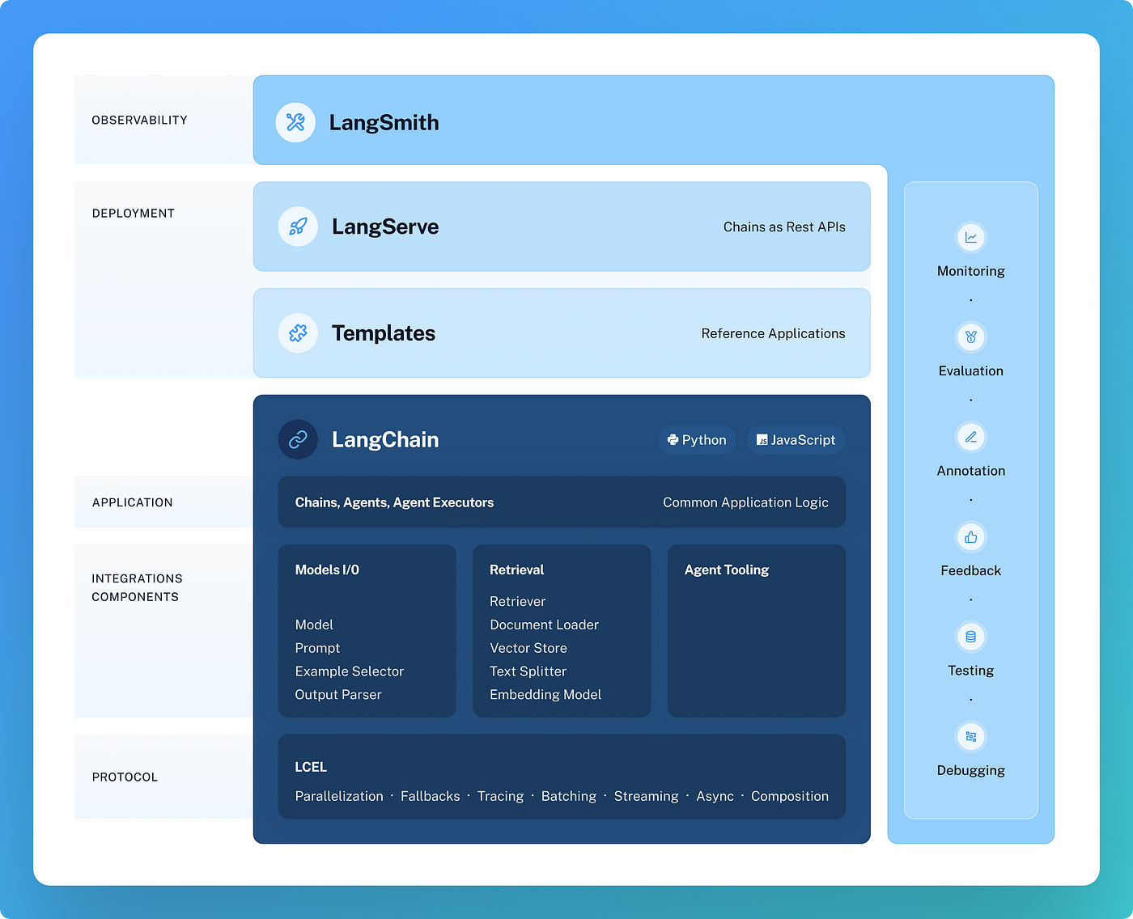
LangChain Extended Ecosystem
https://github.com/langchain-ai/langchain/tree/master
Notes:
As of right now, we have talked about a single chain, which is already a powerful module for generating an LLM “external” response to a user.
Chaining these together, however, allows you to make pipelines that route from one component to another. You can imagine processes like gating, prompt selection, and even programmatic decision making would happen at this layer, and then the user would only end up seeing the final result that comes out from the chat model after all of the internal prompt construction is finished.
In this notebook, you’ll get to explore chaining and more, including LangServe for chain deployment and the aforementioned Gradio framework for making user interfaces.
(Slide showing current notebook environment, including the routes that will be delivered via langserve)

Slide 88
Our Environment
Jupyter Notebooks + Frontend
LLM Client
Your Device
Remote Host
:8090
Frontend
LLMs
Docker
Router
:9012
:9000
Jupyter Notebook Server
:88
Notes:
As of right now, we have talked about a single chain, which is already a powerful module for generating an LLM “external” response to a user.
Chaining these together, however, allows you to make pipelines that route from one component to another. You can imagine processes like gating, prompt selection, and even programmatic decision making would happen at this layer, and then the user would only end up seeing the final result that comes out from the chat model after all of the internal prompt construction is finished.
In this notebook, you’ll get to explore chaining and more, including LangServe for chain deployment and the aforementioned Gradio framework for making user interfaces.
(Slide showing current notebook environment, including the routes that will be delivered via langserve)

Slide 89
Building RAG Agents with LLMs
Part 4: Running State Chain

Slide 90
Chain Building
Recall Our Assumptions
External
Input
Prompt
LLM
Prompt
LLM
Output
What to do?
If/Else
No Lookup
Prompt
Needs Lookup
Off-Topic
Database
Internal
Output
Notes:
In the previous section, you learned a bit about chaining LLMs to make interesting systems!
Great idea, internal vs external reasoning! Modularity of components. But there are some limitations
Let’s say you have a chain that performs some internal reasoning (i.e. sentence classification) and you wanted to use it for internal reasoning…
Then, you’d be able to just chain the two components together and stream the final result!
But what if you wanted to use both the original input and the classification at the same time?

Slide 91
Chain Building
Towards Running State
Input
Prompt
Classify Sentence
LLM
Topic
inputs = {‘input’ : ‘sentence’}
cls_chain = cls_prompt | llm
topic = cls_chain.invoke(inputs)
Notes:
In the previous section, you learned a bit about chaining LLMs to make interesting systems!
Great idea, internal vs external reasoning! Modularity of components. But there are some limitations
Let’s say you have a chain that performs some internal reasoning (i.e. sentence classification) and you wanted to use it for internal reasoning…
Then, you’d be able to just chain the two components together and stream the final result!
But what if you wanted to use both the original input and the classification at the same time?

Slide 92
Chain Building
Towards Running State
Input
Prompt
Classify Sentence
LLM
Topic
Prompt
Generate Sentence
LLM
Output
inputs = {‘input’ : ‘sentence’}
cls_chain = cls_prompt | llm
topic = cls_chain.invoke(inputs)
gen_chain = out_prompt | llm
out_chain = cls_chain | gen_chain
for token in out_chain.stream(inputs):
print(token, end=””)
Notes:
In the previous section, you learned a bit about chaining LLMs to make interesting systems!
Great idea, internal vs external reasoning! Modularity of components. But there are some limitations
Let’s say you have a chain that performs some internal reasoning (i.e. sentence classification) and you wanted to use it for internal reasoning…
Then, you’d be able to just chain the two components together and stream the final result!
But what if you wanted to use both the original input and the classification at the same time?

Slide 93
Chain Building
Towards Running State
Input
Prompt
Classify Sentence
LLM
Prompt
Generate Sentence
LLM
Output
Prompt
Combine Sentences
LLM
Output
Input
inputs = {‘input’ : ‘sentence’}
new_sentence = out_chain.invoke(inputs)
Notes:
But what if you wanted to use both the original input and the classification at the same time?
One option (previous notebook) was to break the chain and feed in both the output of the first chain and the original input to the second, discrete chain, but then it’s no longer a logical module…
Another way is to use a structure like RunnableAssign which can only mutate and add, not remove, keys!..

Slide 94
Chain Building
Towards Running State
Input
Prompt
Classify Sentence
LLM
Prompt
Generate Sentence
LLM
Output
Prompt
Combine Sentences
LLM
Output
Input
inputs = {‘input’ : ‘sentence’}
new_sentence = out_chain.invoke(inputs)
inputs.update({‘new’ : ‘new_sentence’})
for token in merge_chain.stream(inputs):
print(token, end=””)
Notes:
But what if you wanted to use both the original input and the classification at the same time?
One option (previous notebook) was to break the chain and feed in both the output of the first chain and the original input to the second, discrete chain, but then it’s no longer a logical module…
Another way is to use a structure like RunnableAssign which can only mutate and add, not remove, keys!..

Slide 95
Chain Building
Towards Running State
Input
Prompt
Classify Sentence
LLM
Prompt
Generate Sentence
LLM
Output
Branch Chain
Prompt
Combine Sentences
LLM
Output
Input
RunnableAssign
Branch Chain
out_chain = RunnableAssign({
new_sentence : cls_chain | gen_chain
}) | merge_chain
Notes:
But what if you wanted to use both the original input and the classification at the same time?
One option (previous notebook) was to break the chain and feed in both the output of the first chain and the original input to the second, discrete chain, but then it’s no longer a logical module…
Another way is to use a structure like RunnableAssign which can only mutate and add, not remove, keys!..
Using this as a key component, we can start to formalize a useful paradigm to keep history and progress state: The Running State Chain scheme.

Slide 96
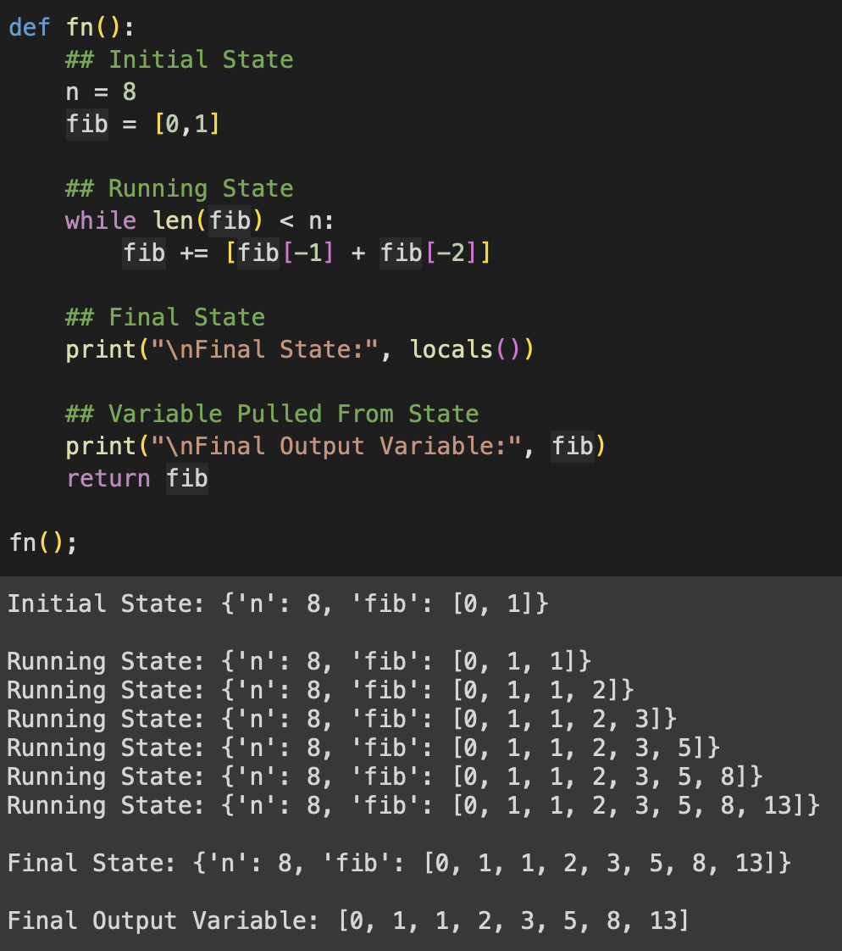
Typical Running State
Regular Fibonacci w/ While Loop
Notes:
We can start to formalize a useful paradigm to keep history and progress state: The Running State Chain scheme.
What is a Running State?
Just the state of your system at any given time. Take this fibonacci function…
Can we make a chain to perform this state transition for us?

Slide 97
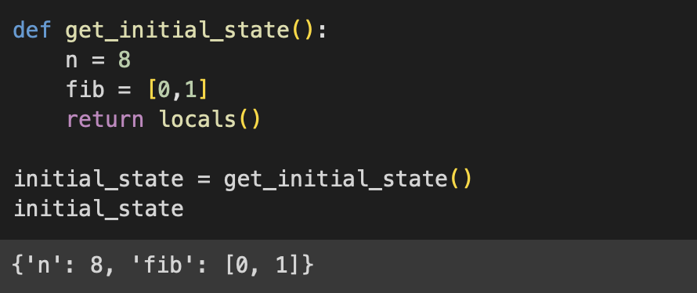
Running State Chain Components
Towards LCEL While Loop
State
n = 8
fib = [0,1]
Notes:
What is a Running State?
Just the state of your system at any given time. Take this fibonacci function…
Can we make a chain to perform this state transition for us?
Create an initial state
Allow a running state to be any mutation of the initial state (that doesn’t lose values, only adds or overrides)
Allow any modifications to the running state, but assert that the modification happens in a RunnableAssign.
As an example, if you invoke an LLM Chain to generate a value, make sure the other values of the running state stick around.
Lastly, make sure that your running state is updated on each run of the chain by overriding it with the newest output.
And that’s it! Those are the roles for your running state chain! Toss it into a while loop that checks on the running state, and you have looping in LCEL land!
And yes, you can put this into a runnable to make a runnable that invokes a loop! Example of that in the notebook 5.

Slide 98
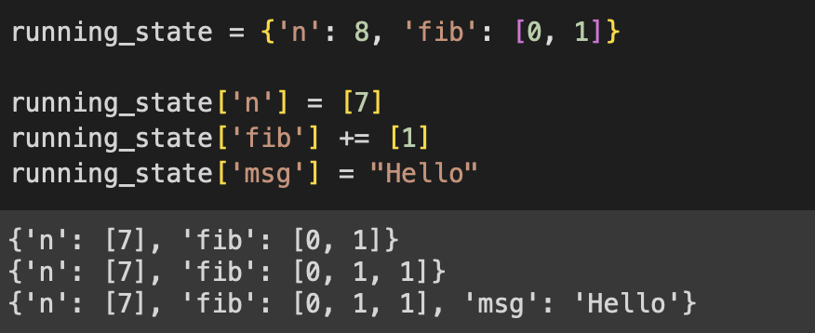
Running State Chain Components
Towards LCEL While Loop
State
n = 8
fib = [0,1]
State
n = 7
fib = [0,1,1]
msg=“Hello”
Notes:
What is a Running State?
Just the state of your system at any given time. Take this fibonacci function…
Can we make a chain to perform this state transition for us?
Create an initial state
Allow a running state to be any mutation of the initial state (that doesn’t lose values, only adds or overrides)
Allow any modifications to the running state, but assert that the modification happens in a RunnableAssign.
As an example, if you invoke an LLM Chain to generate a value, make sure the other values of the running state stick around.
Lastly, make sure that your running state is updated on each run of the chain by overriding it with the newest output.
And that’s it! Those are the roles for your running state chain! Toss it into a while loop that checks on the running state, and you have looping in LCEL land!
And yes, you can put this into a runnable to make a runnable that invokes a loop! Example of that in the notebook 5.

Slide 99
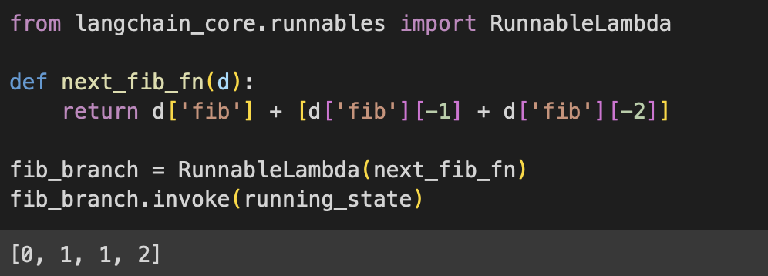
Running State Chain Components
Towards LCEL While Loop
State
n = 8
fib = [0,1,1]
[0,1,1,2]
Notes:
What is a Running State?
Just the state of your system at any given time. Take this fibonacci function…
Can we make a chain to perform this state transition for us?
Create an initial state
Allow a running state to be any mutation of the initial state (that doesn’t lose values, only adds or overrides)
Allow any modifications to the running state, but assert that the modification happens in a RunnableAssign.
As an example, if you invoke an LLM Chain to generate a value, make sure the other values of the running state stick around.
Lastly, make sure that your running state is updated on each run of the chain by overriding it with the newest output.
And that’s it! Those are the roles for your running state chain! Toss it into a while loop that checks on the running state, and you have looping in LCEL land!
And yes, you can put this into a runnable to make a runnable that invokes a loop! Example of that in the notebook 5.

Slide 100
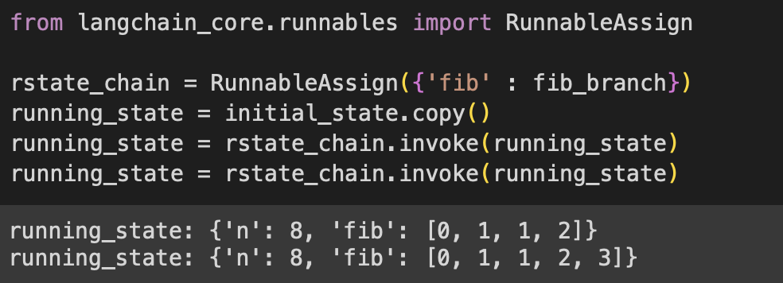
Running State Chain Components
Towards LCEL While Loop
State
n = 8
fib = [0,1,1]
[0,1,1,2]
State
n = 8
fib = [0,1,1,2]
Notes:
What is a Running State?
Just the state of your system at any given time. Take this fibonacci function…
Can we make a chain to perform this state transition for us?
Create an initial state
Allow a running state to be any mutation of the initial state (that doesn’t lose values, only adds or overrides)
Allow any modifications to the running state, but assert that the modification happens in a RunnableAssign.
As an example, if you invoke an LLM Chain to generate a value, make sure the other values of the running state stick around.
Lastly, make sure that your running state is updated on each run of the chain by overriding it with the newest output.
And that’s it! Those are the roles for your running state chain! Toss it into a while loop that checks on the running state, and you have looping in LCEL land!
And yes, you can put this into a runnable to make a runnable that invokes a loop! Example of that in the notebook 5.

Slide 101
Running State Chain Components
Towards LCEL While Loop
State
n = 8
fib = [0,1,1]
State
n = 8
fib = [0,1,1,2]
State
n = 8
fib =
[0,1,1,2, 3]
Notes:
What is a Running State?
Just the state of your system at any given time. Take this fibonacci function…
Can we make a chain to perform this state transition for us?
Create an initial state
Allow a running state to be any mutation of the initial state (that doesn’t lose values, only adds or overrides)
Allow any modifications to the running state, but assert that the modification happens in a RunnableAssign.
As an example, if you invoke an LLM Chain to generate a value, make sure the other values of the running state stick around.
Lastly, make sure that your running state is updated on each run of the chain by overriding it with the newest output.
And that’s it! Those are the roles for your running state chain! Toss it into a while loop that checks on the running state, and you have looping in LCEL land!
And yes, you can put this into a runnable to make a runnable that invokes a loop! Example of that in the notebook 5.

Slide 102
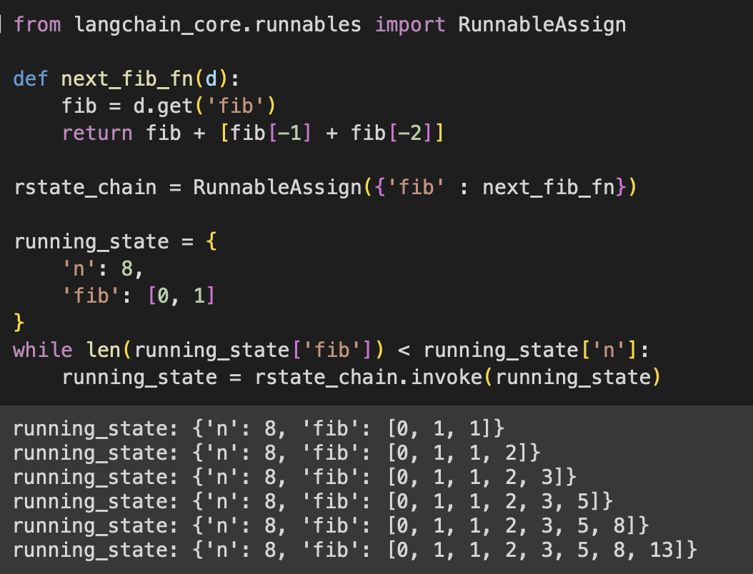
Final Running State Loop
Notes:
What is a Running State?
Just the state of your system at any given time. Take this fibonacci function…
Can we make a chain to perform this state transition for us?
Create an initial state
Allow a running state to be any mutation of the initial state (that doesn’t lose values, only adds or overrides)
Allow any modifications to the running state, but assert that the modification happens in a RunnableAssign.
As an example, if you invoke an LLM Chain to generate a value, make sure the other values of the running state stick around.
Lastly, make sure that your running state is updated on each run of the chain by overriding it with the newest output.
And that’s it! Those are the roles for your running state chain! Toss it into a while loop that checks on the running state, and you have looping in LCEL land!
And yes, you can put this into a runnable to make a runnable that invokes a loop! Example of that in the notebook 5.
(next slide; side-by-side for comparison)

Slide 103
Typical Running State Loop
Comparing Typical with Running State
Notes:
What is a Running State?
Just the state of your system at any given time. Take this fibonacci function…
Can we make a chain to perform this state transition for us?
Create an initial state
Allow a running state to be any mutation of the initial state (that doesn’t lose values, only adds or overrides)
Allow any modifications to the running state, but assert that the modification happens in a RunnableAssign.
As an example, if you invoke an LLM Chain to generate a value, make sure the other values of the running state stick around.
Lastly, make sure that your running state is updated on each run of the chain by overriding it with the newest output.
And that’s it! Those are the roles for your running state chain! Toss it into a while loop that checks on the running state, and you have looping in LCEL land!
And yes, you can put this into a runnable to make a runnable that invokes a loop! Example of that in the notebook 5.

Slide 104
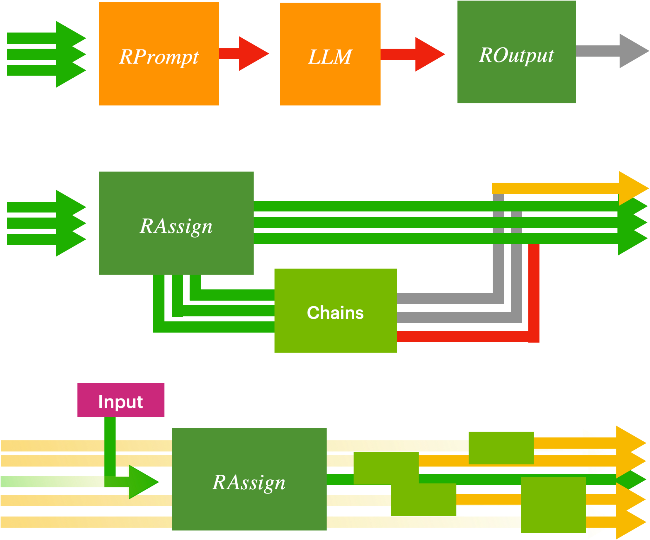
Final Running State Loop
Big Picture
RunnableAssign
RunnableLambda
RunnableBranch
Notes:
And that’s all you need to know to make looping structures using the LCEL specification!
This can be extremely useful for modularization, since you can just make simple modules that perform complex event loops behind the scenes
In The Upcoming Notebook, we use this to set up a chatbot that can pull a customer’s information from a database!

Slide 105
Airline Chatbot
+Knowledge Base
+Response
Input
Prompt
Update Knowledge
DB Lookup
Prompt
Format
Prompt
Update Knowledge
LLM
LLM
+Customer Info
History
User
Notes:
In The Upcoming Notebook, we use this to set up a chatbot that can pull a customer’s information from a database!
But it might be useful to formalize a few more components before that…
Unstructured generation: What you’ve been doing. Natural language -> natural language.
Structured Retrieval: Natural language -> commands that query a system (i.e. SQL, python).
Guided Generation: Natural language -> schema enforced by either instruction or sampling (i.e. dictionary/json generation)
Tooling: Natural language -> [(optionally tool selection) + (tool inputs via guided generation) + (tool code)].
Incorporating these paradigms (especially tooling), you’ll will try to make the LLM predict arguments for a data retriever command, and then subsequently populate your LLM context with the retrieved information so that it can help the user.
And then put it into a loop. There we go!

Slide 106
Modern Chain Paradigms
Towards Powerful Running State
Prompt
LLM
Unstructured Generation
Input
Notes:
In The Upcoming Notebook, we use this to set up a chatbot that can pull a customer’s information from a database!
But it might be useful to formalize a few more components before that…
Unstructured generation: What you’ve been doing. Natural language -> natural language.
Structured Retrieval: Natural language -> commands that query a system (i.e. SQL, python).
Guided Generation: Natural language -> schema enforced by either instruction or sampling (i.e. dictionary/json generation)
Tooling: Natural language -> [(optionally tool selection) + (tool inputs via guided generation) + (tool code)].
Incorporating these paradigms (especially tooling), you’ll will try to make the LLM predict arguments for a data retriever command, and then subsequently populate your LLM context with the retrieved information so that it can help the user.
And then put it into a loop. There we go!

Slide 107
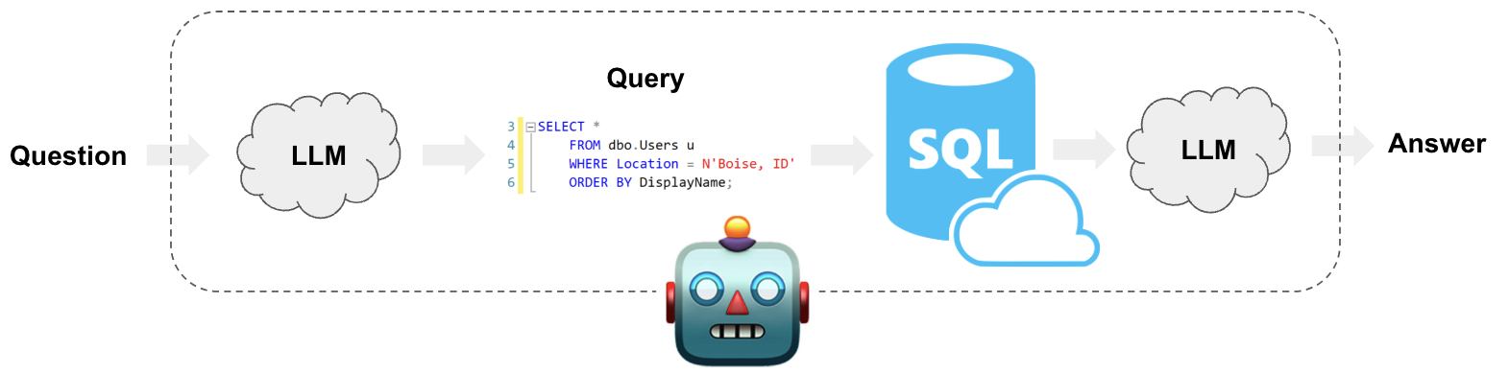
Modern Chain Paradigms
Towards Powerful Running State
Prompt
LLM
Unstructured Generation
Prompt
Code
LLM
Environment
Structured Retrieval
Input
https://python.langchain.com/docs/use_cases/qa_structured/sql
Notes:
In The Upcoming Notebook, we use this to set up a chatbot that can pull a customer’s information from a database!
But it might be useful to formalize a few more components before that…
Unstructured generation: What you’ve been doing. Natural language -> natural language.
Structured Retrieval: Natural language -> commands that query a system (i.e. SQL, python).
Guided Generation: Natural language -> schema enforced by either instruction or sampling (i.e. dictionary/json generation)
Tooling: Natural language -> [(optionally tool selection) + (tool inputs via guided generation) + (tool code)].
Incorporating these paradigms (especially tooling), you’ll will try to make the LLM predict arguments for a data retriever command, and then subsequently populate your LLM context with the retrieved information so that it can help the user.
And then put it into a loop. There we go!

Slide 108
Modern Chain Paradigms
Towards Powerful Running State
Prompt
LLM
Unstructured Generation
Prompt
Code
LLM
Environment
Structured Retrieval
Input
Prompt
LLM
Grammar
/Schema
Guided Generation
{“first_name” : “unknown”,
“last_name” : “unknown”,
“confirmation” : -1}
Update given new info:
“Sure, my name is Jane Doe!”
{“first_name” : “Jane”,
“last_name” : “Doe”,
“confirmation” : -1}
LLM
Notes:
In The Upcoming Notebook, we use this to set up a chatbot that can pull a customer’s information from a database!
But it might be useful to formalize a few more components before that…
Unstructured generation: What you’ve been doing. Natural language -> natural language.
Structured Retrieval: Natural language -> commands that query a system (i.e. SQL, python).
Guided Generation: Natural language -> schema enforced by either instruction or sampling (i.e. dictionary/json generation)
Tooling: Natural language -> [(optionally tool selection) + (tool inputs via guided generation) + (tool code)].
Incorporating these paradigms (especially tooling), you’ll will try to make the LLM predict arguments for a data retriever command, and then subsequently populate your LLM context with the retrieved information so that it can help the user.
And then put it into a loop. There we go!

Slide 109
Modern Chain Paradigms
Towards Powerful Running State
Prompt
LLM
Unstructured Generation
Prompt
Code
LLM
Environment
Structured Retrieval
Input
Prompt
LLM
Grammar
/Schema
Guided Generation
Prompt
LLM
Tool Choice
Tool
Tooling
Tool Schema
Notes:
In The Upcoming Notebook, we use this to set up a chatbot that can pull a customer’s information from a database!
But it might be useful to formalize a few more components before that…
Unstructured generation: What you’ve been doing. Natural language -> natural language.
Structured Retrieval: Natural language -> commands that query a system (i.e. SQL, python).
Guided Generation: Natural language -> schema enforced by either instruction or sampling (i.e. dictionary/json generation)
Tooling: Natural language -> [(optionally tool selection) + (tool inputs via guided generation) + (tool code)].
Incorporating these paradigms (especially tooling), you’ll will try to make the LLM predict arguments for a data retriever command, and then subsequently populate your LLM context with the retrieved information so that it can help the user.
And then put it into a loop. There we go!

Slide 110
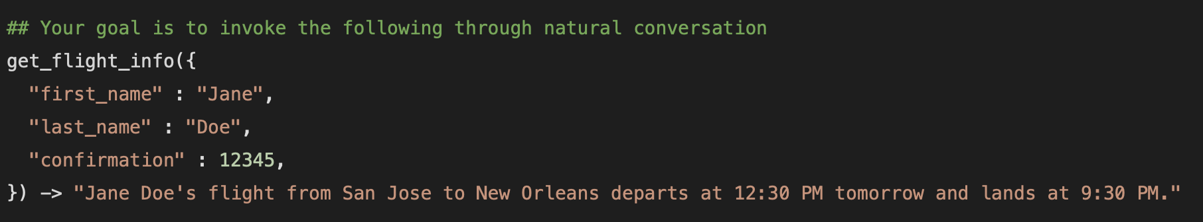
Final Objective
Knowledge Base + Running State Chain
{
“first_name” : “unknown”,
“last_name” : “unknown”,
“confirmation” : -1,
...
}
Update given new info:
“Sure, my name is Jane Doe!”
{
“first_name” : “Jane”,
“last_name” : “Doe”,
“confirmation” : -1,
...
}
LLM
Notes:
In The Upcoming Notebook, we use this to set up a chatbot that can pull a customer’s information from a database!
But it might be useful to formalize a few more components before that…
Unstructured generation: What you’ve been doing. Natural language -> natural language.
Structured Retrieval: Natural language -> commands that query a system (i.e. SQL, python).
Guided Generation: Natural language -> schema enforced by either instruction or sampling (i.e. dictionary/json generation)
Tooling: Natural language -> [(optionally tool selection) + (tool inputs via guided generation) + (tool code)].
Incorporating these paradigms (especially tooling), you’ll will try to make the LLM predict arguments for a data retriever command
Then subsequently populate your LLM context with the retrieved information so that it can help the user…
…making sure to keep the full state of the system intact as the chain progresses.
And then put it into a loop. There we go!

Slide 111
Airline Chatbot
+Knowledge Base
+Response
Input
Prompt
Update Knowledge
DB Lookup
Prompt
Format
Prompt
Update Knowledge
LLM
LLM
+Customer Info
Notes:
In The Upcoming Notebook, we use this to set up a chatbot that can pull a customer’s information from a database!
But it might be useful to formalize a few more components before that…
Unstructured generation: What you’ve been doing. Natural language -> natural language.
Structured Retrieval: Natural language -> commands that query a system (i.e. SQL, python).
Guided Generation: Natural language -> schema enforced by either instruction or sampling (i.e. dictionary/json generation)
Tooling: Natural language -> [(optionally tool selection) + (tool inputs via guided generation) + (tool code)].
Incorporating these paradigms (especially tooling), you’ll will try to make the LLM predict arguments for a data retriever command
Then subsequently populate your LLM context with the retrieved information so that it can help the user…
…making sure to keep the full state of the system intact as the chain progresses.
And then put it into a loop. There we go!

Slide 112
Airline Chatbot
+Knowledge Base
+Response
Input
Prompt
Update Knowledge
DB Lookup
Prompt
Format
Prompt
Update Knowledge
LLM
LLM
+Customer Info
Notes:
In The Upcoming Notebook, we use this to set up a chatbot that can pull a customer’s information from a database!
But it might be useful to formalize a few more components before that…
Unstructured generation: What you’ve been doing. Natural language -> natural language.
Structured Retrieval: Natural language -> commands that query a system (i.e. SQL, python).
Guided Generation: Natural language -> schema enforced by either instruction or sampling (i.e. dictionary/json generation)
Tooling: Natural language -> [(optionally tool selection) + (tool inputs via guided generation) + (tool code)].
Incorporating these paradigms (especially tooling), you’ll will try to make the LLM predict arguments for a data retriever command
Then subsequently populate your LLM context with the retrieved information so that it can help the user…
…making sure to keep the full state of the system intact as the chain progresses.
And then put it into a loop. There we go!

Slide 113
Airline Chatbot
+Knowledge Base
+Response
Input
Prompt
Update Knowledge
DB Lookup
Prompt
Format
Prompt
Update Knowledge
LLM
LLM
+Customer Info
History
User
Notes:
In The Upcoming Notebook, we use this to set up a chatbot that can pull a customer’s information from a database!
But it might be useful to formalize a few more components before that…
Unstructured generation: What you’ve been doing. Natural language -> natural language.
Structured Retrieval: Natural language -> commands that query a system (i.e. SQL, python).
Guided Generation: Natural language -> schema enforced by either instruction or sampling (i.e. dictionary/json generation)
Tooling: Natural language -> [(optionally tool selection) + (tool inputs via guided generation) + (tool code)].
Incorporating these paradigms (especially tooling), you’ll will try to make the LLM predict arguments for a data retriever command
Then subsequently populate your LLM context with the retrieved information so that it can help the user…
…making sure to keep the full state of the system intact as the chain progresses.
And then put it into a loop. There we go!
Good luck with the notebook!!

Slide 114
Building RAG Agents with LLMs
Part 5: Working with Documents
Notes:
KEY TRANSITION:
Previously: We’ve formalized how to make custom pathways and manage chain logic.
NOW: Now let’s learn how we can work with documents using these approaches.

Slide 115
Modern Chain Paradigms
Towards Powerful Running State
Prompt
LLM
Unstructured Generation
Prompt
Code
LLM
Environment
Structured Retrieval
Input
Prompt
LLM
Grammar
/Schema
Guided Generation
Prompt
LLM
Tool Choice
Tool
Tooling
Tool Schema
Notes:
At this point, we’ve gone into detail about some heavier orchestration topics. Many ideas about how we could modify the running state to achieve what we want!
So does that mean we’re ready to handle document reasoning?

Slide 116
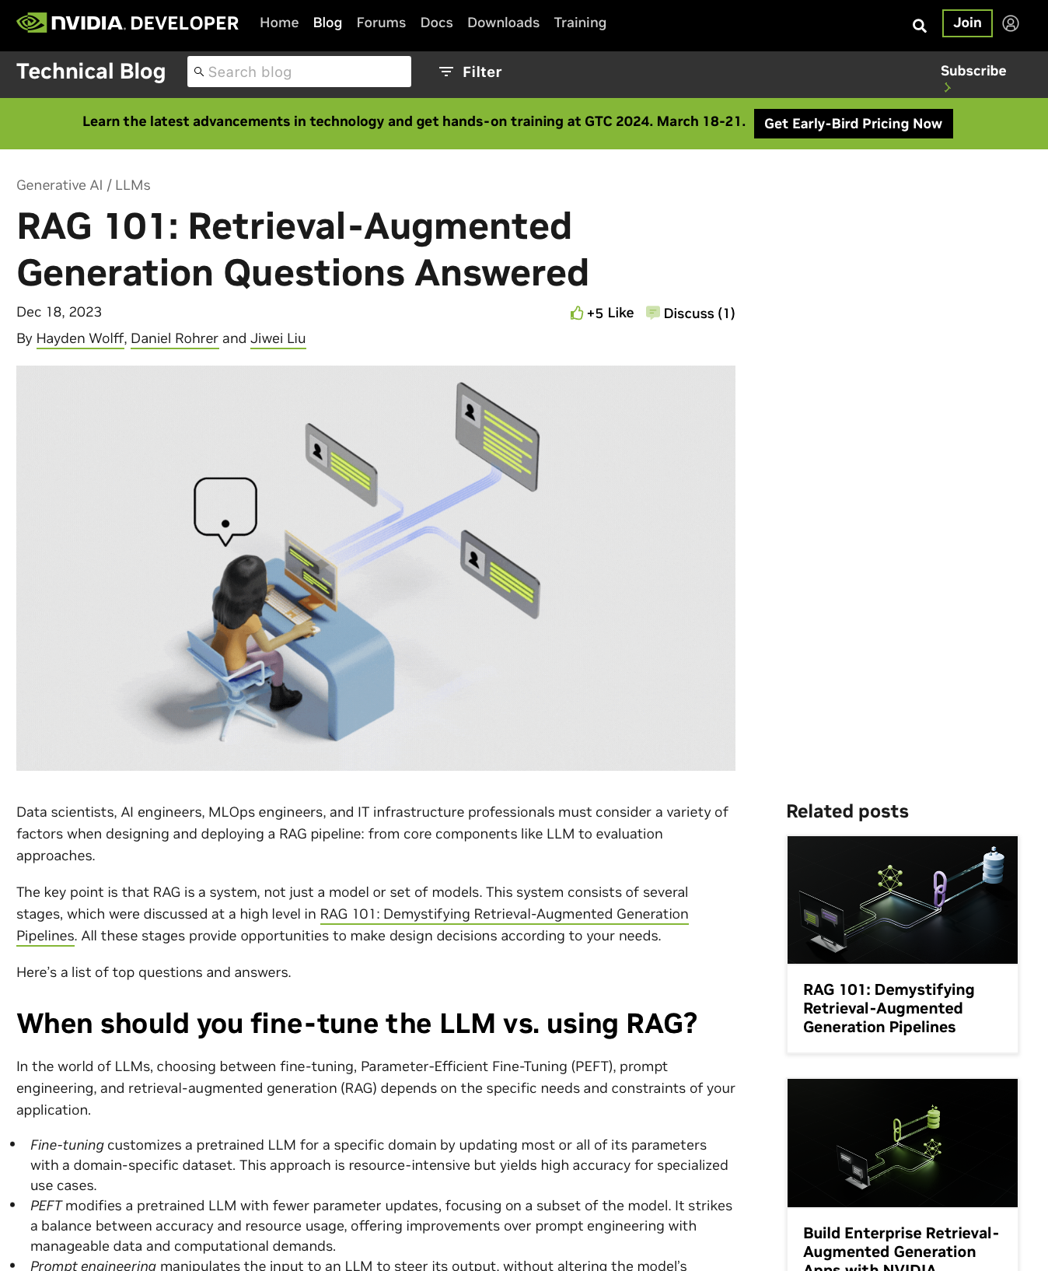
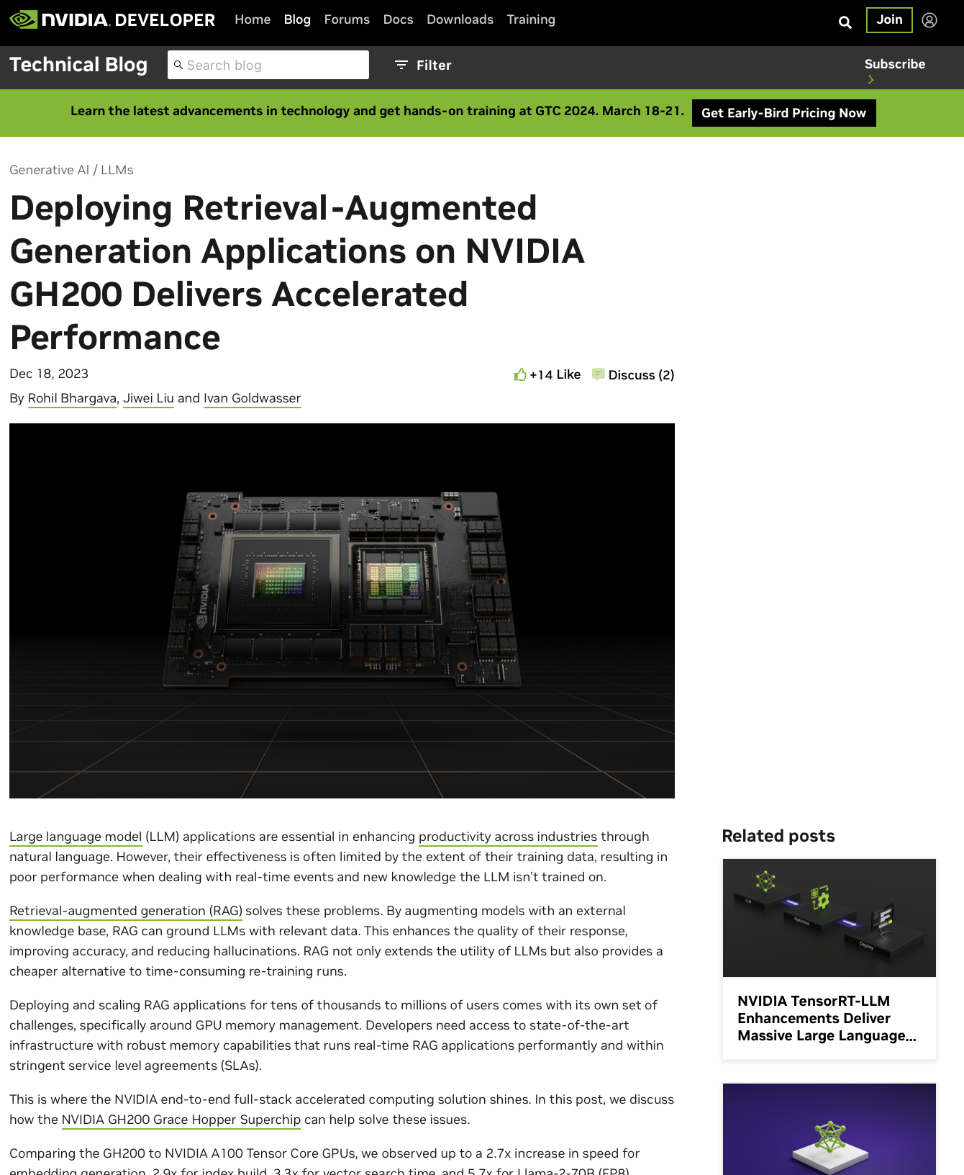
Document Reasoning
Sure, I can answer by referring this blog post!
Prompt
Context Question
LLM
https://developer.nvidia.com/blog/
Notes:
Reasoning about documents is great!
Why not feed documents into an LLM as context?
Use Case: Feed documents by default as a consistent context. Corporate knowledge base?
Use Case: Allow users to upload their own documents and use the data as context. Productivity tool?
Problem: How do we feed a document into our LLM?
Solution: Make connectors to convert to information-dense plaintext.
Problem: But what about for longer-form inputs? Can our LLM handle it? Can it still follow instructions? (Probably not)

Slide 117
Document Reasoning
Company
Database
Sure, I can answer by referring this blog post!
Prompt
Context Question
LLM
Notes:
Reasoning about documents is great!
Why not feed documents into an LLM as context?
Use Case: Feed documents by default as a consistent context. Corporate knowledge base?
Use Case: Allow users to upload their own documents and use the data as context. Productivity tool?
Problem: How do we feed a document into our LLM?
Solution: Make connectors to convert to information-dense plaintext.
Problem: But what about for longer-form inputs? Can our LLM handle it? Can it still follow instructions? (Probably not)

Slide 118
Document Reasoning
Company
Database
Sure, I can answer by referring this blog post!
Prompt
Context Question
LLM
Local files
Your Device
Notes:
Reasoning about documents is great!
Why not feed documents into an LLM as context?
Use Case: Feed documents by default as a consistent context. Corporate knowledge base?
Use Case: Allow users to upload their own documents and use the data as context. Productivity tool?
Problem: How do we feed a document into our LLM?
Solution: Make connectors to convert to information-dense plaintext.
Problem: But what about for longer-form inputs? Can our LLM handle it? Can it still follow instructions? (Probably not)

Slide 119
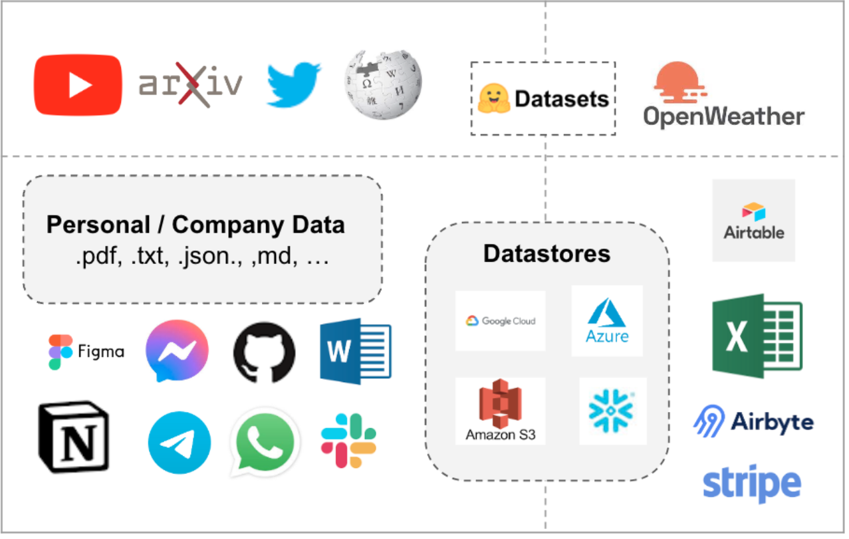
Document Reasoning
Company
Database
Sure, I can answer by referring this blog post!
Prompt
Context Question
LLM
Local files
Your Device
https://js.langchain.com/docs/use_cases/question_answering/
Notes:
Reasoning about documents is great!
Why not feed documents into an LLM as context?
Use Case: Feed documents by default as a consistent context. Corporate knowledge base?
Use Case: Allow users to upload their own documents and use the data as context. Productivity tool?
Problem: How do we feed a document into our LLM?
Solution: Make connectors to convert to information-dense plaintext.
Problem: But what about for longer-form inputs? Can our LLM handle it? Can it still follow instructions? (Probably not)

Slide 120

Document Reasoning
Company
Database
Prompt
Context……………………………………………………………………………………………………………………………………………………………………………………………………………………………………………………………………………………………………………………………………………………………………………………………Question
I forgot the instructions, but I can still say things
LLM
Local files
Your Device
https://js.langchain.com/docs/use_cases/question_answering/
https://d2l.ai/
Notes:
Reasoning about documents is great!
Why not feed documents into an LLM as context?
Use Case: Feed documents by default as a consistent context. Corporate knowledge base?
Use Case: Allow users to upload their own documents and use the data as context. Productivity tool?
Problem: How do we feed a document into our LLM?
Solution: Make connectors to convert to information-dense plaintext.
Problem: But what about for longer-form inputs? Can our LLM handle it? Can it still follow instructions? (Probably not)

Slide 121
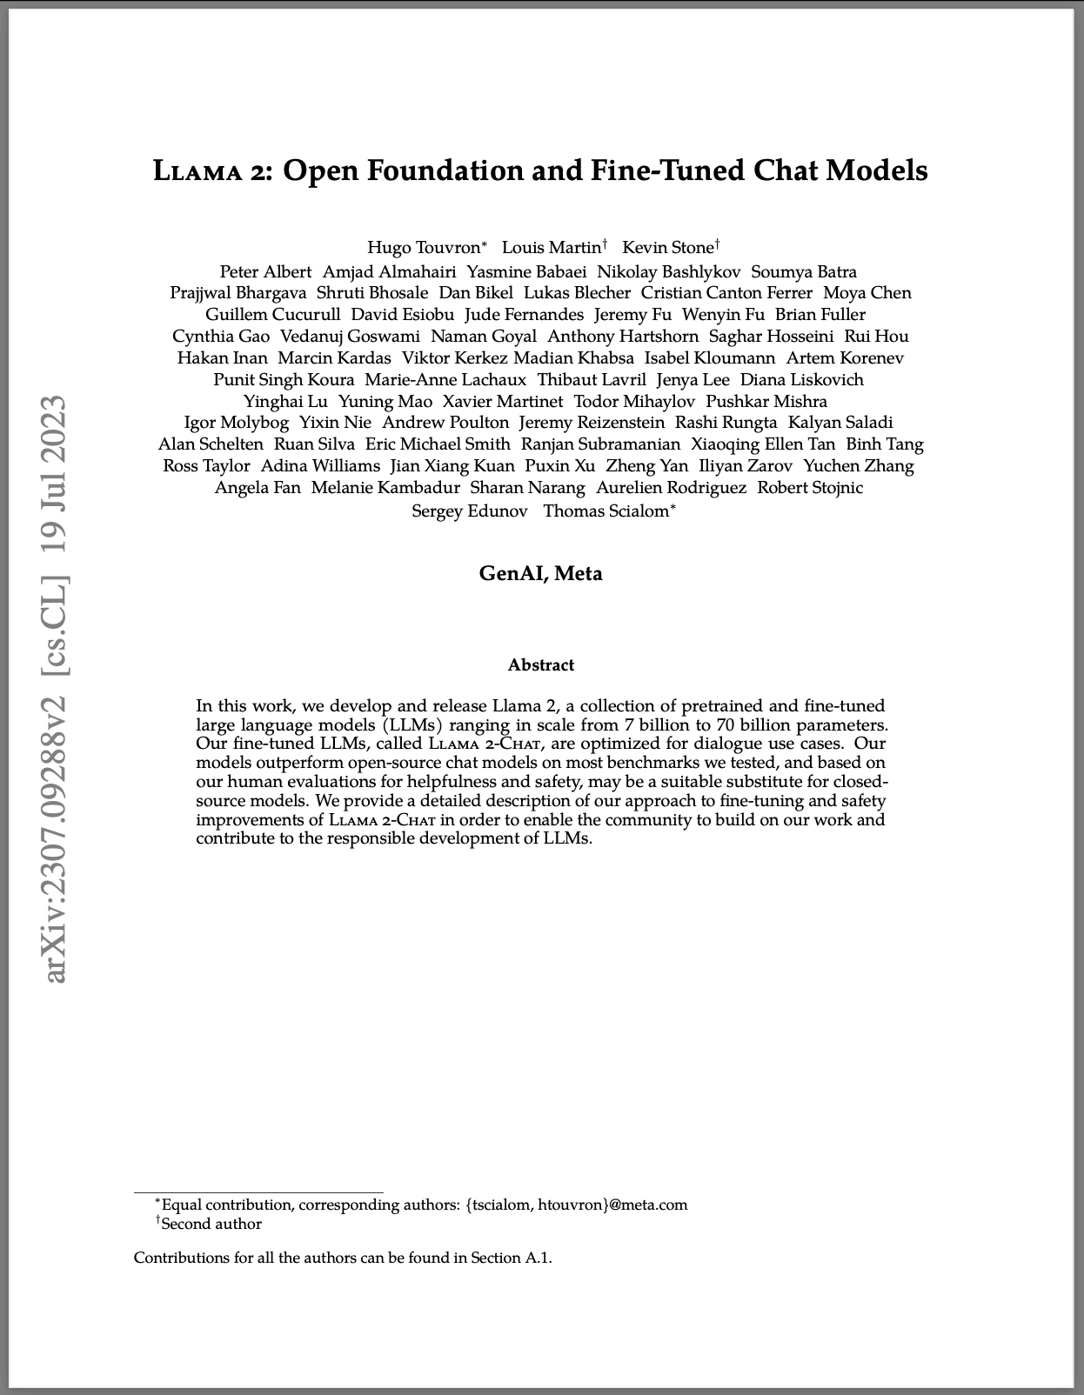
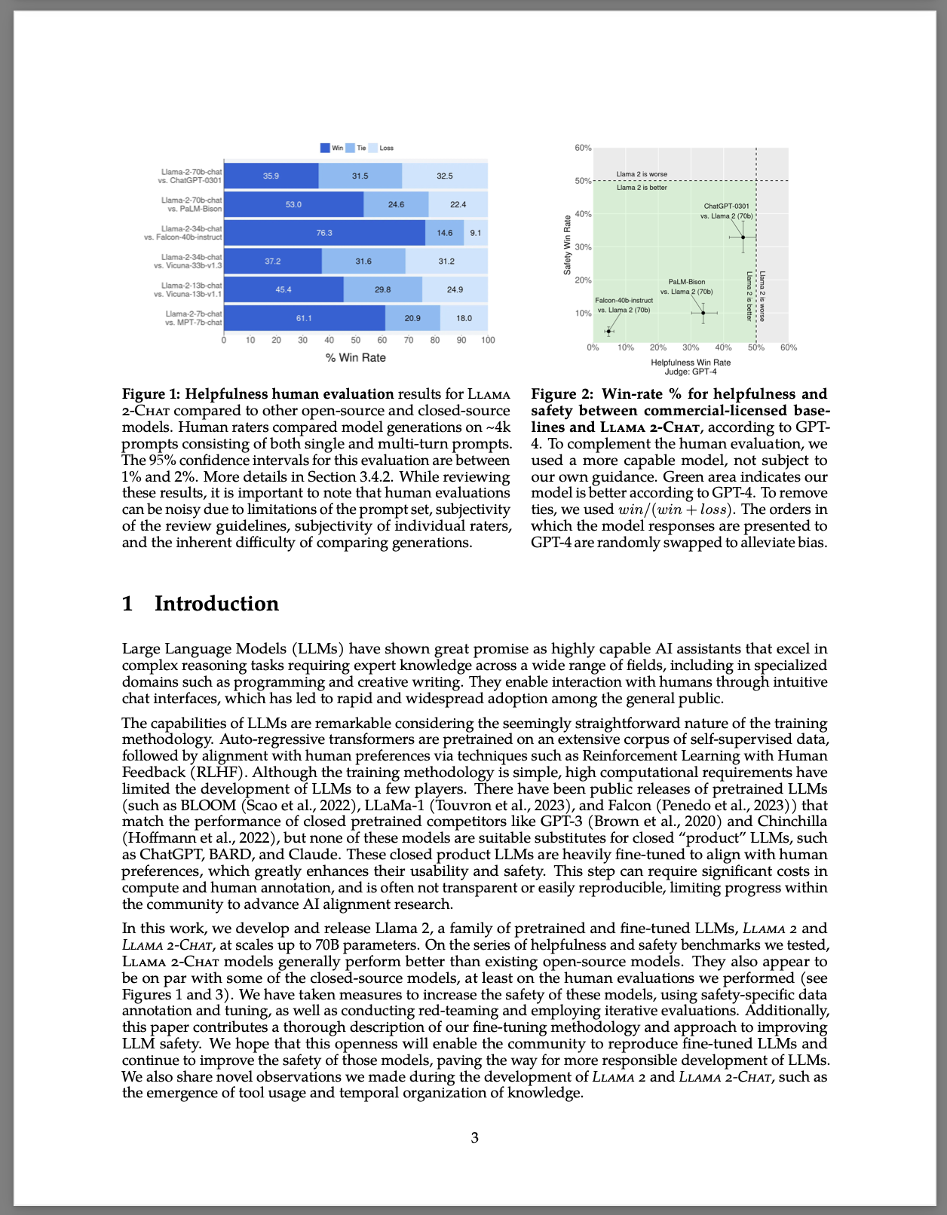
Chunking
https://arxiv.org/pdf/2307.09288.pdf
Notes:
Problem: But what about for longer-form inputs? Can our LLM handle it? Can it still follow instructions? (Probably not)
Strategies:
Chunking: Dividing long documents into smaller pieces. Then, a subset (several? one?) can be fed to an LLM as context.
Stuffing: If you have smaller documents, you can feed multiple into your context, but you’ll soon run out of room…
Map Reduce: We could just try to make all of the chunks smaller? Maybe a same “give the main idea” chain or a “coerce into smaller chunks” chain? Just a single uniform
Refinement: We could also iterate through the chunks and try to get a cumulative summary, synthesis, etc.
Knowledge Graph: Create multiple refinements and you can create logical groupings and organize them into a hierarchy.
Example of traversing the hierarchy

Slide 122
Document Stuffing
Prompt
(DOCS 1-4)
Use Them Please
Question
Oh yes, the intro tells me everything! You see…
LLM
https://arxiv.org/pdf/2307.09288.pdf
Notes:
Problem: But what about for longer-form inputs? Can our LLM handle it? Can it still follow instructions? (Probably not)
Strategies:
Chunking: Dividing long documents into smaller pieces. Then, a subset (several? one?) can be fed to an LLM as context.
Stuffing: If you have smaller documents, you can feed multiple into your context, but you’ll soon run out of room…
Map Reduce: We could just try to make all of the chunks smaller? Maybe a same “give the main idea” chain or a “coerce into smaller chunks” chain? Just a single uniform
Refinement: We could also iterate through the chunks and try to get a cumulative summary, synthesis, etc.
Knowledge Graph: Create multiple refinements and you can create logical groupings and organize them into a hierarchy.
Example of traversing the hierarchy

Slide 123
Map Reduce Chain
Smaller Chunk
Prompt
Useful Info
LLM
Smaller Chunk
Smaller Chunk
⠇
https://arxiv.org/pdf/2307.09288.pdf
Notes:
Problem: But what about for longer-form inputs? Can our LLM handle it? Can it still follow instructions? (Probably not)
Strategies:
Chunking: Dividing long documents into smaller pieces. Then, a subset (several? one?) can be fed to an LLM as context.
Stuffing: If you have smaller documents, you can feed multiple into your context, but you’ll soon run out of room…
Map Reduce: We could just try to make all of the chunks smaller? Maybe a same “give the main idea” chain or a “coerce into smaller chunks” chain? Just a single uniform operation.
Refinement: We could also iterate through the chunks and try to get a cumulative summary, synthesis, etc.
Knowledge Graph: Create multiple refinements and you can create logical groupings and organize them into a hierarchy.
Example of traversing the hierarchy

Slide 124
Refinement Chain
Top 10 Chunks
for doc in docs:
yield doc
Prompt
Useful Info
LLM
Summary
Main Ideas
https://arxiv.org/pdf/2307.09288.pdf
Notes:
Problem: But what about for longer-form inputs? Can our LLM handle it? Can it still follow instructions? (Probably not)
Strategies:
Chunking: Dividing long documents into smaller pieces. Then, a subset (several? one?) can be fed to an LLM as context.
Stuffing: If you have smaller documents, you can feed multiple into your context, but you’ll soon run out of room…
Map Reduce: We could just try to make all of the chunks smaller? Maybe a same “give the main idea” chain or a “coerce into smaller chunks” chain? Just a single uniform
Refinement: We could also iterate through the chunks and try to get a cumulative summary, synthesis, etc.
Knowledge Graph: Create multiple refinements and you can create logical groupings and organize them into a hierarchy.
Example of traversing the hierarchy

Slide 125
Knowledge Graph Construction
Abstraction Main Ideas
Prompt
Useful Constructs
LLM
Abstractions
for doc in docs:
yield doc
Prompt
Chapter Logic
LLM
Chapters
Per-Chapter Main Ideas
Prompt
Character Information
LLM
Names
Identity Key Points
https://blog.langchain.dev/using-a-knowledge-graph-to-implement-a-devops-rag-application/
Notes:
Problem: But what about for longer-form inputs? Can our LLM handle it? Can it still follow instructions? (Probably not)
Strategies:
Chunking: Dividing long documents into smaller pieces. Then, a subset (several? one?) can be fed to an LLM as context.
Stuffing: If you have smaller documents, you can feed multiple into your context, but you’ll soon run out of room…
Map Reduce: We could just try to make all of the chunks smaller? Maybe a same “give the main idea” chain or a “coerce into smaller chunks” chain? Just a single uniform
Refinement: We could also iterate through the chunks and try to get a cumulative summary, synthesis, etc.
Knowledge Graph: Create multiple refinements and you can create logical groupings and organize them into a hierarchy.
Example of traversing the hierarchy

Slide 126
Knowledge Graph Traversal
Abstraction Main Ideas
How does Flying work according to your book?
Abstractions
Prompt
Find Info
LLM
Chapters
Per-Chapter Main Ideas
Prompt
Use Info
LLM
Names
Sure! From the chapter on Birds, I can tell you…
Identity Key Points
https://blog.langchain.dev/using-a-knowledge-graph-to-implement-a-devops-rag-application/
Notes:
Problem: But what about for longer-form inputs? Can our LLM handle it? Can it still follow instructions? (Probably not)
Strategies:
Chunking: Dividing long documents into smaller pieces. Then, a subset (several? one?) can be fed to an LLM as context.
Stuffing: If you have smaller documents, you can feed multiple into your context, but you’ll soon run out of room…
Map Reduce: We could just try to make all of the chunks smaller? Maybe a same “give the main idea” chain or a “coerce into smaller chunks” chain? Just a single uniform
Refinement: We could also iterate through the chunks and try to get a cumulative summary, synthesis, etc.
Knowledge Graph: Create multiple refinements and you can create logical groupings and organize them into a hierarchy.
Example of traversing the hierarchy via agent actions

Slide 127
Refinement Chain
Your Assignment
Top 10 Chunks
for doc in docs:
yield doc
Prompt
Useful Info
LLM
Summary
Main Ideas
https://arxiv.org/pdf/2307.09288.pdf
Notes:
Anyways, those are all things you can do, so what will you be doing? In the notebook, we’ll focus more on refinement, since it’s a great entryway into long-form document processing.
We’ll try to implement a running chain that packages up a while loop to generate a running summary of a longer-form document.
(Tangent Slide) Of note, LangGraph is a first-class-supported framework to abstract the while loop and running state enforcement behind a graph-like structure.
We won’t go into it here, but it is very well-liked for multi-agent workflows and for being somewhat standardizing.
In this notebook, you’ll be implementing the enforcement and while loop manually, so you’ll already understand what’s going on behind the scenes in LangGraph when you get around to it!
Author Note: In the near future, it may not be necessary to do refinement on most documents. But it will be required for human-intuitive knowledge graph construction over larger datasets. Like in the previous slide.

Slide 128
Refinement Chain
Your Assignment
RunnableLambda
for doc in docs:
yield doc
Prompt
Useful Info
LLM
Summary
https://arxiv.org/pdf/2307.09288.pdf
Notes:
Anyways, those are all things you can do, so what will you be doing? In the notebook, we’ll focus more on refinement, since it’s a great entryway into long-form document processing.
We’ll try to implement a running chain that packages up a while loop to generate a running summary of a longer-form document.
(Tangent Slide) Of note, LangGraph is a first-class-supported framework to abstract the while loop and running state enforcement behind a graph-like structure.
We won’t go into it here, but it is very well-liked for multi-agent workflows and for being somewhat standardizing.
In this notebook, you’ll be implementing the enforcement and while loop manually, so you’ll already understand what’s going on behind the scenes in LangGraph when you get around to it!
Author Note: In the near future, it may not be necessary to do refinement on most documents. But it will be required for human-intuitive knowledge graph construction over larger datasets. Like in the previous slide.

Slide 129
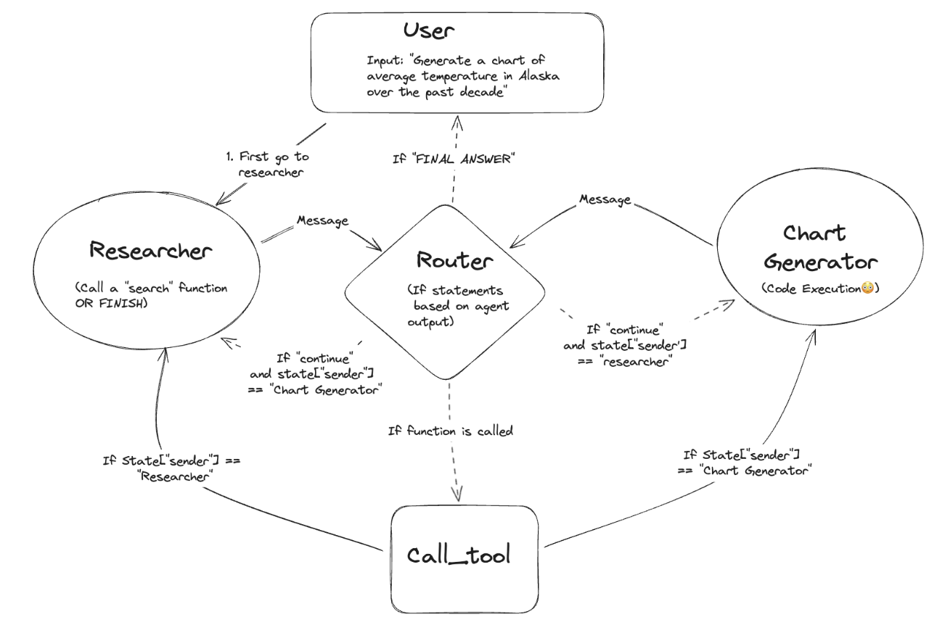
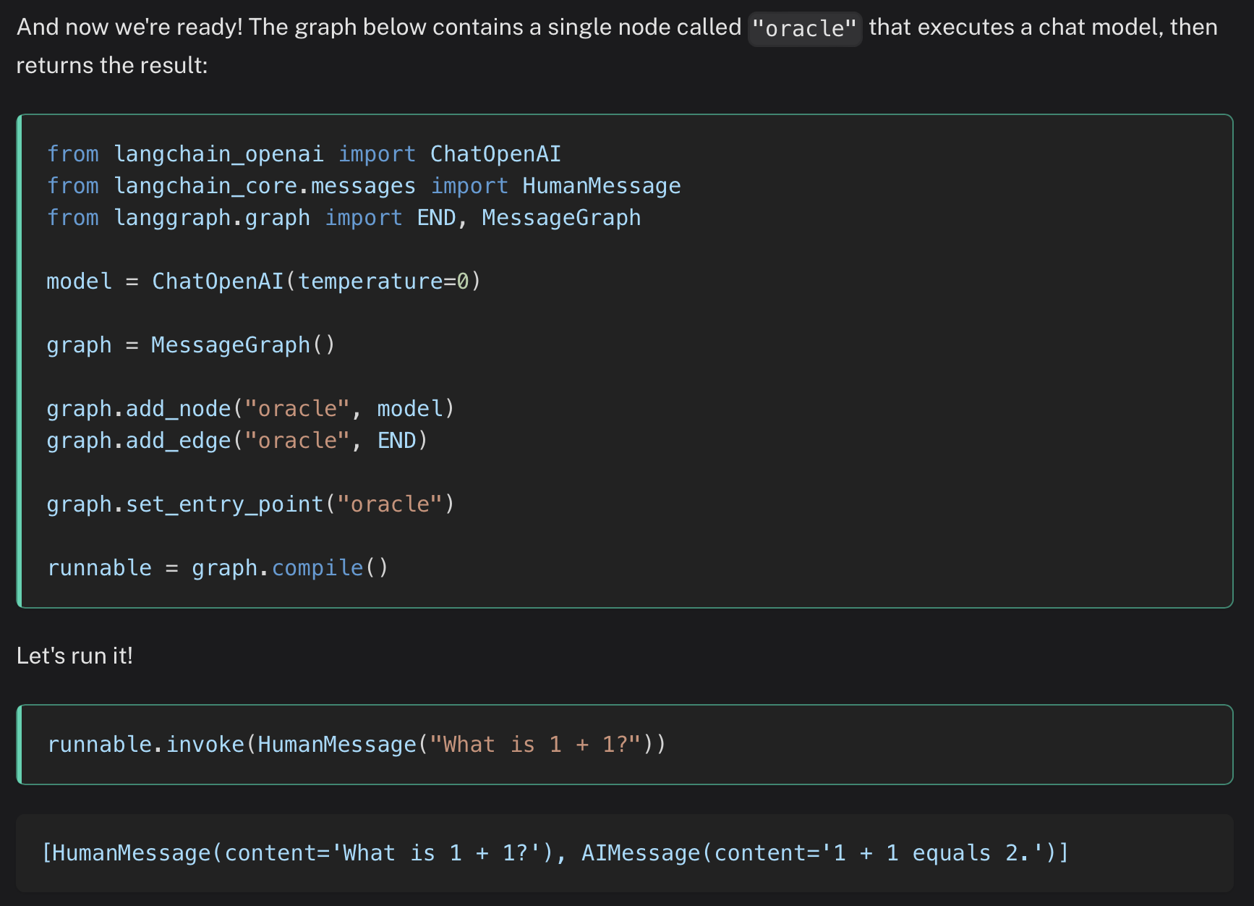
Optional Tangent: LangGraph
https://python.langchain.com/docs/langgraph/
https://blog.langchain.dev/langgraph-multi-agent-workflows/
Notes:
Anyways, those are all things you can do, so what will you be doing? In the notebook, we’ll focus more on refinement, since it’s a great entryway into long-form document processing.
We’ll try to implement a running chain that packages up a while loop to generate a running summary of a longer-form document.
(Tangent Slide) Of note, LangGraph is a popular framework to abstract the while loop and running state enforcement behind a graph-like structure.
We won’t go into it here, but it is very well-liked for multi-agent workflows and for being somewhat standardizing.
In this notebook, you’ll be implementing the enforcement and while loop manually, so you’ll already understand what’s going on behind the scenes in LangGraph when you get around to it!
Author Note: In the near future, it may not be necessary to do refinement on most documents. But it will be required for human-intuitive knowledge graph construction over larger datasets. Like in the previous slide.

Slide 130
Refinement Chain
Your Assignment
RunnableLambda
for doc in docs:
yield doc
Prompt
Useful Info
LLM
Summary
https://arxiv.org/pdf/2307.09288.pdf
Notes:
Anyways, those are all things you can do, so what will you be doing? In the notebook, we’ll focus more on refinement, since it’s a great entryway into long-form document processing.
We’ll try to implement a running chain that packages up a while loop to generate a running summary of a longer-form document.
(Tangent Slide) Of note, LangGraph is a first-class-supported framework to abstract the while loop and running state enforcement behind a graph-like structure.
We won’t go into it here, but it is very well-liked for multi-agent workflows and for being somewhat standardizing.
In this notebook, you’ll be implementing the enforcement and while loop manually, so you’ll already understand what’s going on behind the scenes in LangGraph when you get around to it!
Good Luck!
Author Note: In the near future, it may not be necessary to do refinement on most documents. But it will be required for human-intuitive knowledge graph construction over larger datasets. Like in the previous slide.

Slide 131
Building RAG Agents with LLMs
Part 6: Embedding Model for Retrieval
Notes:
Coming up:
Last time, we learned a good bit about document intake and a little bit about using LLMs to navigate a hierarchy.
PROBLEMS:
This requires a lot of inference steps and can run into errors.
This requires a lot of preprocessing with strong various assumptions about what is important.
What we want:
A relatively simple pipeline where we ask our agent something, it pulls in “relevant” material from a database, and it uses it!
Solution: What if we didn’t need to use an expensive autoregressive model to retrieve our documents?
Back To Basics:
Recall that transformers come in several default configurations (encoders and decoders)
So why don’t we use encoders to encode our documents, and retrieve using embedding similarity?

Slide 132
Knowledge Graph Traversal
Abstraction Main Ideas
How does Flying work according to your book?
Abstractions
Prompt
Find Info
LLM
Chapters
Per-Chapter Main Ideas
Prompt
Use Info
LLM
Names
Sure! From the chapter on Birds, I can tell you…
Identity Key Points
https://blog.langchain.dev/using-a-knowledge-graph-to-implement-a-devops-rag-application/
Notes:
Last time, we learned a good bit about document intake and a little bit about using LLMs to navigate a hierarchy.
PROBLEMS:
This requires a lot of inference steps and can run into errors.
This requires a lot of preprocessing with strong various assumptions about what is important.
What we want:
A relatively simple pipeline where we ask our agent something, it pulls in “relevant” material from a database, and it uses it!
Solution: What if we didn’t need to use an expensive autoregressive model to retrieve our documents?
Back To Basics:
Recall that transformers come in several default configurations (encoders and decoders)
So why don’t we use encoders to encode our documents, and retrieve using embedding similarity?

Slide 133
Modern Chain Paradigms
Towards Powerful Running State
Prompt
LLM
Unstructured Generation
Prompt
Code
LLM
Environment
Structured Retrieval
Input
Prompt
LLM
???
Unstructured Retrieval
Unstructured Retrieval
Notes:
Last time, we learned a good bit about document intake and a little bit about using LLMs to navigate a hierarchy.
PROBLEMS:
This requires a lot of inference steps and can run into errors.
This requires a lot of preprocessing with strong various assumptions about what is important.
What we want:
A relatively simple pipeline where we ask our agent something, it pulls in “relevant” material from a database, and it uses it!
Solution: What if we didn’t need to use an expensive autoregressive model to retrieve our documents?
Back To Basics:
Recall that transformers come in several default configurations (encoders and decoders)
So why don’t we use encoders to encode our documents, and retrieve using embedding similarity?

Slide 134
Modern Chain Paradigms
Towards Powerful Running State
Prompt
LLM
Unstructured Generation
Prompt
Code
LLM
Environment
Structured Retrieval
Input
Prompt
LLM
Vector
Database
Unstructured Retrieval
Unstructured Retrieval
Notes:
Last time, we learned a good bit about document intake and a little bit about using LLMs to navigate a hierarchy.
PROBLEMS:
This requires a lot of inference steps and can run into errors.
This requires a lot of preprocessing with strong various assumptions about what is important.
What we want:
A relatively simple pipeline where we ask our agent something, it pulls in “relevant” material from a database, and it uses it!
Solution: What if we didn’t need to use an expensive autoregressive model to retrieve our documents? Why not use an embedding model?
Back To Basics:
Recall that transformers come in several default configurations (encoders and decoders)
So why don’t we use encoders to encode our documents, and retrieve using embedding similarity?

Slide 135
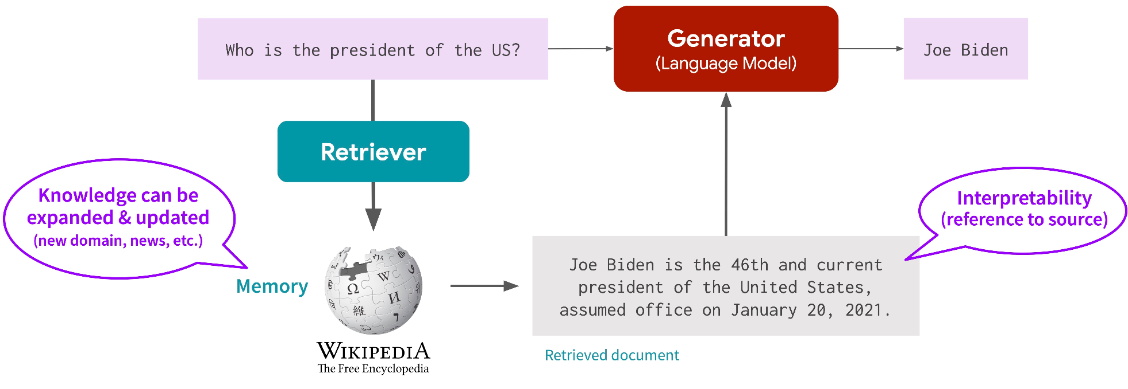
Retrieval-Augmented Generation
Pulling in Information from a Database
https://www.nvidia.com/en-us/training/instructor-led-workshops/rapid-application-development-using-large-language-models/
https://cs.stanford.edu/~myasu/blog/racm3/
Notes:
Feel free to introduce RAG early if you want.

Slide 136

Transformer Architecture
Primary Backbone of LLMs
Element-Wise Feed-Forward
Element-Wise Feed-Forward
Sequence Attention Interface
Sequence Attention Interface
Element-Wise Feed-Forward
Element-Wise Feed-Forward
https://arxiv.org/pdf/1706.03762.pdf
Notes:
What we want:
A relatively simple pipeline where we ask our agent something, it pulls in “relevant” material from a database, and it uses it!
Solution: What if we didn’t need to use an expensive autoregressive model to retrieve our documents?
Back To Basics:
Recall that transformers come in several default configurations (encoders for embedding and decoders for autoregression).
Decoders are the structures used in autoregressive generation. They have unidirectional reasoning and are expected to work well for long-form generation, so they also need to be quite powerful.
Encoders are the structures used in embedding passages with bidirectional reasoning. They don’t need to have good autoregressive (long-horizon with accumulating error) generation, so they can be smaller and faster.
So why don’t we use encoders to encode our documents, and retrieve using embedding similarity?

Slide 137

Transformer Architecture
Autoregressing vs Embedding Flavors
Notes:
What we want:
A relatively simple pipeline where we ask our agent something, it pulls in “relevant” material from a database, and it uses it!
Solution: What if we didn’t need to use an expensive autoregressive model to retrieve our documents?
Back To Basics:
Recall that transformers come in several default configurations (encoders for embedding and decoders for autoregression).
Decoders are the structures used in autoregressive generation. They have unidirectional reasoning and are expected to work well for long-form generation, so they also need to be quite powerful.
Encoders are the structures used in embedding passages with bidirectional reasoning. They don’t need to have good autoregressive (long-horizon with accumulating error) generation, so they can be smaller and faster.
So why don’t we use encoders to encode our documents, and retrieve using embedding similarity?

Slide 138

Transformer Architecture
Autoregressing vs Embedding Flavors
Notes:
What we want:
A relatively simple pipeline where we ask our agent something, it pulls in “relevant” material from a database, and it uses it!
Solution: What if we didn’t need to use an expensive autoregressive model to retrieve our documents?
Back To Basics:
Recall that transformers come in several default configurations (encoders for embedding and decoders for autoregression).
Decoders are the structures used in autoregressive generation. They have unidirectional reasoning and are expected to work well for long-form generation, so they also need to be quite powerful.
Encoders are the structures used in embedding passages with bidirectional reasoning. They don’t need to have good autoregressive (long-horizon with accumulating error) generation, so they can be smaller and faster.
So why don’t we use encoders to encode our documents, and retrieve using embedding similarity?

Slide 139


Retrieval QA Embedding
Asymmetric Query/Document Model
https://catalog.ngc.nvidia.com/orgs/nvidia/teams/ai-foundation/models/nvolve-29k/api
Notes:
So why don’t we use encoders to encode our documents, and retrieve using embedding similarity?
We have models just for that, which can accept passages and generate useful vector embeddings.
Given a selection of passages that you want to consider (i.e. example phrases, document pool, etc)...
…Use a use-case-specific embedding model to encode them into vectors…
…and the embeddings should capture semantic properties which can be reasoned about.

Slide 140
Embedding and Comparing
Querying for Semantically Similar Entries
High-performance computing.
Happy Holidays!
DLSS Gaming Statistics
Any cool video games lately?
Biological vision structure
What’s with GPUs these days?
Mitochondria, powerhouse
https://developer.nvidia.com/blog/accelerating-vector-search-using-gpu-powered-indexes-with-rapids-raft/
Notes:
So why don’t we use encoders to encode our documents, and retrieve using embedding similarity?
We have models just for that, which can accept passages and generate useful vector embeddings.
Given a selection of passages that you want to consider (i.e. example phrases, document pool, etc)...
…Use a use-case-specific embedding model to encode them into vectors…
…and the embeddings should capture semantic properties which can be reasoned about.

Slide 141

Embedding and Comparing
Querying for Semantically Similar Entries
High-performance computing.
Happy Holidays!
DLSS Gaming Statistics
Any cool video games lately?
Biological vision structure
What’s with GPUs these days?
Mitochondria, powerhouse
https://developer.nvidia.com/blog/accelerating-vector-search-using-gpu-powered-indexes-with-rapids-raft/
Notes:
So why don’t we use encoders to encode our documents, and retrieve using embedding similarity?
We have models just for that, which can accept passages and generate useful vector embeddings.
Given a selection of passages that you want to consider (i.e. example phrases, document pool, etc)...
…Use a use-case-specific embedding model to encode them into vectors…
…and the embeddings should capture semantic properties which can be reasoned about.

Slide 142

Embedding and Comparing
Querying for Semantically Similar Entries
High-performance computing.
Happy Holidays!
DLSS Gaming Statistics
Any cool video games lately?
Biological vision structure
What’s with GPUs these days?
Mitochondria, powerhouse
https://developer.nvidia.com/blog/accelerating-vector-search-using-gpu-powered-indexes-with-rapids-raft/
Notes:
So why don’t we use encoders to encode our documents, and retrieve using embedding similarity?
We have models just for that, which can accept passages and generate useful vector embeddings.
Given a selection of passages that you want to consider (i.e. example phrases, document pool, etc)...
…Use a use-case-specific embedding model to encode them into vectors…
…and the embeddings should capture semantic properties which can be reasoned about.

Slide 143



Embedding Spaces
Learned Semantically Dense Values
https://queenscompsci.wordpress.com/2018/03/04/interpolation-in-the-latent-space-of-variational-autoencoders/
https://en.wikipedia.org/wiki/T-distributed_stochastic_neighbor_embedding
https://ichko.github.io/visualizing-vae-with-efemarai
Notes:
Optional Slide: Feel free to nerd out about embedding space theory if you’re interested. Slide can be used to connect to MNIST/DL Fundamentals.

Slide 144
Language Embedding Schemes
Bi-Encoder versus Cross-Encoder
Embedding
Reranker
Bi-Encoder
Cross-Encoder
Cosine-Similarity
u
v
Classifier
Encoder
Encoder
Encoder
Passage 1
Passage 2
Passage 1
Passage 2
https://www.sbert.net/examples/applications/cross-encoder/README.html
Notes:
Embedding Model flavors of interest:
Bi-encoder formulations rely on cosine similarity (same or different encoders used to produce synergized vectors). Deep learning part doesn’t reason about both inputs, but vectors can be pre-computed.
Cross-Encoder formulations take two (or more) passages and produce a classification through an end-to-end deep learning pipeline. Scale worse (since you can’t pre-compute vectors) but allows encoder to reason about both passages at the same time. Powerful, but use sparingly.
Useful for re-ranking (classifying priority among multiple documents)
(next, symmetric vs asymmetric/generalized definitions)

Slide 145

Language Embedding Schemes
Symmetric versus Asymmetric
Symmetric
Asymmetric/Generalized
Cosine-Similarity
u
v
Encoder 1
Encoder 1
Passage 1
Passage 2
https://www.sbert.net/examples/applications/cross-encoder/README.html
https://cs.stanford.edu/~myasu/blog/racm3/
Notes:
Embedding Model flavors of interest:
Symmetric means all the inputs are embedded using the same embedding strategy.
Asymmetric means there are different embedding models/strategies depending on the input type.
i.e. “query” vs “document” pathway
In general, the only requirement is that the output of the different embedding strategies is synergized such that things that you need to be similar end up being similar! Exactly how CLIP works, which is an

Slide 146
Language Embedding Schemes
Generalized Definition
https://cs.stanford.edu/~myasu/blog/racm3/
Notes:
Embedding Model flavors of interest:
Symmetric means all the inputs are embedded using the same embedding strategy.
Asymmetric means there are different embedding models/strategies depending on the input type.
i.e. “query” vs “document” pathway
In general, the only requirement is that the output of the different embedding strategies is synergized such that things that you need to be similar end up being similar! Exactly how CLIP works, which is an image encoder and a text encoder that are synergized to output the same embedding for image-caption pairs.

Slide 147
Embedding and Comparing
Querying for Semantically Similar Entries
High-performance computing.
Happy Holidays!
DLSS Gaming Statistics
Any cool video games lately?
Biological vision structure
What’s with GPUs these days?
Mitochondria, powerhouse
https://developer.nvidia.com/blog/accelerating-vector-search-using-gpu-powered-indexes-with-rapids-raft/
Notes:
For the purposes of this notebook, understanding the embedding model’s properties should be good enough! Namely:
It can embed natural language into a semantic space
The semantic space can be reasoned with to find similarities (or differences, or just properties).
Author’s Notes: Depending on the audience, you may want to walk through notebook 06 yourself and just have students do 64_guardrails by themselves after presenting the next section. Your call.

Slide 148
Building RAG Agents with LLMs
Part 6.4: Guardrails

Slide 149
Embedding and Comparing
Querying for Semantically Similar Entries
High-performance computing.
Happy Holidays!
DLSS Gaming Statistics
Any cool video games lately?
Biological vision structure
What’s with GPUs these days?
Mitochondria, powerhouse
https://developer.nvidia.com/blog/accelerating-vector-search-using-gpu-powered-indexes-with-rapids-raft/
Notes:
In the previous section, you got familiar with the code syntax and prior assumptions of embedding models.
For part 6.4, you’ll get the opportunity to put this API to the test using to implement an “input guardrail”
One of several types of guardrails (output guardrails and topic guardrails also quite common).
Some simple ones rely on raw prompt engineering or zero-shot classification with generative models, you but can actually do it pretty easily by creating a classifier off of a known-useful embedding model.

Slide 150
Semantic Guardrails
Illegal Topics
Irrelevant Questions
Prompt
Answer Please Question
How’s the weather?
No. I shouldn’t answer that
Classifier
Branch
LLM
Prompt
Don’t Answer question
Tell me about GPUs
What’s an LLM Service
What’s a good game with RTX?
Notes:
In the previous section, you got familiar with the code syntax and prior assumptions of embedding models.
For part 6.4, you’ll get the opportunity to put this API to the test using to implement an “input guardrail”
One of several types of guardrails (output guardrails and topic guardrails also quite common).
Some simple ones rely on raw prompt engineering or zero-shot classification with generative models, you but can actually do it pretty easily by creating a classifier off of a known-useful embedding model.
How will this be done?
Given a curated set of good and bad example inputs…
… embed all of them to generate semantically-dense vectors…
… and train a classifier to go from embedding to classification (using supervised machine learning/deep learning)
If the embeddings are good for general reasoning, this is usually easy enough to do with classical logistic regression or a shallow network.

Slide 151
Embedding Classification
Classifying with embeddings
Illegal Topics
Irrelevant Questions
Tell me about GPUs
What’s an LLM Service
What’s a good game with RTX?
https://developer.nvidia.com/blog/accelerating-vector-search-using-gpu-powered-indexes-with-rapids-raft/
Notes:
For part 6.4, you’ll get the opportunity to put this API to the test using to implement an “input guardrail”
How will this be done?
Given a curated set of good and bad example inputs…
… embed all of them to generate semantically-dense vectors…
… and train a classifier to go from embedding to classification (using supervised machine learning/deep learning)
If the embeddings are good for general reasoning, this is usually easy enough to do with classical logistic regression or a shallow network.

Slide 152

Embedding Classification
Classifying with embeddings
Illegal Topics
Irrelevant Questions
Tell me about GPUs
What’s an LLM Service
What’s a good game with RTX?
https://developer.nvidia.com/blog/accelerating-vector-search-using-gpu-powered-indexes-with-rapids-raft/
Notes:
For part 6.4, you’ll get the opportunity to put this API to the test using to implement an “input guardrail”
How will this be done?
Given a curated set of good and bad example inputs…
… embed all of them to generate semantically-dense vectors…
… and train a classifier to go from embedding to classification (using supervised machine learning/deep learning)
If the embeddings are good for general reasoning, this is usually easy enough to do with classical logistic regression or a shallow network.

Slide 153

Embedding Classification
Classifying with embeddings
Illegal Topics
Classification Head
Irrelevant Questions
0 or 1?
Tell me about GPUs
What’s an LLM Service
What’s a good game with RTX?
https://developer.nvidia.com/blog/accelerating-vector-search-using-gpu-powered-indexes-with-rapids-raft/
Notes:
For part 6.4, you’ll get the opportunity to put this API to the test using to implement an “input guardrail”
How will this be done?
Given a curated set of good and bad example inputs…
… embed all of them to generate semantically-dense vectors…
… and train a classifier to go from embedding to classification (using using supervised machine learning/deep learning)
If the embeddings are good for general reasoning, this is usually easy enough to do with classical logistic regression or a shallow network.
And that’s it! You have a classifier branch!

Slide 154
Semantic Guardrails
Illegal Topics
Irrelevant Questions
Prompt
Answer Please Question
How’s the weather?
No. I shouldn’t answer that
Classifier
Branch
LLM
Prompt
Don’t Answer question
Tell me about GPUs
What’s an LLM Service
What’s a good game with RTX?
Notes:
For part 6.4, you’ll get the opportunity to put this API to the test using to implement an “input guardrail”
How will this be done? Given a curated set of good and bad example inputs, embed all of them to generate semantically-dense vectors, and train a classifier to go from embedding to classification.
And that’s it! You have a classifier branch!
You could use this as a hard gating mechanism to stop or route the dialog, or the value could be injected directly into a prompt to request special kind of logic from your LLM. It can also be used to aggregate statistics and move conversations accordingly.
In our case, we will use it to route between two kinds of prompts; one that tries to help, and another that tries to NOT help and explain why.
Good luck! In the next section, we will be using a similar logic for document retrieval and will implement RAG from scratch.

Slide 155
Building RAG Agents with LLMs
Part 7: Document Retrieval with Vector Databases

Slide 156
Embedding and Comparing
Querying for Semantically Similar Entries
High-performance computing.
Happy Holidays!
DLSS Gaming Statistics
Any cool video games lately?
Biological vision structure
What’s with GPUs these days?
Mitochondria, powerhouse
https://developer.nvidia.com/blog/accelerating-vector-search-using-gpu-powered-indexes-with-rapids-raft/
Notes:
So now we know how embeddings work, how can we use embeddings for retrieval?
If we assume our embeddings are useful for identifying similarity between passages…
… then we can go ahead and embed our documents into a container, and then embed questions as queries to the container!
How hard is it?
Not very hard at all! Very automatic!
In this code, you can see that a vector store is pre-loaded with all of the documents…
…and a store is interpreted as a retriever (produces an API that you can query)...
…which allows you to put in a new entry, embed it on the fly, and run a comparison to return relevant information.

Slide 157
Retrieval-Augmented Generation
Pulling in Information from a Database
https://www.nvidia.com/en-us/training/instructor-led-workshops/rapid-application-development-using-large-language-models/
https://cs.stanford.edu/~myasu/blog/racm3/
Notes:
So now we know how embeddings work, how can we use embeddings for retrieval?
If we assume our embeddings are useful for identifying similarity between passages…
… then we can go ahead and embed our documents into a container, and then embed questions as queries to the container!
How hard is it?
Not very hard at all! Very automatic!
In this code, you can see that a vector store is pre-loaded with all of the documents…
…and a store is interpreted as a retriever (produces an API that you can query)...
…which allows you to put in a new entry, embed it on the fly, and run a comparison to return relevant information.

Slide 158
Retrieval QA Embedding
Asymmetric Query/Document Model
https://catalog.ngc.nvidia.com/orgs/nvidia/teams/ai-foundation/models/nvolve-29k/api
Notes:
So now we know how embeddings work, so how can we use embeddings for retrieval?
If we assume our embeddings are useful for identifying similarity between passages…
… then we can go ahead and embed our documents into a container, and then embed questions as queries to the container!
How hard is it?
Not very hard at all! Very automatic!
In this code, you can see that a vector store is pre-loaded with all of the documents…
…and a store is interpreted as a retriever (produces an API that you can query)...
…which allows you to put in a new entry, embed it on the fly, and run a comparison to return relevant information.

Slide 159

Integrating a Vector Store
Notes:
So now we know how embeddings work, so how can we use embeddings for retrieval?
If we assume our embeddings are useful for identifying similarity between passages…
… then we can go ahead and embed our documents into a container, and then embed questions as queries to the container!
How hard is it?
Not very hard at all! Very automatic!
In this code, you can see that a vector store is pre-loaded with all of the documents…
…and a store is interpreted as a retriever (produces an API that you can query)...
…which allows you to put in a new entry, embed it on the fly, and run a comparison to return relevant information.

Slide 160


Integrating a Vector Store
https://engineering.fb.com/2017/03/29/data-infrastructure/faiss-a-library-for-efficient-similarity-search/
Notes:
So now we know how embeddings work, so how can we use embeddings for retrieval?
If we assume our embeddings are useful for identifying similarity between passages…
… then we can go ahead and embed our documents into a container, and then embed questions as queries to the container!
How hard is it?
Not very hard at all! Very automatic!
In this code, you can see that a vector store is pre-loaded with all of the documents…
…and a store is interpreted as a retriever (produces an API that you can query)...
…which allows you to put in a new entry, embed it on the fly, and run a comparison to return relevant information.

Slide 161
Integrating a Vector Store
VDB
https://engineering.fb.com/2017/03/29/data-infrastructure/faiss-a-library-for-efficient-similarity-search/
Notes:
So now we know how embeddings work, so how can we use embeddings for retrieval?
If we assume our embeddings are useful for identifying similarity between passages…
… then we can go ahead and embed our documents into a container, and then embed questions as queries to the container!
How hard is it?
Not very hard at all! Very automatic!
In this code, you can see that a vector store is pre-loaded with all of the documents…
…and a store is interpreted as a retriever (produces an API that you can query)...
…which allows you to put in a new entry, embed it on the fly, and run a comparison to return relevant information.

Slide 162
Integrating a Vector Store
VDB
Retriever
https://engineering.fb.com/2017/03/29/data-infrastructure/faiss-a-library-for-efficient-similarity-search/
Notes:
So now we know how embeddings work, so how can we use embeddings for retrieval?
If we assume our embeddings are useful for identifying similarity between passages…
… then we can go ahead and embed our documents into a container, and then embed questions as queries to the container!
How hard is it?
Not very hard at all! Very automatic!
In this code, you can see that a vector store is pre-loaded with all of the documents…
…and a store is interpreted as a retriever (produces an API that you can query)...
…which allows you to put in a new entry, embed it on the fly, and run a comparison to return relevant information.

Slide 163
Integrating a Vector Store
VDB
<metadata>
your name is NVBot…
Retriever
<conversation>
Hey, my name is Jane
<wikipedia>
…a name is a term…
https://engineering.fb.com/2017/03/29/data-infrastructure/faiss-a-library-for-efficient-similarity-search/
Notes:
So now we know how embeddings work, so how can we use embeddings for retrieval?
If we assume our embeddings are useful for identifying similarity between passages…
… then we can go ahead and embed our documents into a container, and then embed questions as queries to the container!
How hard is it?
Not very hard at all! Very automatic!
In this code, you can see that a vector store is pre-loaded with all of the documents…
…and a store is interpreted as a retriever (produces an API that you can query)...
…which allows you to put in a new entry, embed it on the fly, and run a comparison to return relevant information.
(And obviously you don’t want this kind of result, so you’d want to do compartmentalization, built into most frameworks)
NEXT COUPLE OF SLIDES GO OVER:
Reranking/Reordering -> Query Augmentation -> RAG Fusion
Big picture idea is that these are all things you can do, and they exploit properties of the embedding model. They’re all heuristics.
Feel free to talk about your favorite flavor of RAG, including hierarchical RAG, metadata RAG, RAFT, SRAG, CRAG, etc as you’d like. Make it clear that they’re all heuristics which you can either engineer to work well - or could be fundamentally insufficient depending on your use case.

Slide 164
Retrieval Reordering/Selection
<metadata>
your name is NVBot…
VDB
What’s
my name?
Retriever
<conversation>
Hey, my name is Jane
Reranker
<wikipedia>
…a name is a term…
LongContextReorder
Notes:
Reranking/Reordering -> Query Augmentation -> RAG Fusion
Big picture idea is that these are all things you can do, and they exploit properties of the embedding model. They’re all somewhat heuristical in their approach.
Feel free to talk about your favorite flavor of RAG, including hierarchical RAG, metadata RAG, RAFT, SRAG, CRAG, etc as you’d like. Make it clear that they’re all heuristics which you can either engineer to work well - or could be fundamentally insufficient depending on your use case.

Slide 165
Query Augmentation
Prompt
Rephrase as Question
LLM
VDB
What’s
my name?
Retriever
Prompt
Rephrase as Hypothesis
LLM
Notes:
Reranking/Reordering -> Query Augmentation -> RAG Fusion
Big picture idea is that these are all things you can do, and they exploit properties of the embedding model. They’re all somewhat heuristical in their approach.
Feel free to talk about your favorite flavor of RAG, including hierarchical RAG, metadata RAG, RAFT, SRAG, CRAG, etc as you’d like. Make it clear that they’re all heuristics which you can either engineer to work well - or could be fundamentally insufficient depending on your use case.

Slide 166
RAG Fusion
Prompt
Rephrase as Question
LLM
VDB
What’s
my name?
Retriever
Reranker
Prompt
Rephrase as Hypothesis
LLM
Notes:
Reranking/Reordering -> Query Augmentation -> RAG Fusion
Big picture idea is that these are all things you can do, and they exploit properties of the embedding model. They’re all somewhat heuristical in their approach.
Feel free to talk about your favorite flavor of RAG, including hierarchical RAG, metadata RAG, RAFT, SRAG, CRAG, etc as you’d like. Make it clear that they’re all heuristics which you can either engineer to work well - or could be fundamentally insufficient depending on your use case.

Slide 167

Integrating a Vector Store
https://faiss.ai/
Notes:
Under the hood, there is actually a lot going on to make all of this very fast. A lot of the computation does rely on some reliable vector libraries like FAISS to perform decent semantic search.
Luckily, these frameworks work pretty well even on CPU-bound instances, meaning that the similarity search can happen pretty easily on local compute sessions.
Combine that with the speed of embedding, and there is a decent amount of RAG that you can do on your local environment with your own document requests.
That said, enterprise deployments that want to provide default files or databases will want to perform their semantic search behind a query router interface and offload compute to a scalable deployment.
For that use-case, at minimum you’d want to can take advantage of GPU compute by default and accelerate not only the vector operations but the rest of the pipeline. Pictured is RAFT, which offers additional similarity search speedup and can run alongside other GPU processes. Synergize this with a GPU-empowered embedding model with in-flight batching and optimized inference, and you have a retrieval scheme which you can scale towards deployment..
If you anticipate on having even more load, then you’ll then have to look into clustering deployments, so there are schemes that work well for those use cases, but the details will have to be left for a more devops-oriented discussion. For now, just note that there are various scales at which retrievers can be deployed, and even some cases when multiple levels of scale can work together for optimal user experience.

Slide 168
Integrating a Local Vector Store
Your Device
Local Host
Milvus Standalone
Frontend
Jupyter Notebook
FAISS
https://faiss.ai/
Notes:
Under the hood, there is actually a lot going on to make all of this very fast. A lot of the computation does rely on some reliable vector libraries like FAISS to perform decent semantic search.
Luckily, these frameworks work pretty well even on CPU-bound instances, meaning that the similarity search can happen pretty easily on local compute sessions.
Combine that with the speed of embedding, and there is a decent amount of RAG that you can do on your local environment with your own document requests.
That said, enterprise deployments that want to provide default files or databases will want to perform their semantic search behind a query router interface and offload compute to a scalable deployment.
For that use-case, at minimum you’d want to can take advantage of GPU compute by default and accelerate not only the vector operations but the rest of the pipeline. Pictured is RAFT, which offers additional similarity search speedup and can run alongside other GPU processes. Synergize this with a GPU-empowered embedding model with in-flight batching and optimized inference, and you have a retrieval scheme which you can scale towards deployment..
If you anticipate on having even more load, then you’ll then have to look into clustering deployments, so there are schemes that work well for those use cases, but the details will have to be left for a more devops-oriented discussion. For now, just note that there are various scales at which retrievers can be deployed, and even some cases when multiple levels of scale can work together for optimal user experience.

Slide 169
Integrating a Local Vector Store
Your Device
Local Host
<s>[INST]<<SYS>>
{{system_message}}
<</SYS>>
{{instruction}} [/INST] {{primer}}
Milvus Standalone
Frontend
Llama
Mistral
Jupyter Notebook
FAISS
{
“context”:{{context}}
“model”:“query”/”doc”
}
E5
Query Router
doc1
doc2
doc3
Notes:
Under the hood, there is actually a lot going on to make all of this very fast. A lot of the computation does rely on some reliable vector libraries like FAISS to perform decent semantic search.
That said, enterprise deployments that want to provide default files or databases will want to perform their semantic search behind a query router interface and offload compute to a scalable deployment.
For that use-case, at minimum you’d want to can take advantage of GPU compute by default and accelerate not only the vector operations but the rest of the pipeline. Synergize this with a GPU-empowered embedding model with in-flight batching and optimized inference, and you have a retrieval scheme which you can scale towards deployment.
Pictured is RAFT, which offers additional similarity search speedup and can run alongside other GPU processes, so something like this should also be implemented when you’re using datacenter-accelerated retrieval.
If you anticipate on having even more load, then you’ll then have to look into clustering deployments, so there are schemes that work well for those use cases, but the details will have to be left for a more devops-oriented discussion. For now, just note that there are various scales at which retrievers can be deployed, and even some cases when multiple levels of scale can work together for optimal user experience.

Slide 170


GPU-Accelerating Vector Stores
https://developer.nvidia.com/blog/accelerating-vector-search-using-gpu-powered-indexes-with-rapids-raft/
https://engineering.fb.com/2017/03/29/data-infrastructure/faiss-a-library-for-efficient-similarity-search/
Notes:
That said, enterprise deployments that want to provide default files or databases will want to perform their semantic search behind a query router interface and offload compute to a scalable deployment.
For that use-case, at minimum you’d want to can take advantage of GPU compute by default and accelerate not only the vector operations but the rest of the pipeline. Synergize this with a GPU-empowered embedding model with in-flight batching and optimized inference, and you have a retrieval scheme which you can scale towards deployment.
Pictured is RAFT, which offers additional similarity search speedup and can run alongside other GPU processes, so something like this should also be implemented when you’re using datacenter-accelerated retrieval.
If you anticipate on having even more load, then you’ll then have to look into clustering deployments, so there are schemes that work well for those use cases, but the details will have to be left for a more devops-oriented discussion. For now, just note that there are various scales at which retrievers can be deployed, and even some cases when multiple levels of scale can work together for optimal user experience.

Slide 171

Compute Scale Progression
Milvus Cluster
Milvus Standalone
Jupyter Notebook
Server .
FAISS
https://developer.nvidia.com/blog/making-data-science-teams-productive-kubernetes-rapids/
Notes:
That said, enterprise deployments that want to provide default files or databases will want to perform their semantic search behind a query router interface and offload compute to a scalable deployment.
For that use-case, at minimum you’d want to can take advantage of GPU compute by default and accelerate not only the vector operations but the rest of the pipeline. Synergize this with a GPU-empowered embedding model with in-flight batching and optimized inference, and you have a retrieval scheme which you can scale towards deployment.
Pictured is RAFT, which offers additional similarity search speedup and can run alongside other GPU processes, so something like this should also be implemented when you’re using datacenter-accelerated retrieval.
If you anticipate on having even more load, then you’ll then have to look into clustering deployments, so there are schemes that work well for those use cases, but the details will have to be left for a more devops-oriented discussion. For now, just note that there are various scales at which retrievers can be deployed, and even some cases when multiple levels of scale can work together for optimal user experience.

Slide 172
Simple Conversation RAG Setup
Hello! My name is Jane
Hello Jane! How are you?
VDB
Retriever
What’s My Name?
Prompt
History
Context
Question
LLM
It’s Jane!
Retriever
VDB
Notes:
Going back to the notebooks, you’ll be using the vector store to do a few cool things with memory and document reasoning.
These will all use the “naive RAG” setup of always-on retrieval, meaning that your system will always be querying a retriever for context.
For the isolated use cases of “conversation memory” and “always think about this document pool,” this is an easy default.
Alternatively, you may also sometimes want to implement non-naive RAG, or a RAG agent, which can choose to use RAG sometimes, or choose what kind of documents they want to query. In the simplest case, it would look something like this, with at least some “do I do this or do I do that” logic.
Going beyond that, you could go towards a real agent loop with tooling and treat the RAG components as tools in a chain. In this form, you use an LLM to figure out what to do and plan a course, understanding that they have access to various modules and allowing them to plan a course towards a “final output.”

Slide 173
Simple RAG Agents
Prompt
Question
How does RAG work?
LLM
Sure! According to the paper…
Classifier
Branch
Prompt
Context
Question
Retriever
VDB
Notes:
Going back to the notebooks, you’ll be using the vector store to do a few cool things with memory and document reasoning.
These will all use the “naive RAG” setup of always-on retrieval, meaning that your system will always be querying a retriever for context.
For the isolated use cases of “conversation memory” and “always think about this document pool,” this is an easy default.
Alternatively, you may also sometimes want to implement non-naive RAG, or a RAG agent, which can choose to use RAG sometimes, or choose what kind of documents they want to query. In the simplest case, it would look something like this, with at least some “do I do this or do I do that” logic.
Going beyond that, you could go towards a real agent loop with tooling and treat the RAG components as tools in a chain. In this form, you use an LLM to figure out what to do and plan a course, understanding that they have access to various modules and allowing them to plan a course towards a “final output.”

Slide 174
Proper RAG Agent
Tool-Selection Agents
TOOLSET
How does RAG work?
Prompt
Context
Question
LLM
Prompt
What Should I do?
LLM
LLM Data Retriever
Final Answer
History
Prompt
Question
Answer
LLM
Notes:
Going back to the notebooks, you’ll be using the vector store to do a few cool things with memory and document reasoning.
These will all use the “naive RAG” setup of always-on retrieval, meaning that your system will always be querying a retriever for context.
For the isolated use cases of “conversation memory” and “always think about this document pool,” this is an easy default.
Alternatively, you may also sometimes want to implement non-naive RAG, or a RAG agent, which can choose to use RAG sometimes, or choose what kind of documents they want to query. In the simplest case, it would look something like this, with at least some “do I do this or do I do that” logic.
Going beyond that, you could go towards a real agent loop with tooling and treat the RAG components as tools in a chain. In this form, you use an LLM to figure out what to do and plan a course, understanding that they have access to various modules and allowing them to plan a course towards a “final output.”

Slide 175
Building RAG Agents with LLMs
Part 8: RAG Evaluation

Slide 176
LLM-As-A-Judge
Pipeline Evaluation
RAG Pipeline
How does RAG work?
Prompt
Context
Question
LLM
According to my resources…
Retriever
Notes:
Previously: We developed our RAG pipeline
This time: Let’s evaluate it automatically using LLMs.
Plan of action: Use your agent pipeline as a module, and make an evaluator that assesses how good your model is. This is called an LLM-as-a-Judge formulation

Slide 177
LLM-As-A-Judge
Pipeline Evaluation
RAG Pipeline
How does RAG work?
Prompt
Context
Question
LLM
According to my resources…
Retriever
Prompt
Facilitate Testing
LLM
Evaluation Pipeline
Prompt
Is This Good?
LLM
Functions
Functions
Notes:
Previously: We developed our RAG pipeline
This time: Let’s evaluate it automatically using LLMs.
Plan of action: Use your agent pipeline as a module, and make an evaluator that assesses how good your model is. This is called an LLM-as-a-Judge formulation

Slide 178
Our Evaluation Chain Components
Synthetic Generation
VDB
Q: How Does RAG Work?
A: From these documents…
Doc1
Prompt
Ask+Answer
LLM
Doc2
Notes:
Plan of action: Use your agent pipeline as a module, and make an evaluator that assesses how good your model is. This is called an LLM-as-a-Judge formulation
For our assessment, we will start by getting some questions that we think out agent can answer (if it’s implemented well enough). This can be provided or generated synthetically (in our case, it will be synthesized by sampling and rephrasing documents from our vectorstore). In the same process, we can also generate a synthetic answer with knowledge of the necessary documents and call it a “baseline answer”.
After that, we can ask our RAG chain the exact same question and see whether it’s able to perform better using its own devices (presumably including the use of a retriever).
And from there, we can just take the two answers and compare them (making sure that we set up the chain properly and implement good assumptions for our judge system)!
And after that, we can just determine whether this was a success or failure (or the magnitude thereof) and aggregate it into a metric!

Slide 179
Our Evaluation Chain Components
RAG Pipeline Sample
VDB
Q: How Does RAG Work?
A: From these documents…
Doc1
Prompt
Ask+Answer
LLM
Doc2
How does RAG work?
Prompt
Context
Question
LLM
According to my resources…
Retriever
Notes:
Plan of action: Use your agent pipeline as a module, and make an evaluator that assesses how good your model is. This is called an LLM-as-a-Judge formulation
For our assessment, we will start by getting some questions that we think out agent can answer (if it’s implemented well enough). This can be provided or generated synthetically (in our case, it will be synthesized by sampling and rephrasing documents from our vectorstore). In the same process, we can also generate a synthetic answer with knowledge of the necessary documents and call it a “baseline answer”.
After that, we can ask our RAG chain the exact same question and see whether it’s able to perform better using its own devices (presumably including the use of a retriever).
And from there, we can just take the two answers and compare them (making sure that we set up the chain properly and implement good assumptions for our judge system)!
And after that, we can just determine whether this was a success or failure (or the magnitude thereof) and aggregate it into a metric!

Slide 180
Our Evaluation Chain Components
Ground Truth vs Our Pipeline
VDB
Q: How Does RAG Work?
A: From these documents…
Doc1
Prompt
Ask+Answer
LLM
Doc2
Prompt
Which Is Better?
LLM
How does RAG work?
Prompt
Context
Question
LLM
According to my resources…
[1] Bot 2 Better
Retriever
Notes:
Plan of action: Use your agent pipeline as a module, and make an evaluator that assesses how good your model is. This is called an LLM-as-a-Judge formulation
For our assessment, we will start by getting some questions that we think out agent can answer (if it’s implemented well enough). This can be provided or generated synthetically (in our case, it will be synthesized by sampling and rephrasing documents from our vectorstore). In the same process, we can also generate a synthetic answer with knowledge of the necessary documents and call it a “baseline answer”.
After that, we can ask our RAG chain the exact same question and see whether it’s able to perform better using its own devices (presumably including the use of a retriever).
And from there, we can just take the two answers and compare them (making sure that we set up the chain properly and implement good assumptions for our judge system)!
And after that, we can just determine whether this was a success or failure (or the magnitude thereof) and aggregate it into a metric!

Slide 181
Our Evaluation Chain Components
Ground Truth vs Our Pipeline
VDB
Q: How Does RAG Work?
A: From these documents…
Doc1
Prompt
Ask+Answer
LLM
Doc2
Prompt
Which Is Better?
LLM
How does RAG work?
Prompt
Context
Question
LLM
According to my resources…
[1] Bot 2 Better
Retriever
[0]
[1]
[0]
[1]
[1]
4/6
Notes:
Plan of action: Use your agent pipeline as a module, and make an evaluator that assesses how good your model is. This is called an LLM-as-a-Judge formulation
For our assessment, we will start by getting some questions that we think out agent can answer (if it’s implemented well enough). This can be provided or generated synthetically (in our case, it will be synthesized by sampling and rephrasing documents from our vectorstore). In the same process, we can also generate a synthetic answer with knowledge of the necessary documents and call it a “baseline answer”.
After that, we can ask our RAG chain the exact same question and see whether it’s able to perform better using its own devices (presumably including the use of a retriever).
And from there, we can just take the two answers and compare them (making sure that we set up the chain properly and implement good assumptions for our judge system)!
Then, we can just determine whether this was a success or failure (or the magnitude thereof) and aggregate it into a metric!

Slide 182



General Evaluation Chain Components
Multiple Metrics at Once
VDB
Embedder
RagasEvaluatorChain
LLM
{question}
Prompt
Context
Question
LLM
Retriever
https://github.com/explodinggradients/ragas
Notes:
The above previous example is just a sample LLM-as-a-judge formulation.
More generally, there are many evaluation formulations which you can employ that have various assumptions about objectives, capabilities, and definitions of “success”.
It’s important to identify which evaluation techniques are right for your use-case and also tweak them to work properly for your objectives (both to meaningfully target your evaluated system and to properly work with your judge LLM).

Slide 183
RAG Evaluation with
Quantifying System Goodness with LLM-as-a-Judge
Control
Sources
RagasEvaluatorChain
Input
https://arxiv.org/pdf/2307.09288.pdf
Notes:
Ways Forward:
Look over RAGAS, which has many nice examples and proposes some decent abstractions for making modular evaluator components.
For example, here’s some code you might find in the implementation. Should give some inspiration for making your own systems.
Additionally, you will probably also want to take advantage of evaluator agent loops (i.e. trajectory evaluators or multi-turn evaluators) which try to assess goodness of long-form tasks that require multiple interactions to execute. This is good to evaluate agents that are intended to progress dialog towards defined objectives.

Slide 184

RAG Evaluation with
Quantifying System Goodness with LLM-as-a-Judge
https://arxiv.org/pdf/2307.09288.pdf
https://github.com/explodinggradients/ragas/blob/main/src/ragas/metrics/_faithfulness.py
Notes:
Ways Forward:
Look over RAGAS, which has many nice examples and proposes some decent abstractions for making modular evaluator components.
For example, here’s some code you might find in the implementation. Should give some inspiration for making your own systems.
Additionally, you will probably also want to take advantage of evaluator agent loops (i.e. trajectory evaluators or multi-turn evaluators) which try to assess goodness of long-form tasks that require multiple interactions to execute. This is good to evaluate agents that are intended to progress dialog towards defined objectives.

Slide 185
Evaluator Agent
Pipeline Evaluation
Prompt
Ask some questions
LLM
Chain to Evaluate
Prompt
What Should I do?
LLM
TOOLSET
Final Answer
History
Prompt
Is This Good?
LLM
Notes:
Ways Forward:
Look over RAGAS, which has many nice examples and proposes some decent abstractions for making modular evaluator components.
For example, here’s some code you might find in the implementation. Should give some inspiration for making your own systems.
Additionally, you will probably also want to take advantage of evaluator agent loops (i.e. trajectory evaluators or multi-turn evaluators) which try to assess goodness of long-form tasks that require multiple interactions to execute. This is good to evaluate agents that are intended to progress dialog towards defined objectives.

Slide 186
Our Evaluation Chain Components
Ground Truth vs Our Pipeline
VDB
Q: How Does RAG Work?
A: From these documents…
Doc1
Prompt
Ask+Answer
LLM
Doc2
Prompt
Which Is Better?
LLM
How does RAG work?
Prompt
Context
Question
LLM
According to my resources…
[1] Bot 2 Better
Retriever
[0]
[1]
[0]
[1]
[1]
4/6
Notes:
Call to action Notebook 8 and the final assessment.

Slide 187
Evaluate RAG In The Frontend
Final Assessment
Your Device
Remote Host
Frontend
:8090
RAG
Jupyter Notebook
NVIDIA
GPU CLOUD
Notes:
Call to action Notebook 8 and the final assessment.
Algorithm for assessment:
Copy notebook 35
From there %%writefile server_app.py with modifications and run the file
Trigger eval from the UI

Slide 188

Congratulations!
AND THANK YOU SO MUCH!

